Slide 1
Wake up. Wake up, sleepyhead.
Welcome to Having Fun in the
Financial Aid Office!

Slide 2
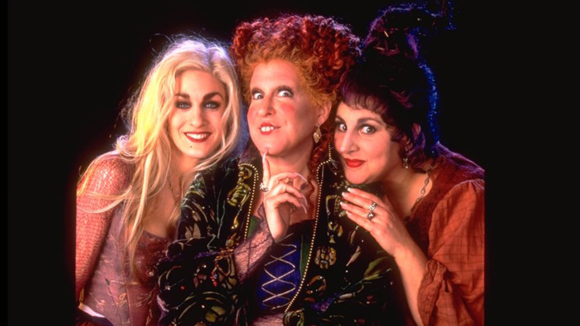
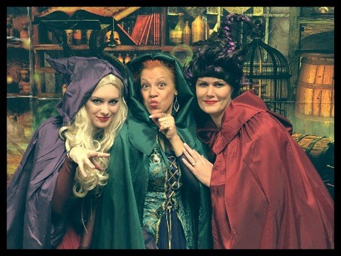
Presented by Winifred Sanderson (Judy Hager),
Mary Sanderson (Katie Dunphy) and Sarah Sanderson (Amy Myers)

Slide 3
Why are we dressed like this?! It’s just one of the many ways we have fun in our office!

Slide 4
Why is this important?
Huffington post
Over a lifetime, people will spend 13 years and 2 months at work vs 328 days socializing with friends
Overtime adds 1 year and 2 months
Average worker spends nearly a quarter of their time on the job over 50 years
Technology connects us to work from home – average 5.3 hours/week checking work emails

Slide 5

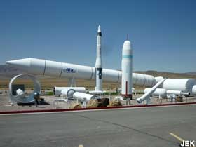
Why is this important, cont.
Monster.com
The levity effect by Adrian gostick and scott Christopher
Thiokol factory

Slide 6
Ways UJ Makes Their Office Fun
Physical appearance of the office
Organization of the physical office space
Keep desks clean
Aesthetically pleasing
Money trees, money mints, treasure chest with chocolate coins, Keurig/go cups for guests, Katie’s bran muffins and much more!

Slide 7
Ways UJ Makes Their Office Fun, Cont.
Focus on the customer who enters the office
Take your eyes off your computer and put them on the customer
Verbally welcome visitors to your office
It’s ok to ask them to wait one second while you finish what you’re doing or jot down a reminder for yourself
Turn your dnd button on if you have one, or turn the ringer off your phone
Ask their name, repeat the name back to them
Introduce yourself – shake their hand, be welcoming
Smile!
Work station/computer for students needing help

Slide 8
Ways UJ Makes Their Office Fun, Cont.
Focus on the customer who enters the office, cont.
Ask questions you need to know to help them let you know what they need
Repeat their question back to them
Speak their language/don’t condescend/show compassion
Be approachable
Fake it until you make it

Slide 9
Ways UJ Makes Their Office Fun, Cont.
Create productive processes
Automate
Do it now – janet riis – RMASFAA leadership pipeline – 0 email inbox policy
Cross train
Constantly question if there’s a better way – avoid easter hams!
Make sure your communications are being understood – gunning fog
Communicate with students in a manner that they will see

Slide 10
Ways UJ Makes Their Office Fun, Cont.
Satisfied staff = satisfied customers
Empower each staff member
Respect one another
Realize each other’s strengths – brag about them!
Focus on the positive
Secret codes can be helpful! – ddc, asterisk, nicknames, etc.
Make it fun – tenzi on new year’s eve day
Make your own little rules – if we’re late, we bring in coffee
Planking!

Slide 11
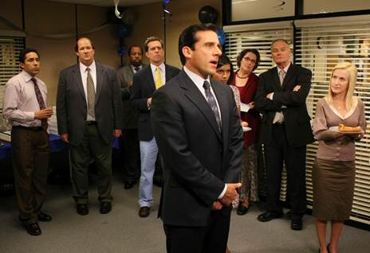
Ways UJ Makes Their Office Fun, Cont.
Satisfied staff = satisfied customers, cont.
Share fun stories (our husbands)
Get to know each other on a personal level – our coworkers can make our jobs wonderful or awful
Good management vs strong leadership – servant leadership (it’s what we are all about!)
Cnbc.com – most effective leaders 6 traits: vulnerability, approachable, active participants, live in the moment, servant leaders, and compelling storytellers

Slide 12
Ways UJ Makes Their Office Fun, Cont.
Outside the office
Get involved – support your students and coworkers (buy the cookie dough from the fundraiser that your coworker’s kid is selling)
Make presentations fun – art young, Fa director at Utah state university – rmasfaa 2018 – fact or crap game
Art says a good presentation needs 3 things: content that is meaningful to the audience, treats, and to end early

Slide 13
Questions?

