Slide 1

Thank you
NDASFAA Participation in RMASFAA
Karrie Huber - North Dakota State Delegate/Summer Institute
Laurie Weber - Vice President/AG/F&A
Shawn Rosaasen – Treasurer/Summer Institute
Jeff Jacobs – Association Governance/Conference
Association News
Heather Fink
Membership
Kathy Lowe
Summer Institute
Lindsey Benson

Slide 2

What’s Happening at the RMASFAA Board
Implementation of 2019-2021 Strategic Long Range Plan
Search for a new Website Provider
Value of RMASFAA Membership
Appropriate Behavior and Conduct Policy/Event Policy
NASFAA Proposal To RMASFAA

Slide 3
2019-2021 Strategic Long Range Plan
Strengthening the Annual Conference Experience
Define the role and goals
Review the conference structure
Review the contract process
State & Regional Collaboration and Support
Define role and expectations of state delegates
Support state officer development & leadership training
Intentional training of state delegates
Fiscal Stability and Transparency
Define purpose of RMASFAA reserve funds
Review reports for readability
Create RMASFAA flagship event dashboards

Slide 4
RMASFAA Website
The RMASFAA Website is one of our most important tools in communicating with our members. Currently looking at these website providers:
Keybridge
Member Clicks
Member Leap
Each of these providers will have more functionality for users.

Slide 5
Value of RMAFAA Membership
RMASFAA provides the resources in our region to support financial aid offices by:
Training via webinars and on-site training within the region
Networking opportunities to connect with other schools to promote best practices
Leadership Development opportunities on committees and the board
Leadership Pipeline assists in developing leaders on campus
Diversity and Inclusion initiatives supporting training of administrators encouraging diversity in our profession
RMASFAA Summer Institute provides intense training at a reduced cost

Slide 6
Appropriate Behavior and Conduct Policy
Some regional associations have had incidents where inappropriate behavior occurred during association events
Association Governance is looking into creating an overall “Appropriate Behavior and Conduct Policy” along with an “Event Conduct Policy”
Insure all feel welcome and safe at association events
Appropriate behavior is outlined and conveyed

Slide 7
NASFAA/Regional Proposal
Last year I attended NDASFAA in Fargo and we discussed the possible collaboration with NASFAA in the following areas:
Membership
Website
Events
Update

Slide 8
Leadership Pipeline
Exceptional Professional Growth Opportunity
Recognized by NASFAA in 2008 with a Regional Training Award
Training begins at the 2019 RMASFAA Conference
Leadership Pipeline Application is due 6/30/2019
Mentees join a cohort and will spend a twelve month period engaging in leadership training, discussions and exercises
Mentees are strategically paired with seasoned RMASFAA mentors, building a relationship to enhance the experience
For more information:
Chelsea Springer, University of Utah
cspringer@sa.utah.edu
(801) 585-5828

Slide 9

RMASFAA Summer Institute 2019
Colorado College
Colorado Springs, CO
June 2-7, 2019

Slide 10
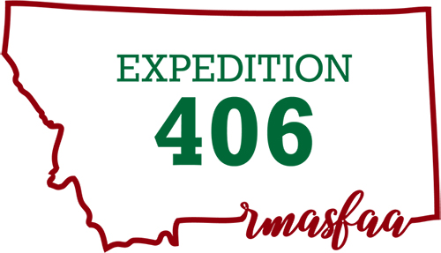
2019 RMASFAA Conference
October 20-23, 2019
Billings, MT

