Slide 1
Bridges 0ut of Poverty
Welcome to
An Overview of
Bridges Out of Poverty
Notes:
Welcome. I am a member of a local St. Vincent de Paul conference in Fargo. One of our focuses is meeting with individual or families in need, usually of financial assistance. We, like everyone else, get frustrated they come looking for assistance when they are about to be evicted or their power shut off. We think to ourselves, they should have planned ahead, or approached us at the beginning of the month before the late fees were added on. Or we question why they gave all of their tax refund to fix a friend’s car instead of paying their rent.
This Bridges out of Poverty research has been an eye opener to help us understand and communicate better with our friends in need. It is in understanding each other that we can better communicate.
I believe some of the ideas in this research can help you in your communication with the students crossing your path in the financial aid office.

Slide 2
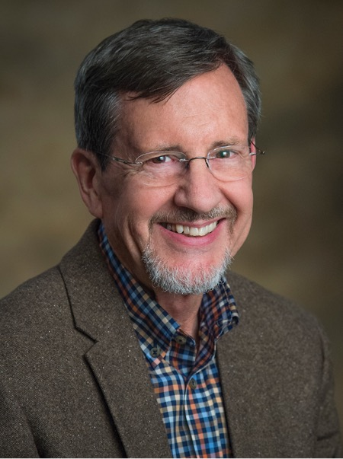
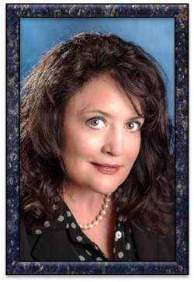
Bridges 0ut of Poverty History
Notes:
Dr, Ruby Payne, an educator and administrator, began studying poverty. She knew most people researching poverty look at age, race, and gender. While these are certainly factors that affect poverty, her research on poverty focused on the economic classes in which people were living.
She noticed patterns in 3 distinct economic classes: poverty, middle class, and wealthy. A Framework for Understanding Poverty, written in 1994 summarizes her research.
She introduced that research to educators, many of whom have embraced it across the country.
Other parts of the community started to see how these Bridges concepts could be applied in their organizations and businesses that work with individuals in poverty.
She connected with fellow teacher Terie Dreussi Smith and Phil DeVol who was an administrator of chemical dependency treatment center for nearly 20 years The 3 of them coauthored Bridges Out of Poverty Strategies for Professionals and Communities. Healthcare and businesses have used these Bridges ideas to help train and keep employees, especially those coming from poverty.

Slide 3
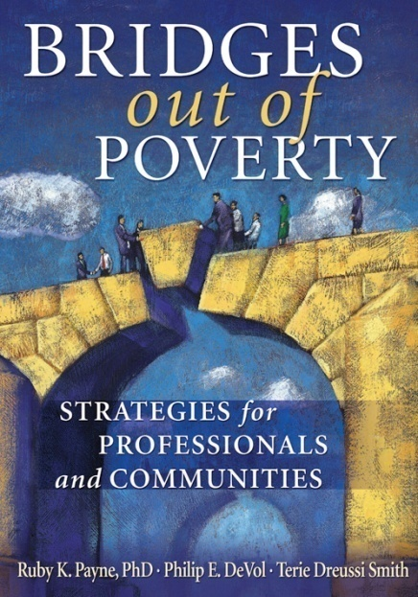
“Why do they do that?”
Understand how economic class affects the way we and those we serve view the world
Mutual understanding is critical to relationships and empowerment
Notes:
Any of us who have worked with people living in poverty may wonder why they have this big screen TV and can’t pay their electric bill? Bridges out Poverty provides some insight.
Through the lens of economic class, we can all grow to understand basics patterns in people’s lives. Respect grows with understanding.

Slide 4
7 Modules
Mental Models
Research
Key points
Hidden Rules
Language & Story
Family Structure
Resources
Notes:
This afternoon’s presentation will focus on 7 “modules” of the Bridges research: Mental Modules, Research, Key Points, Hidden Rules, Language and Story, Family Structure, and Resources. You will be shown some clips from the training video produced by Aha! Process as well as enter in to small group discussion for other modules. This is a condensed overview of a normally 8 eight hour presentation.

Slide 5
Bridges: Mental Modules
Base plans on accurate mental models of poverty, middle class, and wealth.
Notes:
One of Bridges “constructs” or concepts is that any program that plans to work with people in poverty need to be based on accurate mental models for poverty, middle class, and wealth. Mental models are simply visual depictions of our thoughts.
Let’s take a moment to do a quick exercise. Let’s take a minute to jot down things you think about and do in a typical day. Now, categorize those idea/things in general groups. Next make a pie chart on half a sheet of paper, labeling each section with one of the general categories – some sections may be larger than others.
Pause.
Now , think of someone you know and like who lives in poverty. Let’s do the same exercise with that person in mind. 1st jot down what they think and do during their typical day. Make a pie chart of their life. Pause
This is a quick version of a mental model – a physical depiction of your thoughts.

Slide 6
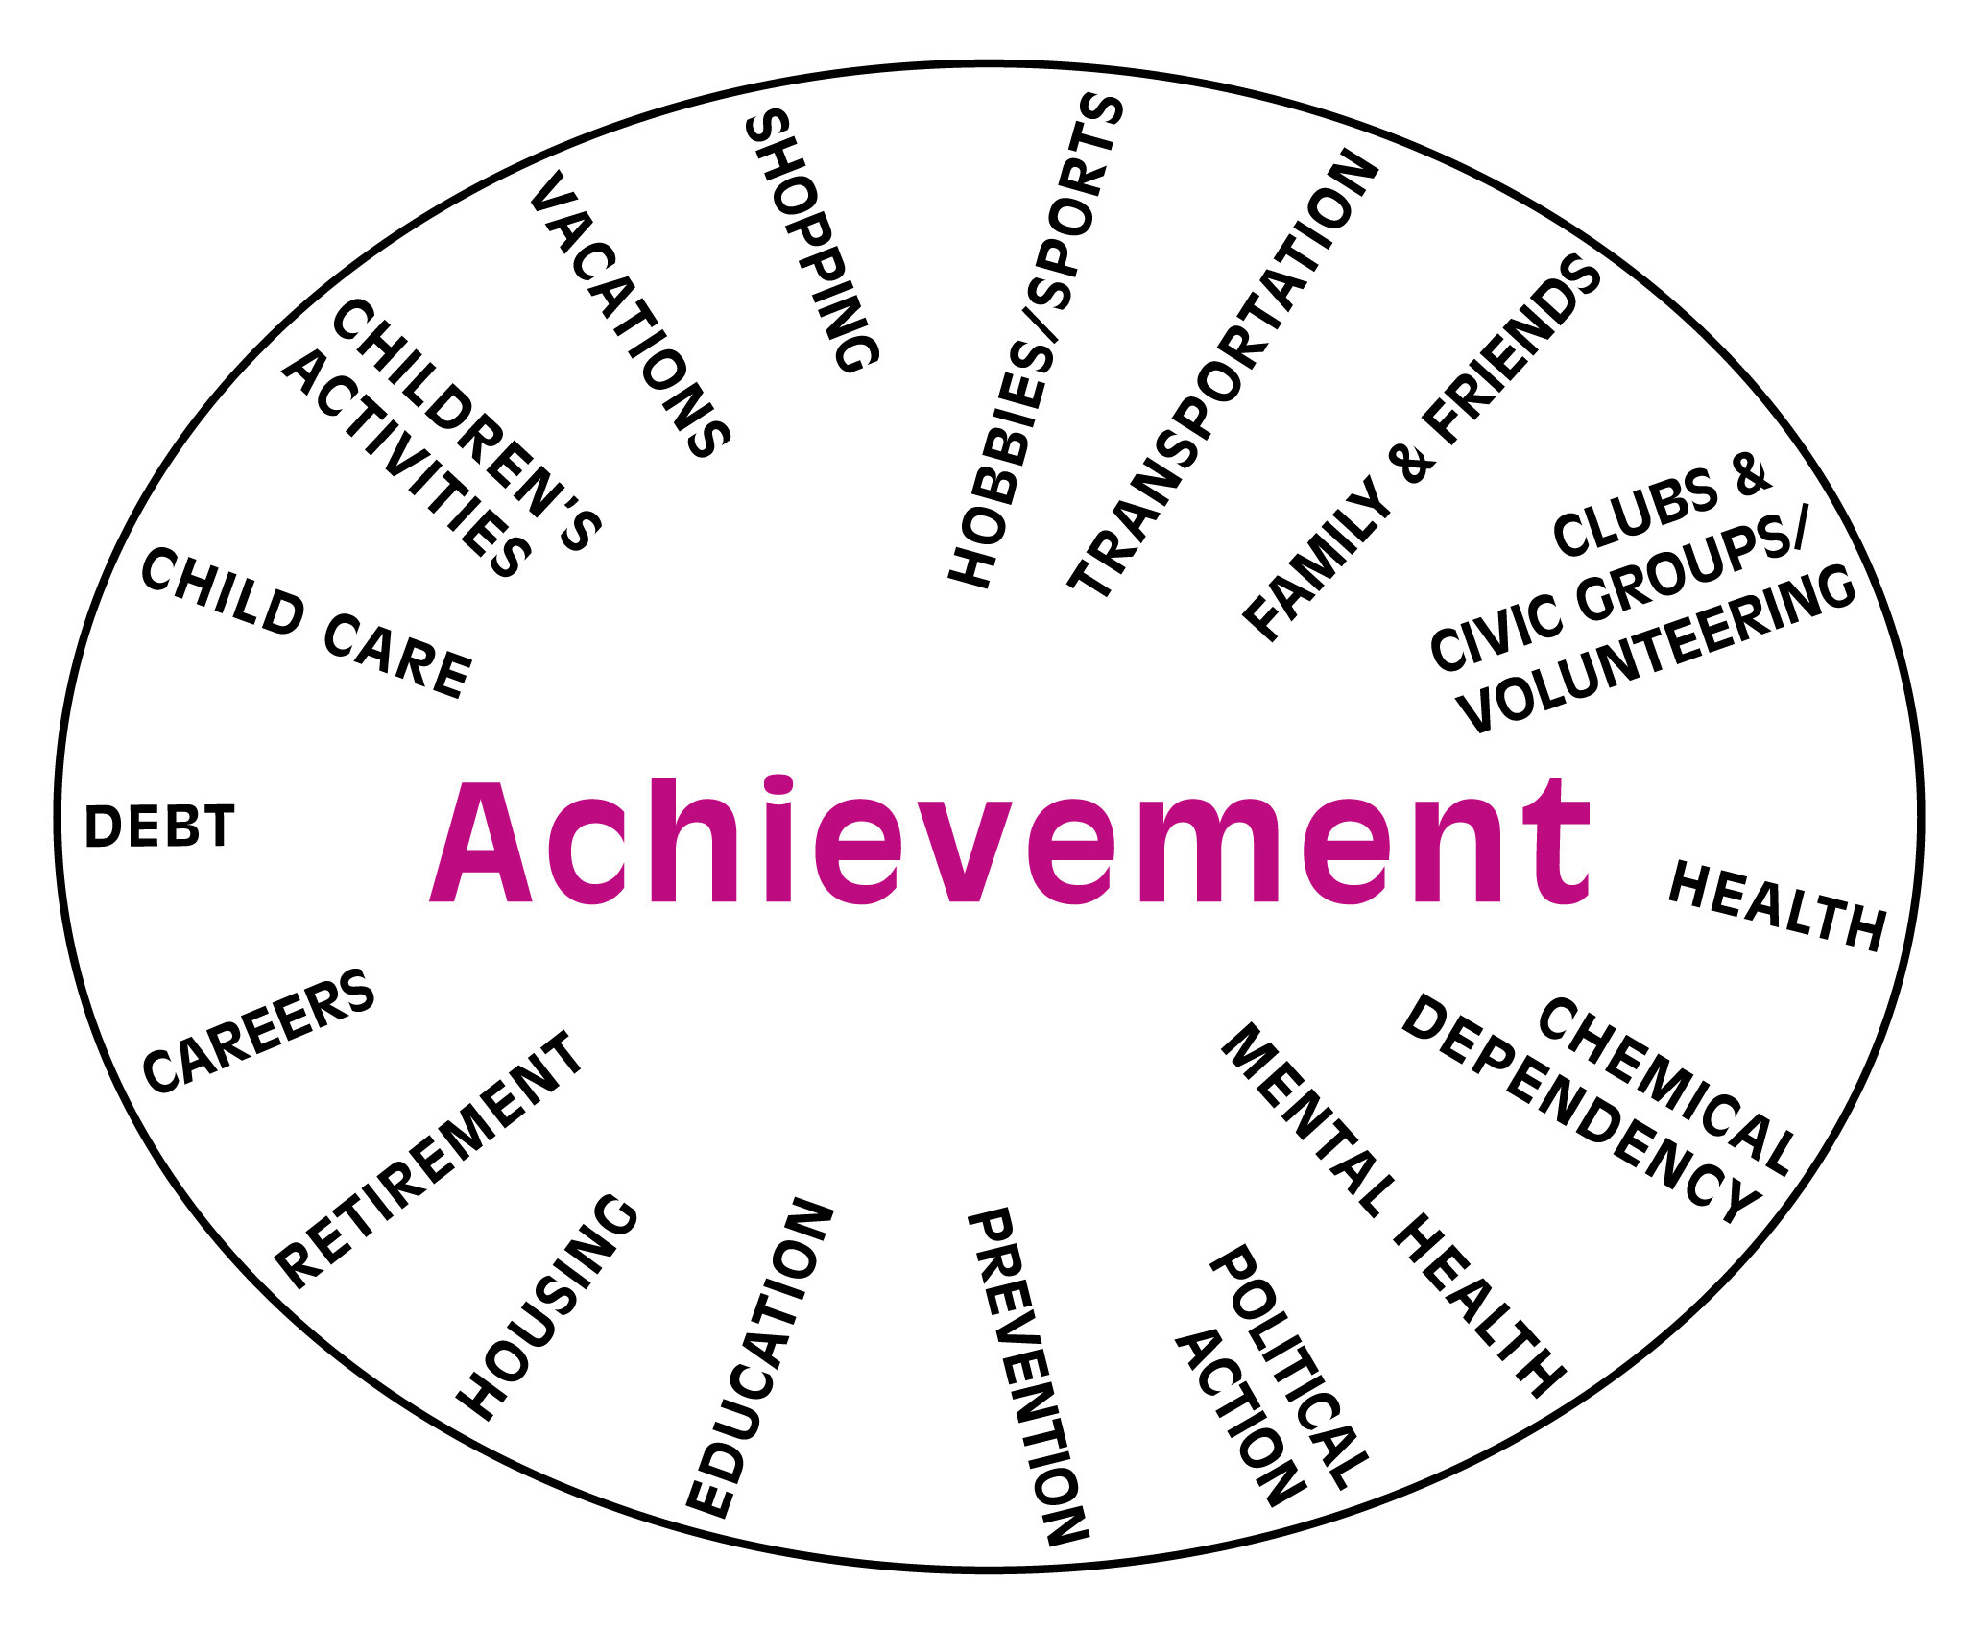
Mental Model of Middle Class
Middle Class Is an Achievement-Based World
Developed by
Phil DeVol (2006)
© aha! Process, Inc.
Notes:
Here’s an example of a mental model for someone living in the Middle Class.
Many of us probably grew up in a middle class household. In many middle class families, the driving force in life is achievement: in sports - to win, in school - to get better grades to get into a better college, to get a better job, to buy a better house, to do well in your career, to save for a secure retirement…. That expectation or drive for achievement, shaped many of our attitudes, choices and actions.
How did your mental model compare?

Slide 7
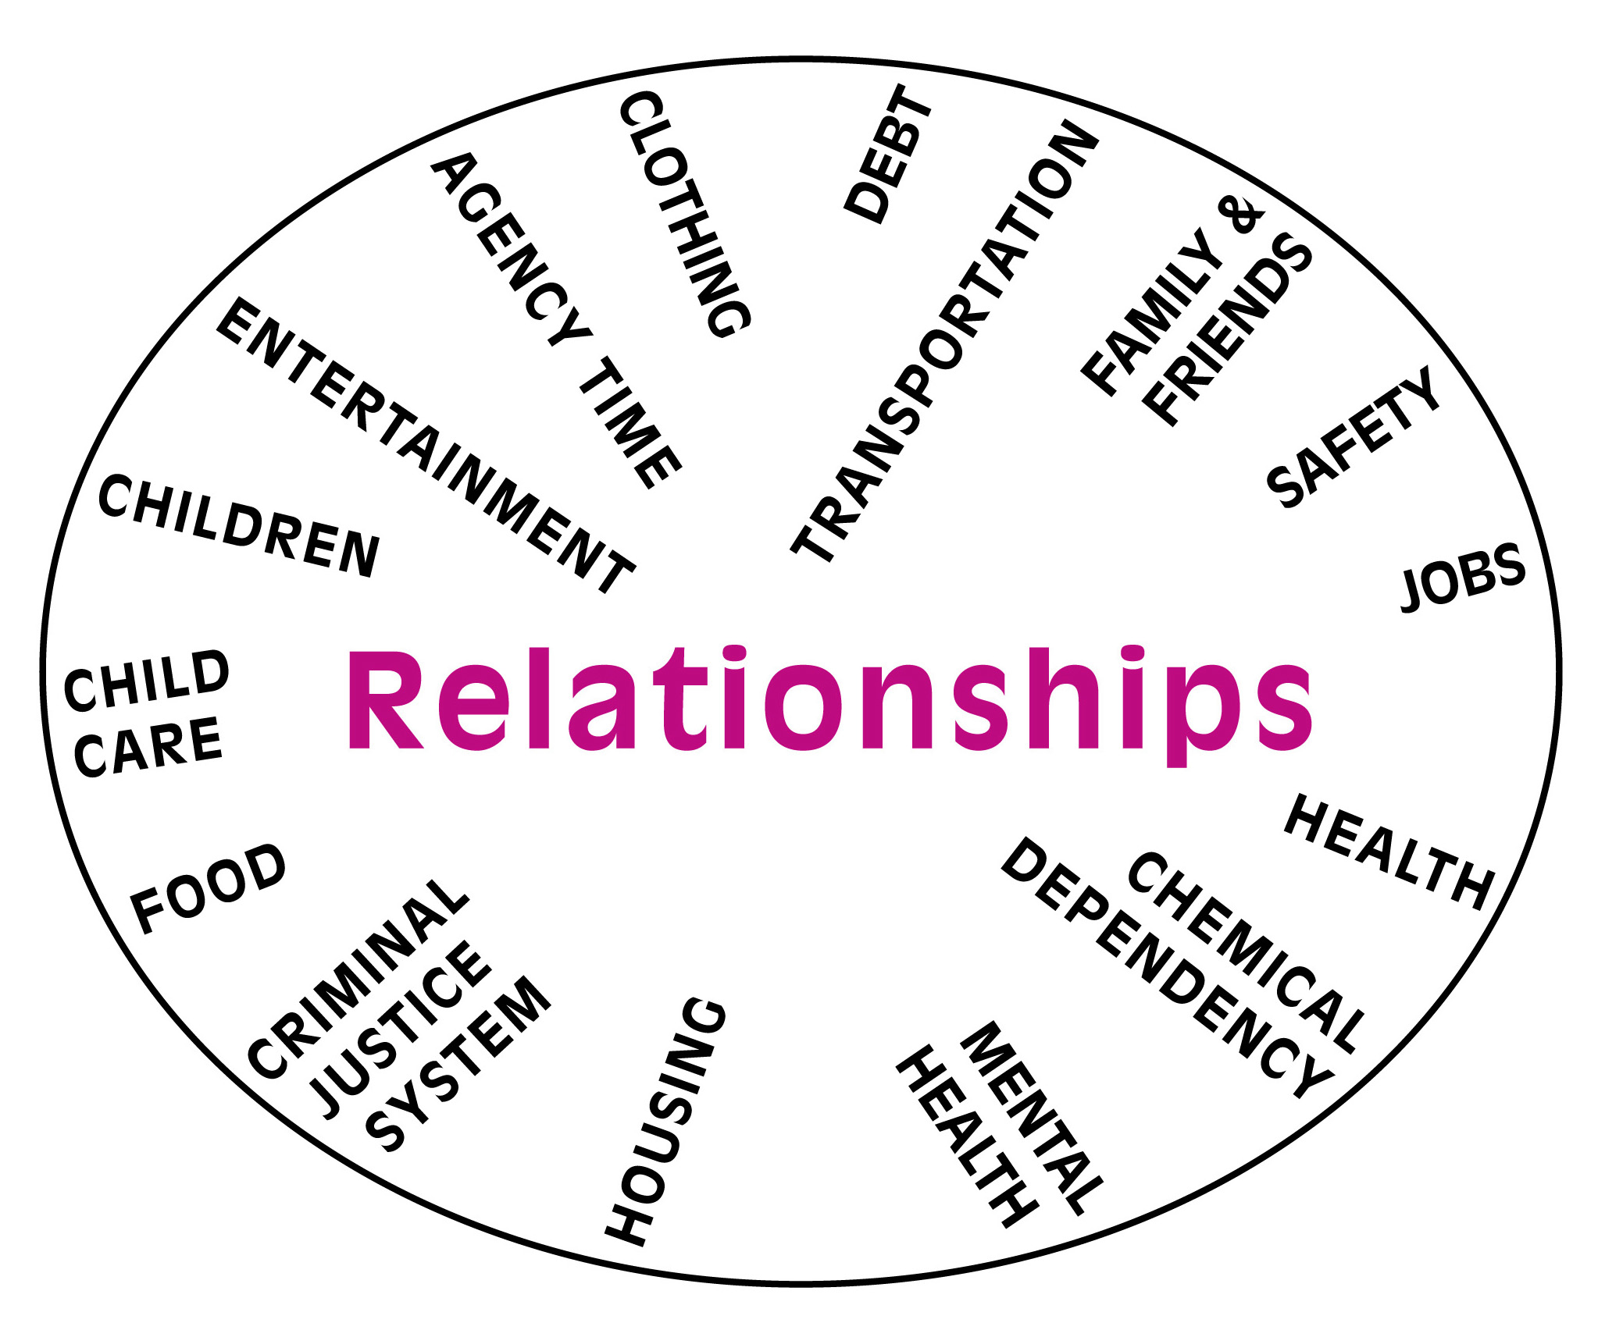
Mental Model for Poverty
Poverty is a Relationships-centered World
What It’s Like Now
Developed by Phil DeVol (2006)
© aha! Process, Inc.
Notes:
Here is a mental model for poverty. It might vary somewhat by region, race, ethnicity, and culture, but it has common features that appear in all situations.
A mental model quickly gives you the big picture and can give you insights into the “why.” For example, in poverty you need people to survive, to “get by” - - that’s why “relationships” are critical in generational poverty.

Slide 8
Mental Models
Poverty
Middle Class
Developed by Phil DeVol (2006)
© aha! Process, Inc.
Notes:
Let’s take a look at the similarities and differences between these 2 mental models.
Notice the different words in the middle of each mental model. Why are relationships so important in poverty? Why is achievement in the center of middle class?
You see transportation, family & friends, health, chemical dependency , mental health, housing, debt, and child care appear in both models. Does that surprise you?
Notice in poverty you have job – in middle class you have career. Is there a difference?
We all have stress in our lives. If you are a person living in middle class, how do you relieve stress? - vacations, hobbies and sports.
Living in poverty is stressful. They live in what Dr Payne calls the Tyranny of the moment – putting out one fire after another. Since people living In poverty can’t afford to travel to DisneyLand or Hawaii, how do they relieve stress? - entertainment – the big screen TV.
Not sure if you noticed, but education and retirement are in the middle class but absent from the poverty model. Why is that?
A mental model quickly gives you the big picture and can give you insights into the “why.” For example, in poverty you need people to just to “get by” by to survive - - that’s why “relationships” are critical in generational poverty. That is why if a person living in poverty believes his boss does not like him, he will quit that job without having another job lined up. A person in Middle class wouldn’t do that, but in poverty it is relationship that help sustain us.

Slide 9
Bridges: Research
RESEARCH
What do people say causes poverty?
What do you say causes poverty?
Notes:
Let’s start this next section with 2 questions: quickly jot your answers on a slip of paper.
What do people say causes poverty?
What do you say causes poverty?

Slide 10
Bridges: Research
Causes of poverty:
Behaviors of the Individual
Community Human & Social Capital
Exploitation
Political / Economic Structures
Notes:
Contrary to public belief poverty is not caused solely by an individual’s behavior, nor are the political structures totally to blame. Based on his research, Phil Devol has defined 4 causes of poverty: Individual behavior, Community Human and Social Capital, Exploitation, and political/economic structures. He believes all of these factors need to be examined and understood to fully understand why poverty exists in a community.
Let’s take a quick look at each one.

Slide 11
Bridges: Research
Causes
Behaviors of the Individual
Dependency
Single parenthood
Values/work ethic
Break up of family
Addiction/mental illness
Language experience
Notes:
Strengthening individual behaviors and skills is foundational
Let’s brainstorm a list of behaviors of the individual that causes poverty
Here is Phil Devol’s list. How did we do?
Did you know that research suggests that what children experience in their first 3 years of life prepares them for the rest of their lives?
We developed strategies and programs to combat these behaviors: work first, marriage promotion, treatment interventions, abstinence education, literacy programs, and enhanced language experience.

Slide 12
Bridges: Research
Causes
Community Human & Social Capital
Lack of employment
Lack of education
Inadequate skill sets
Declining neighborhoods
Middle class flight
Lack of career ladder between the service and knowledge sectors
Notes:
Another cause that is frequently studied is called human and social capital. This area includes: lack of employment/education opportunities, inadequate skills sets, declining neighborhoods, middle class flight, and a lack of a “career ladder” allowing a person to “climb” from a service sector job to a knowledge sector job.
To tackle these issues we must look at the availability of a quality education, childcare for working families, neighborhood safety, transportation systems, head start programs, and neighborhood associations.
Another issue is the availability of well paying jobs. It was suggested at a previous meeting that while the ND minimum wage is $7.25/hour, a living wage in Fargo is more like $14.50/hours.

Slide 13
Bridges: Research
Causes
Exploitation
Payday Lenders
Human trafficking
Drug trade
Notes:
You must also remove the elements that prey on people – like payday lenders, human trafficking & drug trade;
Phil Devol found check cashing places average 500% interest.
An Illinois study found that 77% of people who used a payday lender will go back an average of 10 times.
It sounds crazy, but there is a big money to be made off people living in poverty.

Slide 14
Bridges: Research
Causes
Political & Economic Structures
De - industrialization
Globalization
Race to the bottom
Increased productivity
Shrinking middle class
Economic Disparity
Corporate influence
Notes:
Race to the bottom – new businesses will open where the labor is the cheapest
More jobs are lost to our increased productivity than to outsourcing.
Shrinking middle class – remember the days when 1 wage earner could support a family of 4
Income disparity in the 1970’s the top .01% of taxpayers earned 70 times the average family.
In 1998 the top .01% increased to 300%.

Slide 15
Bridges: Key Points
This is about economic diversity.
There are other lenses through which to analyze poverty.
Poverty is relative.
Generational poverty and situational poverty are different.
Having a future story is important for those trying to move to a place of more stability.
Notes:
This is about economic diversity.
There are other lenses through which to analyze poverty.
Poverty is relative.
Generational poverty and situational poverty are different.
Having a future story is important for those trying to move to a place of more stability.

Slide 16
Bridges: Key Points
This work is based on patterns within environments. All patterns have exceptions.
You may have to give up relationships to focus on achievement. They may feel like they live in two different worlds.
You can’t blame people for being in poverty.
Don’t make excuses for nor scold people living in poverty.
Notes:
This work is based on patterns within environments. All patterns have exceptions.
You may have to give up relationships to focus on achievement. They may feel like they live in two different worlds.
You can’t blame people for being in poverty.
Don’t make excuses for nor scold people living in poverty.

Slide 17
Bridges: Hidden Rules
An individual brings with him/her
the hidden rules of the class
in which he/she was raised
Notes:
Another key point from the Bridges research is that each of us brings with us a whole set of hidden rules. Hidden rules come from the environments represented by the mental models of poverty, middle class, and wealth. A child learns the hidden rules of survival of his/her environment simply by breathing. Hidden rules are easily broken because they are hidden. You know you’ve broken a rule when there’s an awkward silence or perhaps you get “the look”—the look that says, “you don’t belong here”. We shouldn’t criticize the rules of other classes because those rules are used for survival.
Hidden rules help people navigate different and difficult situations. Using them skillfully can help us build resources; knowing them means we can design programs more skillfully and respectfully. Hidden rules can be used to resolve conflicts; we can understand our own behaviors and values better; we can understand the behaviors and points of view of others;
Knowing the hidden rules of all classes can help people in poverty gain power and influence—and move out of poverty if they so choose.
A problem with hidden rules is that they're seldom articulated. But more importantly, they're often equated with intelligence—or a lack thereof.

Slide 18
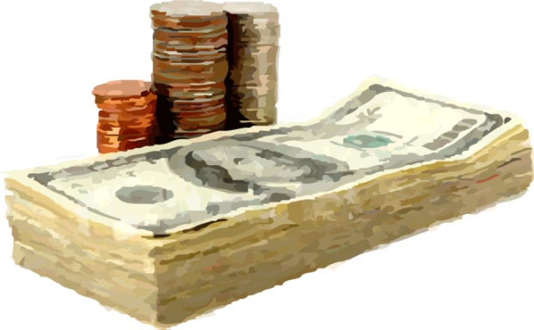
HIDDEN RULE: Money
POVERTY
To be used, spent
MIDDLE CLASS
To be managed
WEALTH
To be conserved, invested
Notes:
Let’s talk about the hidden rules for money as an example.
In middle class money is to be managed. In middle class, you’re expected to pay your mortgage and bills, save a little back, and if there’s anything left, maybe go out to dinner and a movie. Someone who mismanages money is not planning for the future; this is discouraged.
In poverty the arithmetic of life doesn’t work. There is never enough money. So, when money comes, it will be spent because there are so many needs and wants that you have had to do without for so long. Money is spent to pay the bills, for entertainment, and for relationships (it is given to friends or relatives in need). This is directly related to the living in the “tyranny of the moment” brought about by surviving in poverty. People living in poverty are criticized for this rule.

Slide 19
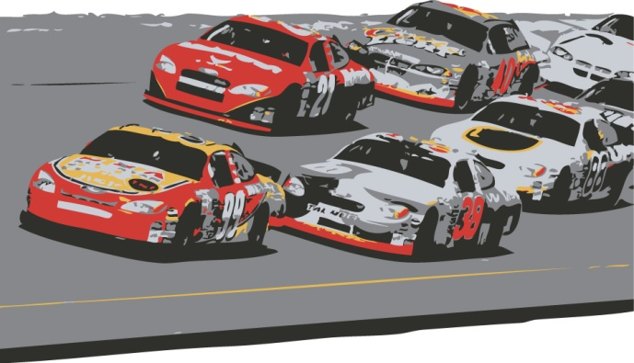
DRIVING FORCES
POVERTY
Survival, relationships, entertainment
MIDDLE CLASS
Work, achievement,
material security
WEALTH
Financial, political, social connections
Notes:
What are the driving forces, that force that makes us do what we do. Understanding these rules can help us design programs that meet the expectations of each of the stakeholders - those in poverty we are trying to help, our typical middle class staff, and those in wealth who help fund our programs.
In wealth, driving forces include protecting the family’s financial assets – its legacy – along with political and social connections.
In middle class, it tends to be about achievement, work, and material security.
In poverty, it’s about survival, relationships and entertainment.
The hidden rules of poverty are necessary to survive…the hidden rules of middle class are necessary to get ahead. Both are “right or best” for their environments. Understanding these differences is necessary for those in middle class who want to develop a relationship with someone in poverty. It will be necessary for someone in poverty to understand the hidden rules of middle class if they want to successfully navigate the world of school or work which are built around middle class norms.

Slide 20
TIME
POVERTY
Present,
Decisions made for moment, based on feeling, emotions, or personality
MIDDLE CLASS
Future,
Decisions made against future ramifications
WEALTH
Tradition and history,
Decisions made partially on
basis of tradition and decorum
Notes:
How about the hidden rules on time.

Slide 21
DESTINY
POVERTY
Believes in fate
MIDDLE CLASS
Believes in choice
WEALTH
Noblesse oblige
Notes:
Destiny-
Poverty – cannot do much to mitigate chance
Middle class – can change future with good choices now
Wealth - With wealth, power, and prestige comes a responsibility to act nobly

Slide 22
EDUCATION
POVERTY
Valued and revered as abstract, but not a reality
MIDDLE CLASS
Crucial for climbing success ladder and making money
WEALTH
Necessary tradition for making and maintaining connections
Notes:
Hidden rules of Education

Slide 23
Family Structure
POVERTY
Tends to be matriarchal
MIDDLE CLASS
Tends to be patriarchal
WEALTH
Depends on who has the money
Notes:
Hidden rules of Family Structure

Slide 24
Possessions
POVERTY
People
MIDDLE CLASS
Things
WEALTH
One of a kind objects, legacies, pedigrees
Notes:
Hidden rules on Possessions.
those “relationships” that are the driving force in poverty can become co-dependent and dysfunctional

Slide 25
LANGUAGE
REGISTERS
Frozen
Intimate
Consultative
Casual
Formal
Notes:
VIDEO
You will have to take notes.

Slide 26
LANGUAGE
If individuals depend on a random, episodic story structure for memory,
live in an unpredictable environment,
and have not developed the ability to plan…
… they cannot predict.
If they cannot predict…
they cannot identify cause and effect
If they cannot identify cause and effect….
they cannot identify consequences.
If they cannot identify consequences…
… they cannot control impulsivity.
If they cannot control impulsivity…
they have an inclination toward criminal behavior.
~Reuven Feuerstein
Notes:
VIDEO

Slide 27
FAMILY STRUCTURE
Structure exists as a means to survive
Middle Class
Blended family – marry-divorce-marry
Man is provider
Woman is care giver/provider
Tends to be patriarchal
Notes:
Family structures may be different in middle class and poverty.
Each structure is there as a means for the individual or family to survive.
We again remind you these are PATTERNS, not meant to stereotype

Slide 28
FAMILY STRUCTURE
Poverty
Marry (maybe), move on (no divorce), live together
Man is protector, lover, fighter
Woman is rescuer, keeper of the soul
Tends to be matriarchal

Slide 29
FAMILY STRUCTURE
In poverty, it is not “where you live, but “where are you staying”
Life in poverty tends to be unstable
Disciple/Punishment is about maintaining relationship not changing behaviors
Arched eyebrow is a sign of judgment
Notes:
Some final thoughts on family structure
Remember back to Phil’s discussion of the floor plan. People living in poverty sometimes move their families
in with other families. This means they need to share bedrooms or sleep on couches in the living.
In this type of arrangement, where and when can a student do school work. No separate study space like children
From middle class have. If your bedroom is the couch, you are staying awake until everyone else goes to sleep.

Slide 30
FAMILY STRUCTURE
Multiple relationships vs single relationship
Based on the needs of the person at that time.
Favoritism
Changing allegiances
Notes:
Multiple relationships
People in poverty can “hook up” with a lot of different people because they are concerned about annual income or graduate level degrees of potential partner.
If your “baby daddy” is respected then your baby is respected.

Slide 31
RESOURCES
Poverty is
“the extent to which an individual, institution, or community does without resources”
© aha! Process, Inc.
Notes:
Dr. Payne defines poverty as “the extent to which a person does without resources”, not just financial.

Slide 32
RESOURCES
FINANCIAL
EMOTIONAL
MENTAL
LANGUAGE
SOCIAL CAPITAL
SPIRITUAL
PHYSICAL
INTEGRITY & TRUST
MOTIVATION & PERSISTENCE
RELATIONSHIPS / ROLE MODELS
KNOWLEDGE OF HIDDEN RULES
© aha! Process, Inc.
Notes:
Here are the different resources Dr. Payne has identified in order to be successful. If a person is lacking in at least 4 of these resources, they may be on the brink of poverty.
Financial – for now and for future
Emotional how do you deal with what you encounter
Mental – how educated are you
Spiritual – anything bigger that give direction to your life
Physical- are you physically able to deal with what comes your way
Support systems – people/agency who will support your change
Hidden rules – understanding how things work
Relationships-role models – those you can rely on
People living in poverty are problem solvers

Slide 33
BUILDING RELATIONSHIP
Seek first to understand
Keep promises
Use kindnesses and courtesies
Clarify expectations
Show loyalty to absent friends/family
Be willing to apologize
Stay open to feedback
Notes:
Since relationships are the driving force for people living in poverty, here are some final, concrete examples of what you can do to build relationship with the students coming into the your financial aid office.

Slide 34
BUILDING RELATIONSHIP
Appreciate humor and entertainment.
Accept what a person cannot say about another or the situation.
Respect the demands/priorities of relationships.
Use adult (not parent) voice.
Assist (not tell) with goal setting.
Identify (rather than judge) options to available resources.
Understand importance of speech and personality.
Notes:
Since relationships are the driving force for people living in poverty, here are some final, concrete examples of what you can do to build relationship with the students coming into the your financial aid office.

Slide 35
Thank you

