Slide 1
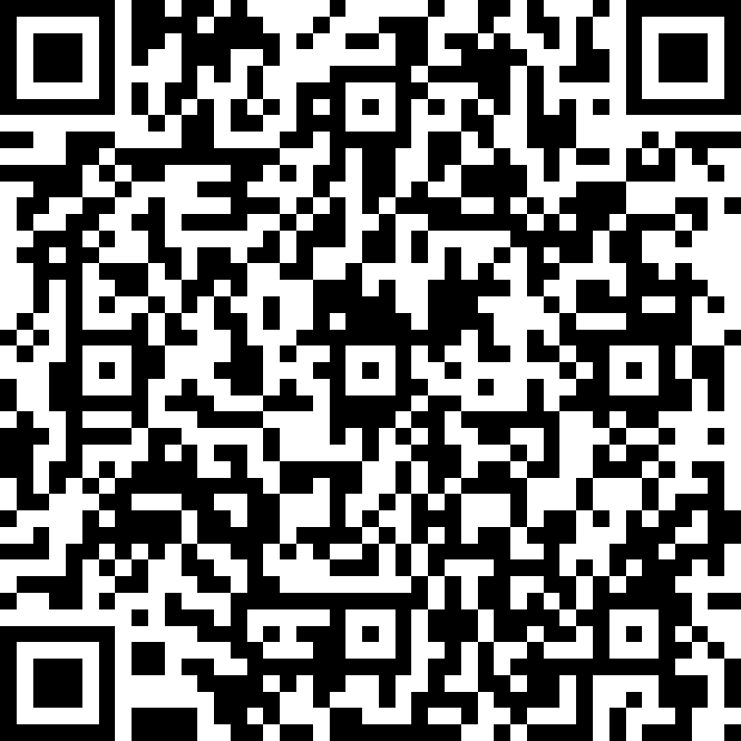
Did you complete our pre-session survey?
5 questions that help direct our conversation today.
Using a QR reader scan this image and complete the Microsoft Form.

Slide 2
9.2 PeopleSoft Demo
NDASFAA Pre-Conference Session

Slide 3
Agenda
Introduction to 9.2
Important Language
Navigation
  Favorites
  Navigator
  Homepage
The Student Experience
Open Conversation
Resources

Slide 4
Disclaimer
We are currently in the midst of the upgrade process and any screenshots, images, or demonstrations we go through today are from our Test environment. There may be changes in the final version that is deployed when we go-live. Please refer to our Training & Documentation page for all of our most current documentation.

Slide 5
Introduction to 9.2
Notes:
Crystal

Slide 6
Survey Says:
Question
On a scale of 1 to 5, with 1 being poor and 5 being excellent, how much do you know about the Campus Solutions 9.2 Upgrade?
Notes:
Crystal

Slide 7

What is 9.2?
This is a technical upgrade from Campus Solutions version 9.0 to 9.2.
9.2 contains enhanced mobile functionality.
Primarily look/feel upgrade, very little functionality changes.
Notes:
Sue

Slide 8
Survey Says:
Results
“To make Campus Solutions more modern and able to interact with other systems.”
“It's my understanding it will be implementing the 'fluid' method … but, I'm not exactly sure what that means. Likely fewer 'bread crumbs' for finding things and navigating the system?”
“We have to catch-up with the times!”
“Because we are familiar with the old method and you want to keep us on our toes.”
Question
In a few words tell us your understanding of why we are upgrading to 9.2.
Notes:
Sue

Slide 9



Why are we upgrading to 9.2?
Some additional features
Enhanced Mobile Functionality
Oracle Support for Campus Solutions 9.0 ends in December 2019
We upgraded to 9.0 in June of 2008. 11 years ago!
It’s like cell phone technology. Everything changes!
8.0
9.0
9.2
Notes:
Sue

Slide 10
When are we upgrading to 9.2?
March 18 - April 18: 9.2 Advisory Group Members Testing
May 13 – June 28: Stage Testing and Campus Sign-Off
July 12 at 5PM – July 15 at 12PM: Planned Outage for Production Upgrade
July 22: Query Environment Available (unavailable starting July 12)
There is an alternate/back up date two weeks after the current go-live should the project not meet critical benchmarks and need to be pushed back.
Notes:
Sue

Slide 11
Important Language
Notes:
Crystal

Slide 12
Common Verbiage
Breadcrumbs: The navigation shown across the top of the workspace that allows for backwards and forward navigation from any point in the navigation path.
Classic Plus: Your current navigation and style in 9.0
Homepage: A collection of Tiles for easy navigation. There are both delivered and personal/customizable Homepages.
http://cts.ndus.edu/sits-departments/connectnd/campus-solutions/upgrade-to-cs-9-2/cs-9-2-glossary/
Notes:
Crystal

Slide 13

Common Verbiage
Favorites: A collection of pages you refer back to often and want easy access to.
Fluid: Dynamic pages that adjust based on screen size. Desirable for mobile devices.
Navigation Bar or NavBar: The navigation bar (NavBar) is a control that provides quick access to pages and folders in CS.
http://cts.ndus.edu/sits-departments/connectnd/campus-solutions/upgrade-to-cs-9-2/cs-9-2-glossary/
Notes:
Crystal

Slide 14
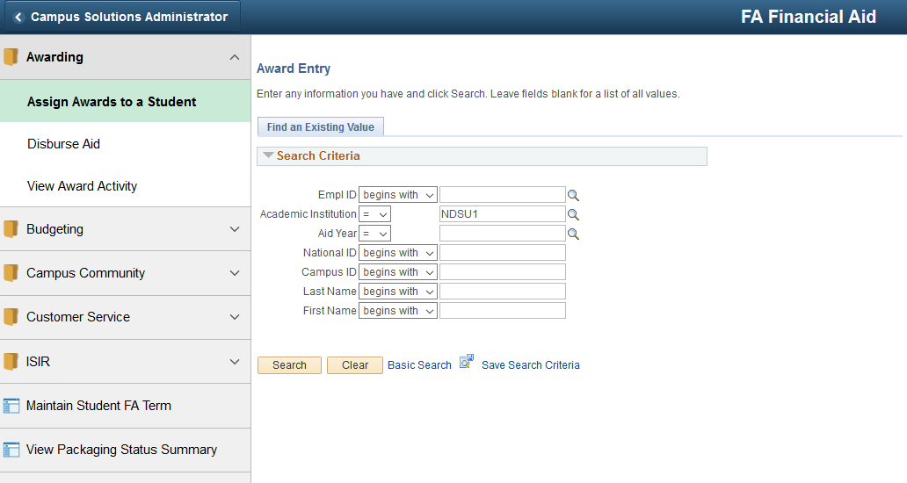
Common Verbiage
Navigation Collection or NavCollection: A collection of pages, grouped together for easy navigation. NavCollections are usually associated with Tiles, but Tiles don’t always have NavCollections. Created/maintained by CTS.
http://cts.ndus.edu/sits-departments/connectnd/campus-solutions/upgrade-to-cs-9-2/cs-9-2-glossary/
Notes:
Crystal

Slide 15
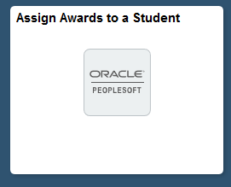
Common Verbiage
Page Tiles: A Tile that is tied to a single page.
PUM: Acronym for PeopleSoft Update Manager. This replaces “Bundles” in 9.2. PUMs allow for a high degree of flexibility in installation.
Self Service: A menu or collection of pages used by the student to complete tasks in Campus Solutions. The Student Center is located in Self Service.
http://cts.ndus.edu/sits-departments/connectnd/campus-solutions/upgrade-to-cs-9-2/cs-9-2-glossary/
Notes:
Crystal

Slide 16
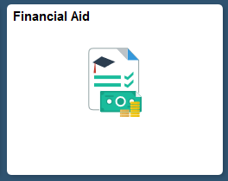
Common Verbiage
Student Center or Student Services Center: The student’s primary method of completing tasks in Campus Solutions 9.0. This is available in 9.2 but no longer the primary method of activity for students.
Tiles: A navigation icon found on a Homepage. Can be a direct link or NavCollection.
http://cts.ndus.edu/sits-departments/connectnd/campus-solutions/upgrade-to-cs-9-2/cs-9-2-glossary/
Notes:
Crystal

Slide 17
Navigating
Notes:
Crystal

Slide 18
Survey Says:
Question
What is your PRIMARY method of navigating in Campus Solutions?
I have a lot of favorites, and rely on them heavily.
I’m like Hansel and Gretel and like to follow the breadcrumbs.
I prefer to navigate with “center navigation” with all the options displayed in the middle of my screen.
I don’t know. I get where I’m going somehow.
What’s Campus Solutions?
I can’t pick any of the other choices because I don’t do the same thing twice in one day.
Notes:
Crystal

Slide 19
Navigating with Favorites in 9.2
Your favorites will still be available in 9.2!!
Access favorites
Adding new favorites
Editing favorites
http://cts.ndus.edu/wp-content/uploads/2019/01/Access-Adding-and-Deleting-Favorites.pdf
Notes:
Lindsey

Slide 20
Demo
Notes:
Lindsey:
Show that your favorites are still there
Add favorite
Change/Delete a favorite

Slide 21
Navigating with the Navigator
This is the same ideas as clicking “Main Menu” in 9.0
Access the Navigator
Sub-folders
Going “back up to the top.”
http://cts.ndus.edu/wp-content/uploads/2019/01/How-to-Navigate-in-Campus-Solutions-92-1.pdf
Notes:
Lindsey:

Slide 22
Demo
Notes:
Lindsey:
View Navigator
Navigate to Assign Awards to a Student
-Assign an award to demonstrate no Processing changes
Use “back” arrow to go up a level
Use “back up to the top” arrow to demonstrate how you can go back to the beginning
Navigate to another page
Search Icon

Slide 23
Navigating with Homepages in 9.2
Favorites on steroids or shared favorites
Delivered Homepages:
  Campus Solutions Administrator Homepage
  Faculty/Advisory Homepage
  Student Homepage
Homepages are based on roles.
Able to create/personalize your own Homepage
  Add Public Tiles (with NavCollections)
  Add Page Tiles
http://cts.ndus.edu/wp-content/uploads/2019/01/Create-and-Personalize-Your-Own-Homepage.pdf
Notes:
April

Slide 24
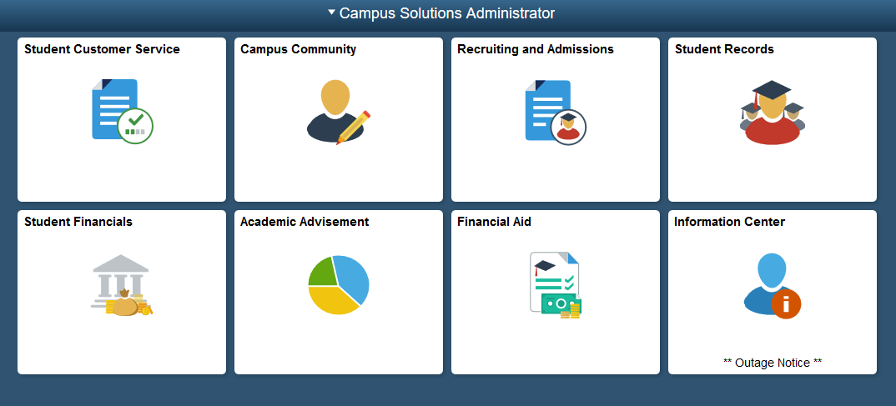
Campus Solutions Administrator Homepage
Security applies! You won’t be able to access content from a Tile that you can’t get to any other way.
The Financial Aid Tile is limited to FA Roles only.
Quick links or shared easy access.
CUSAD approves final FA Tile in Stage prior to go-live
Notes:
April

Slide 25
Demo
Notes:
April
Go to the CS Admin Homepage
Navigate to the Financial Aid Tile
Show how you can change from page to page easily
Navigate to another module Tile
Navigate to “My Homepage”
Add a Tile from Homepage
Add a Page Tile from Navigator
Navigate back to My Homepage

Slide 26
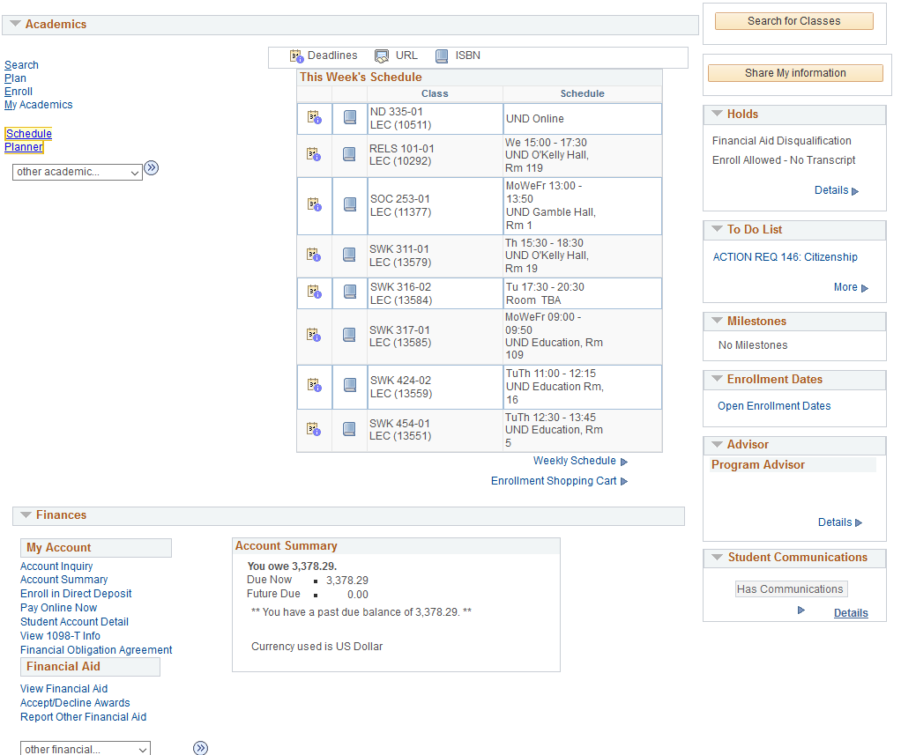
The Student Experience
9.0: Primary methods of completing tasks were using the Student Center and Self Service Menus
Not mobile friendly
Still available in 9.2
Student Services Center (Admin View) available
Notes:
Crystal

Slide 27
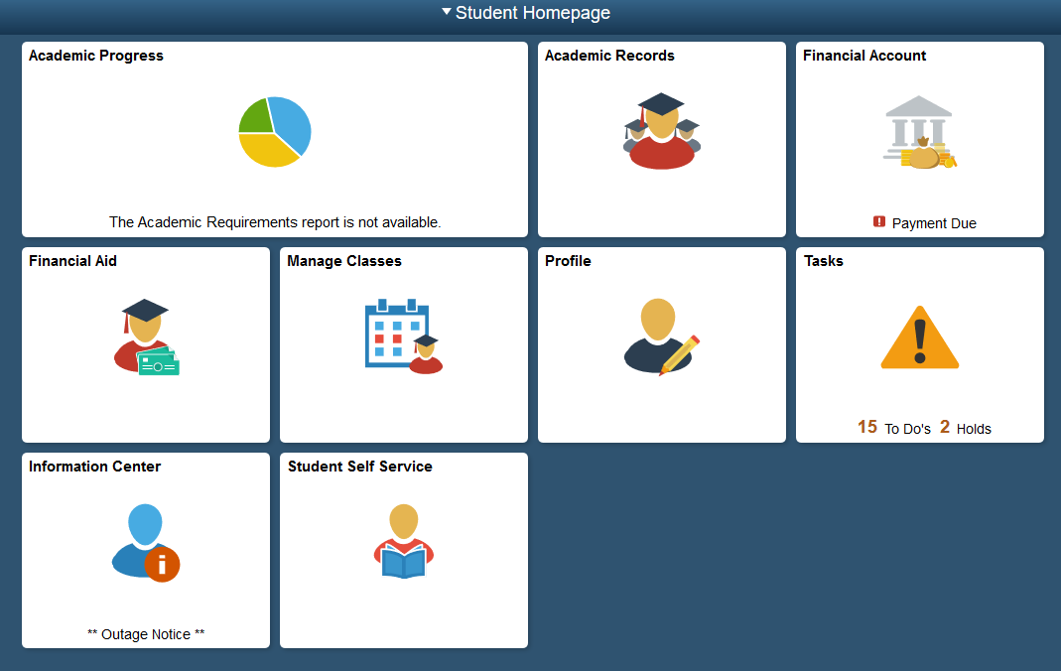
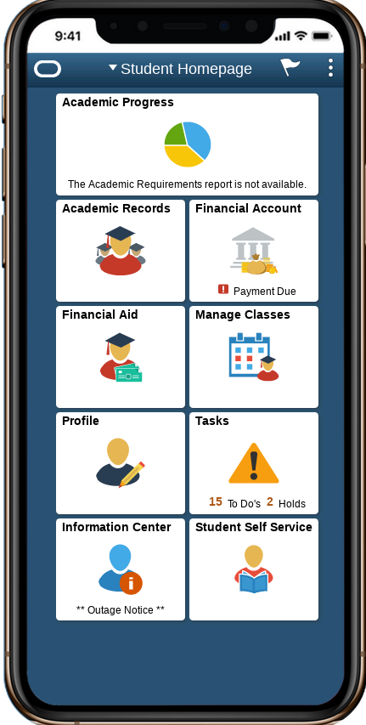
The Student Experience
The Student Experience in 9.2 is designed to be mobile friendly, or Fluid.
More intuitive and in-line with other mobile activities.
No features “turned off” like they were in HighPoint
Notes:
Crystal

Slide 28
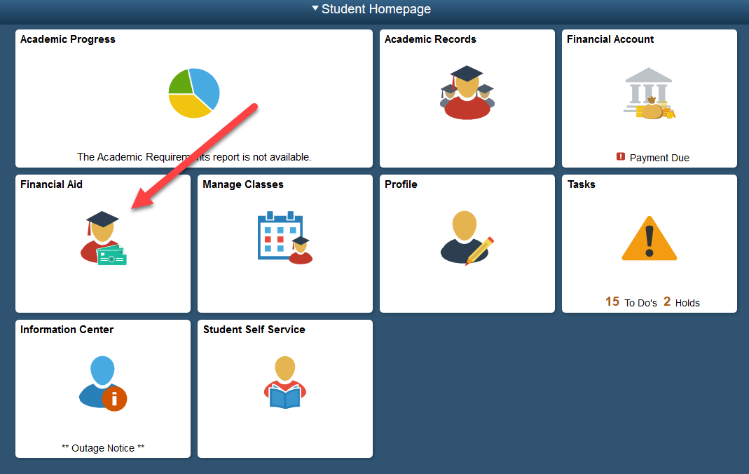
The Student Experience & Financial Aid
Award Summary
Accept/Decline Awards
View Disbursements
Report Outside Aid
View Shopping Sheet
Notes:
Crystal

Slide 29
Demo
Notes:
Go through Student Financial Aid Tile
Demonstrate accepting/declining awards
Go to Task Tile
Demonstrate “To Dos”
Demonstrate Holds
Demonstrate Communications

Slide 30
Open Conversation

Slide 31
Survey Says:
Question
Share what fears or concerns you have about the upgrade to 9.2.
“That the navigation will be slow. I just hope the favorites are still there.”
  Job Aids
  Sorting/cleaning up Favorites ahead of time
  Take Advantage of your time in Stage

Slide 32
Survey Says:
Question
Share what fears or concerns you have about the upgrade to 9.2.
“I [was] so used to the old way I could find my way around fairly quickly. I am worried about being slowed down.”
  You can use the Classic View (for now) if you’re needing more time to transition.
    Oracle will cut off maintenance and likely remove this in the future.

Slide 33
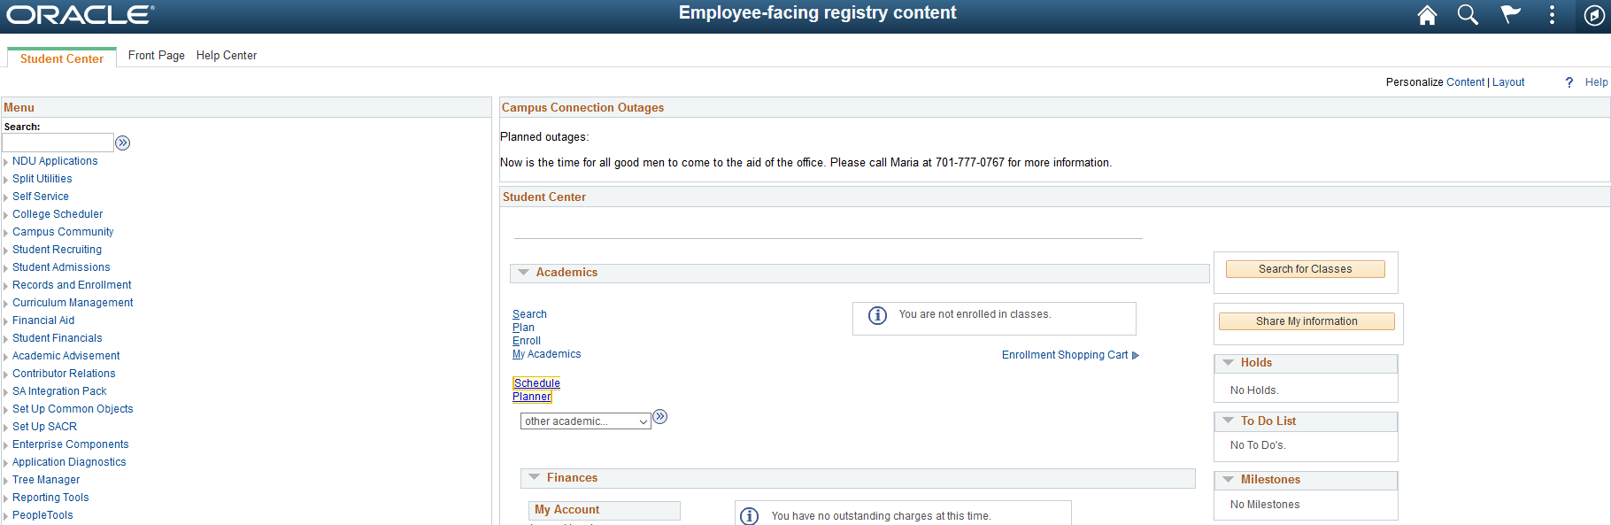
Survey Says:
“I [was] so used to the old way I could find my way around fairly quickly. I am worried about being slowed down.”
  Still no breadcrumbs!

Slide 34
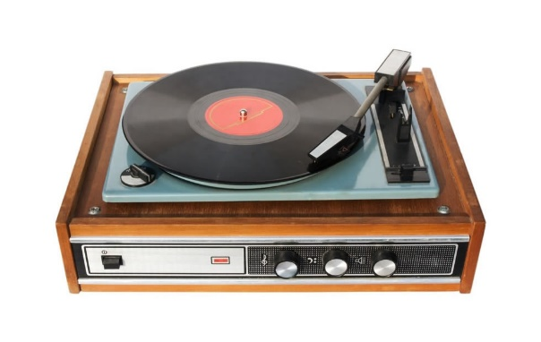
Survey Says:
Question
Share what fears or concerns you have about the upgrade to 9.2.
“Change is not always the easiest to deal with, but, knowing where to look for processes and procedures, or who to contact if questions arise will alleviate some of the concerns I have going into it.”
  Future Training Opportunities
  Updated documentation
  Take Advantage of your time in Stage

Slide 35

Survey Says:
Question
Share what fears or concerns you have about the upgrade to 9.2.
“Students will have no idea how to navigate the system and they withdraw from our campus because they are frustrated.”
  Communication to students. Get the word out!
    CTS Providing:
      Boilerplate Templates
      Recorded Videos
  Update CommGen templates
  Take Advantage of your time in Stage

Slide 36
Who needs to know about the 9.2 upgrade?
What information do they need to know?
How are you going to communicate this information?
When do they need to know it?

Slide 37
Questions?

Slide 38
Resources
Campus Solutions 9.2 Upgrade Page
  Glossary
  Timeline
  Videos
Campus Solutions Training & Documentation Page
  Job Aids
  FA Processing Documentation
Campus Solution Blue Page
  Updated links to environments
http://cts.ndus.edu/sits-departments/connectnd/campus-solutions/upgrade-to-cs-9-2/
http://cts.ndus.edu/sits-departments/connectnd/campus-solutions/training-documentation/
https://webapps.ndus.edu/systems/campus-solutions-links.php

Slide 39
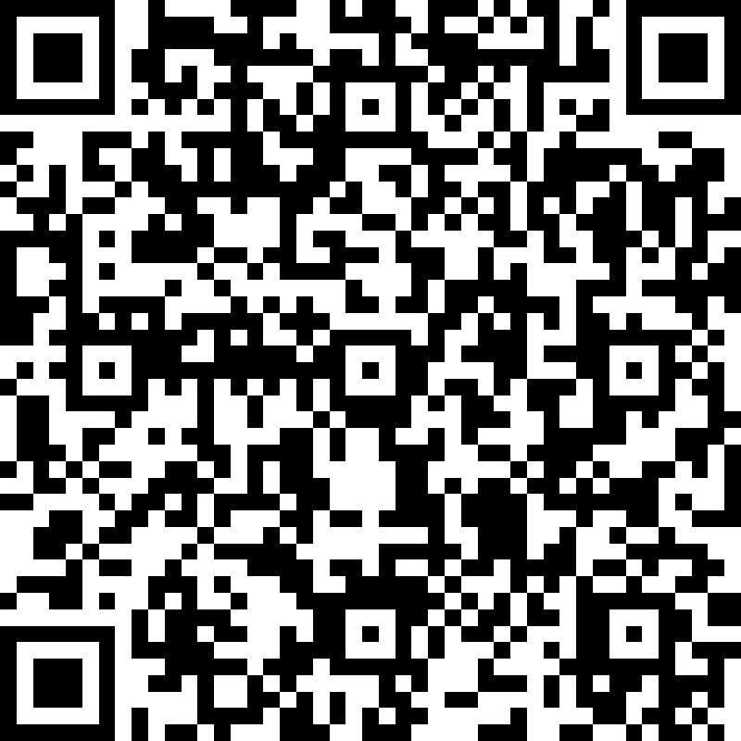
Please complete our post-survey!
8 questions that help tell us how we did!
Using a QR reader scan this image and complete the Microsoft Form.

