Slide 1
2019 NDASFAA Conference
NDUS Financial Aid Presentation
April 4, 2019

Slide 2
North Dakota State Grant
State Methodology

Slide 3
What is “state methodology” and why did processes change?
2019 Legislative Assembly
  SB2202 – Eliminates the displacement of the state grant award because of other state, institutional, public or private funds received.
  New “state methodology” –VS- federal methodology for calculation.
  Transparency in awarding for students and families as they prepare for college.
  Begins with the 2019-20 awards.

Slide 4
ND State Grant – Student Eligibility
NDUS Evaluation
  FAFSA required annually.
  EFC required for consideration – “rejected” ISIRs will not process
    Eligible recipients must meet all Title IV eligibility criteria, including C-flag resolution.
  ND resident?
  ND high school diploma or GED from ND?
  Eligible ND college?
  Selective Service indicator “Y”?
  Citizenship?

Slide 5
ND State Grant – Student Eligibility
NDUS Evaluation continued
  Undergraduate student?
  Not received 1st bachelor’s degree? (2nd bachelor’s degree, teaching credential or graduate/professional = NOT eligible)
  No default on NSLDS match?
  LEU less than equivalency of 8 “full time” semesters?
  Unmet need based on NDUS formula?
  Application deadline (date awards are issued by NDUS)?
  Verification – does not prevent the NDUS evaluation, however, a disbursement HOLD is placed on the student’s award.
  IMPORTANT: If a student is not awarded by NDUS, they will not be considered for the state grant. Contact Kristin PRIOR to awarding any student not on an official NDUS award list!!

Slide 6
ND State Grant – Student Eligibility
School Evaluation – What the FAO must verify prior to posting payment
  Familiarize yourself with the rules. If there is conflicting information, FAO needs to inform NDUS and awards may need to be adjusted.
  Unmet need based on new “state” formula?
  Student has not exceeded COA on awards?
  Verification complete?
    What if verification done after disbursements made?
  Student meeting all Title IV eligibility criteria? All C-flags resolved?
  Meeting SAP at school?

Slide 7
ND State Grant – Student Eligibility
School Evaluation continued
  Student in an eligible program (degree or certificate seeking)?
    Non-degree programs do NOT qualify.
    Programs less than 1 year in length qualify IF they are Title IV aid eligible.
    1st bachelor’s degree
  Appropriate award amount applied based on enrollment?
    Enrollment is based on the financial aid census date!!
      Fulltime (12+ credits) = $975/semester or $650/quarter
      Three-Qtr. Time (9-11 credits) = $731/semester or $487/quarter
      Half Time (6-8 credits) = $487/semester or $325/quarter
      Less than Half Time (3-5 credits) = $243/semester or $162/semester

Slide 8
State Grant Award Formulas
NDUS Need Formula:
  COA – EFC – Pell >= $1
    Name forwarded to school to evaluate eligibility
  How is COA determined?
    Calculated annually by NDUS based on current year’s ACTUAL COA for each school.
    Plus an estimated increase for the upcoming year for COA components.
    NDUS then averages each “tier” of institution to determine the COA used in the calculations performed by NDUS.
    Students not meeting the calculation as performed by NDUS do not qualify, regardless if they show unmet need at the school.
School Need Formula:
  NEW: COA – EFC – Pell – FSEOG = State Grant Amount (Not to exceed maximum for student’s enrollment level or COA.)
  NEW: The award is NOT to be reduced for other state, district, institutional or private scholarship.
  However…If COA is exceeded with other aid considered, reduce either the state grant or other scholarship or grant.
  Must be reduced for federal grants.
  Reduce loans/work to provide for the state grant.
  State Grant award amount may not exceed COA at the school, however, state grant (or other scholarship/grant) may be reduced to accord with need formula.

Slide 9
State Grant –How to Calculate
Schools: Steps to calculate the state grant amount according to new “State Methodology”:
    Calculate “need” based on the new state formula
      COA – EFC – Pell Grant – FSEOG = State Grant Amt (Not to exceed maximum award based on enrollment level or COA.)
      Maximum Award Amounts for 2019-20:
    State grant award amount may NOT exceed the “need” calculated in step 1.
    State grant award amount may NOT exceed COA.
Enrollment Status | # of Credits | Max Semester Amt | Max Quarter Amt
Full Time | 12+ | $975 | $650
Three-Qtr Time | 9 - 11 | $731 | $487
Half Time | 6 - 8 | $487 | $325
Less Than Half Time | 3 - 5 | $243 | $162

Slide 10
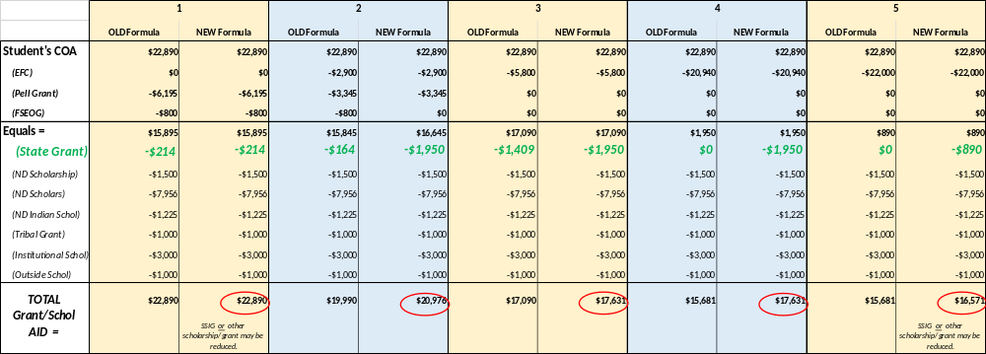
Let’s compare!
Assume these students all passed the NDUS formula/review and showed at least $1 of unmet need. The name is sent to the institution listed on the FAFSA to evaluate for eligibility.
  In the examples below, the state grant was reduced to accord with COA, however, a school has the discretion to reduce OTHER scholarships or grants ahead of the state grant. However, COA may not be exceeded when a student receives a state grant award. Something must be reduced.

Slide 11
ND Academic and
CTE Scholarships
Scholarship Management System(SMS)

Slide 12
Quick Poll
Raise your hand if you process ND scholarships at your institution?
Keep your hand up if you have NOT logged into the Scholarship Management System or SMS?

Slide 13
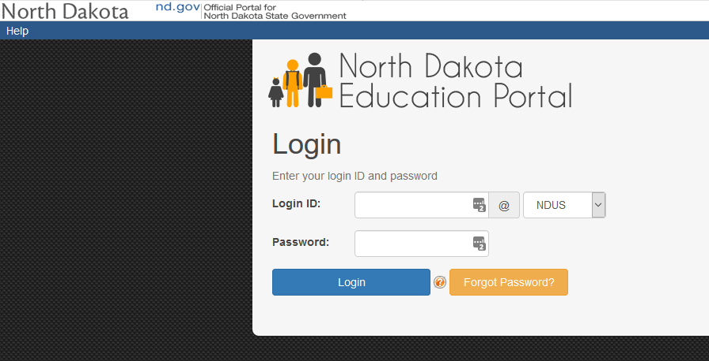
Logging in to the SMS
NDUS Login
Have a new employee or forget your username/password? Contact Crystal

Slide 14
Census and EOT Processing for
Non-NDUS Schools
For Registrars Only
Directly following FA Census (for Census) and grades posting (for End of Term) your Registrar SMS users will login and report the following:
Census
Completed Cumulative Hours
Current Enrolled Hours
Academic Career
End of Term
Completed Cumulative Hours
Cumulative GPA
Academic Career

Slide 15
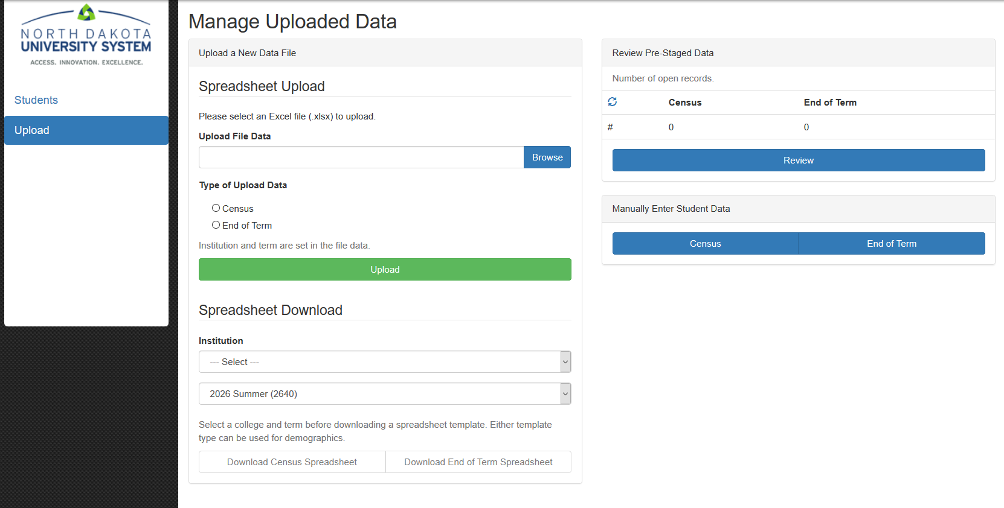
Census and EOT Processing for
Non-NDUS Schools
For Registrars Only
Download either Census Spreadsheet or EOT Spreadsheet
Complete highlighted fields
Upload spreadsheet for appropriate Term
Confirm and process

Slide 16
Census and EOT Processing for
Non-NDUS Schools
For Registrars Only
Helpful Tips:
Do not enter text in hours or GPA fields. Zero or blanks are appropriate.
Career is a one character field:
  U= Undergraduate
  G= Graduate

Slide 17
Census and EOT Processing for
NDUS Schools
Automated Processing
Directly following FA Census (for Census) and the special GPA deadline (for End of Term) NDUS pulls data below directly from Campus Solutions:
End of Term
Completed Cumulative Hours: Highest # by career summed (Highest UGRD + Highest GRAD)
Cumulative GPA: Special GPA for UGRD careers and cumulative GPA for all other careers
Academic Career
Census
Completed Cumulative Hours: Highest # by career summed (Highest UGRD + Highest GRAD)
Current Enrolled Hours: From FA Term as of Census
Academic Career

Slide 18
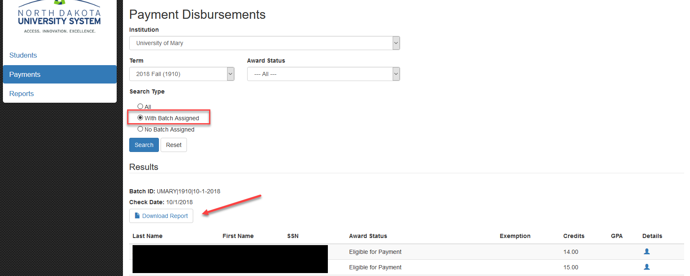
Reviewing Payment Info

Slide 19
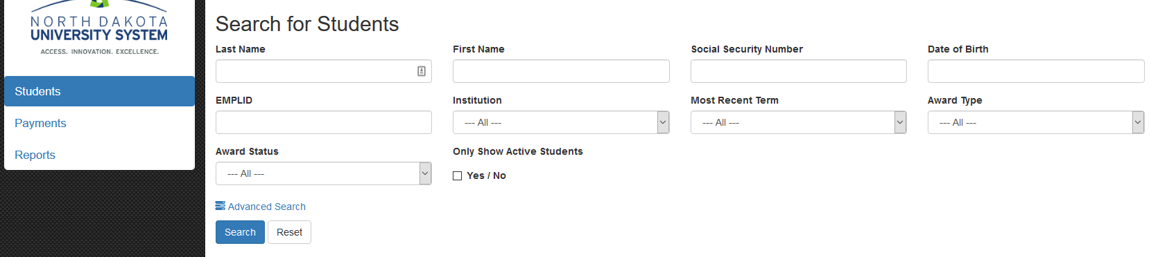
Did you know you can find more info on just one student?
You can identify one student and search for their data
Identify a group of students (i.e. all with a particular award or all students who didn’t meet the GPA requirement)

Slide 20
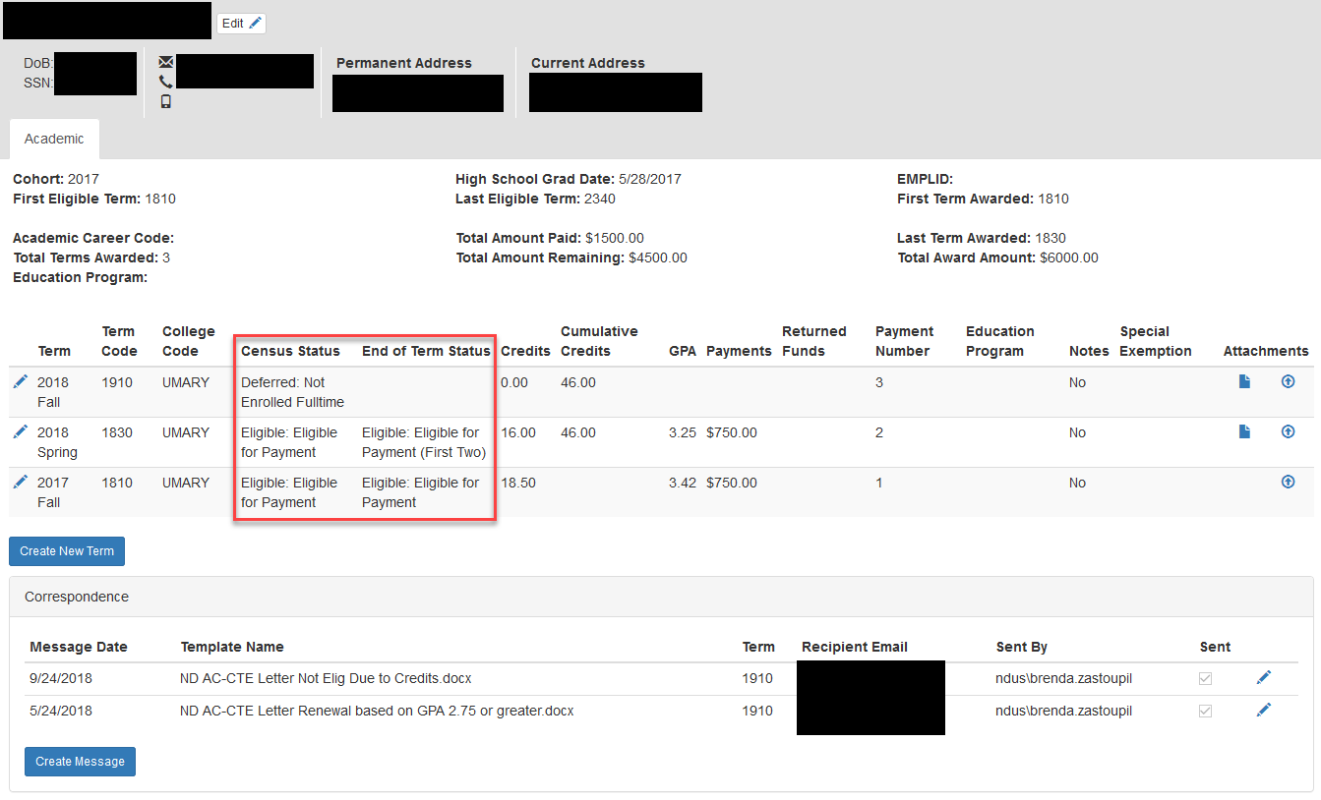
Student Data
Helpful Information
How long they can receive the award.
Eligibility Status
Calculated Cumulative Credits
Communications Sent

Slide 21
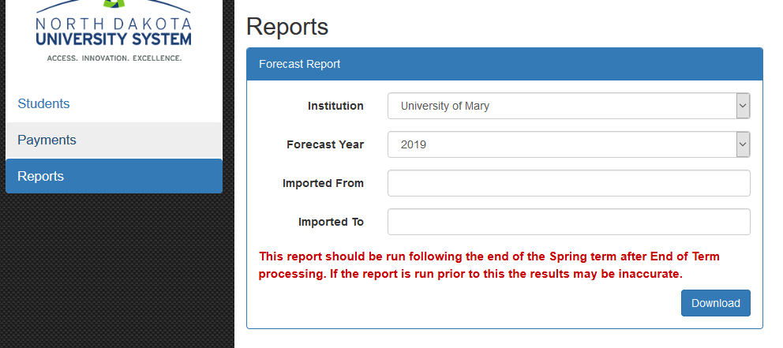
Forecast Report
Report replaces both the “new students” and “renewal students” files you received from NDUS.
This report should only be used post Spring End of Term (EOT) processing. The results are based on the student’s eligibility at the end of that term.
This is a forecast, just like the weather it can change. We evaluate eligibility at Census every term.
Pull this report regularly, on your own schedule, to make sure your system is updated with new awards

Slide 22
Resources
Campus User Documentation (in Conference Materials)
Contact NDUS for specific student award or processing questions.
  State Grant & Academic/CTE Scholarship:
      Kristin Ellingson: 701-328-4156 or kellingson@ndus.edu
  ND Scholars Program & ND Indian Scholarship & Reciprocity:
      Alexandria Bauer: 701-328-2964, abauer@ndus.edu
Contact CTS with technical questions, including access:
  Crystal Tangsrud: 701-777-1975, ctangsrud@ndus.edu

Slide 23
Questions?

