Slide 1
Academic and CTE Scholarship Updates
Jim Upgren, Assistant Director of School Approval and Opportunity

Slide 2
Topics of Discussion
Basic overview of the Academic/CTE Scholarship
Academic and Testing Requirements
Course Requirements
Transcripts and Planning
Scholarship Webinars/Presentations

Slide 3
1st Year Counselors
I plan to reach out to all 1st year counselors to see how things are going and if you have questions on the Academic/CTE Scholarship, eTranscript, or anything else
If you have questions before then, please do not hesitate to reach out to me

Slide 4
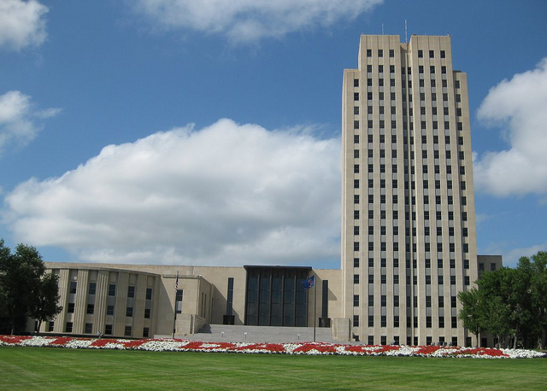
What are the Academic and CTE Scholarships?
$6000 Scholarship to students who meet the requirements
    ALL students who meet the requirements get a scholarship!
    Must attend a North Dakota College or University
    Must be a North Dakota Resident
    Qualifications for the scholarship are based on:
        High school grade point average ( 3.0)
        ACT Score (24) or WorkKeys scores (5)
        Courses taken in high school
            Above and beyond graduation requirements

Slide 5
Academic and Testing Requirements

Slide 6

Grade Requirements
3.0 Cumulative GPA ( non-weighted) or higher
    Overall OR
    Amongst required 22 credits
Have no grade lower than a “C” on any unit or half-unit required for the scholarship
    District may allow students to retake classes that they got a grade below a C

Slide 7
COVID-19 Grading Considerations
The requirement of “C or higher” was waived for the second semester of the 2019-2020 school year due to adjustments to distance learning
    Allows D’s to count, as well as “P” or “S” grades for second semester 2019-2020
    Will apply to students for the next three school years ( class of 2021, 2022, 2023)
ONLY APPLIES TO SECOND SEMESTER OF 2019-2020 SCHOOL YEAR!!
DOES NOT exempt second semester 2019-2020 classes from the 3.0 GPA requirement
    Students must still have a 3.0 overall or 22 credit GPA

Slide 8

Testing Requirements
Academic Scholarship: Composite ACT score of 24 or higher
CTE Scholarship
    Composite ACT score of 24 or higher OR
    A score of 5 or higher on each of the three WorkKeys assessments
        Applied Math
        Graphic Literacy
        Workplace Documents

Slide 9

Testing Requirements (Cont.)
All testing must take place before the student graduates!
June 2021 ACT cannot be used for class of 2021 graduates

Slide 10
ACT Superscores
Starting with the graduating class of 2021, students may use an ACT superscore to meet the requirement of earning a 24 or higher
A superscore combines a student’s best English, math, reading, and science scores into one score for students that have taken the ACT more than once
The superscore must come from ACT!
    Can’t be a hand calculation of the regular ACT scores
    Student has to select that they wish to have a superscore at the time they apply to take the test

Slide 11

WorkKeys Exam
Students can take the WorkKeys at their school ( if it is offered), or at another testing site
Students should visit with their counselor to find out where the WorkKeys is offered
WorkKeys scores must be sent to DPI

Slide 12
Course Requirements

Slide 13
Basic Course Requirements
Students must meet all course requirements for high school graduation
Students must also successfully complete some courses above and beyond those required for graduation, listed on the next slide……

Slide 14
Summary of Courses Required for Scholarship Beyond Graduation Requirements
Academic Scholarship
CTE Scholarship
1 credit Algebra II
1 credit of math for which Algebra II is a prerequisite
One of the following:
  ½ credit dual credit class
  1 full credit AP class AND the AP exam
One of the following
  2 credits of same foreign language
  2 credits CTE in the same CTE coordinated Plan of Study
1 credit Algebra II
4 credits of CTE
  2 of those credits in the same CTE Coordinated Plan of Study

Slide 15

Math Requirement
Academic Scholarship
CTE Scholarship
One unit Algebra II
One Unit of any course that Algebra II is a prerequisite for
One additional math unit
One unit Algebra II
Two additional math units

Slide 16

CTE Coordinated Plan of Study
4 units of Career and Technical Education for CTE Scholarship
    Two of these units must be part of a coordinated plan of study
Be sure they are CTE classes!!!

Slide 17


Slide 18

Foreign Language Requirement- Academic Scholarship
Two units of EITHER
    The same foreign language, Native American language, or American Sign Language
    Career and Technical Education credits
        Must be part of the same coordinated plan of study

Slide 19
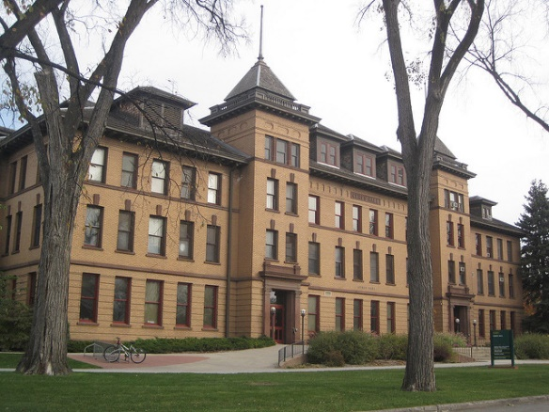
Advanced Courses- Academic Scholarship
Complete one of the following:
    1 unit of an Advanced Placement (AP) course along with the AP exam
    ½ unit of a dual credit course
    1 unit of an early entry college course from a college or university that has a physical presence in North Dakota

Slide 20
Teacher Pathway
Students may use an educational pathway for the Academic/CTE Scholarship
    Substitute for the 2 credits of the same foreign language/CTE Coordinated Plan of Study for the Academic Scholarship
    Substitute for the 2 credits of CTE from the same Coordinated Plan of Study for the CTE Scholarship

Slide 21
Teacher Pathway ( Cont.)
Educational Pathway for Academic/CTE Scholarship
    1 credit Teaching Profession
    1 credit Educational Methodology
    1 credit from the following list:
        AP Psychology
        Dual Credit Psychology
        Child Development
        Peer-to-Peer Leadership
        Child-Related Careers

Slide 22
Transcripts and Planning

Slide 23

Use of eTranscript
Use the Progress Monitoring tool in eTranscript throughout the year to measure scholarship progress for students in grades 9-12
Check student progress at least once at the beginning of each semester
    Especially with seniors!
PLEASE open eTranscript to parents!
    Can track scholarship progress

Slide 24

Course Codes
Be sure to use the correct course codes
    Schools can call the course whatever they want, the course code is what matters
    All course codes can be found on DPI Website
        Click on Districts and Schools, then Course Codes

Slide 25
Diploma/Scholarship Alignment Chart
Refer to the Diploma/Scholarship Alignment Chart to determine which courses can count for each scholarship requirement
Courses in each content area
Courses that can replace one another
Located on DPI Website
    Click on Districts and Schools, then Course Codes, then Grades 9-12 drop down menu

Slide 26
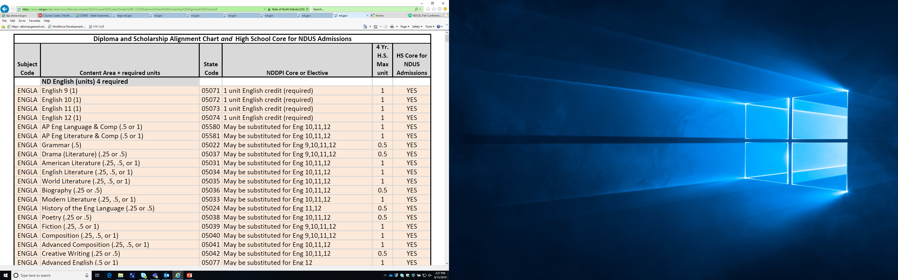

Slide 27
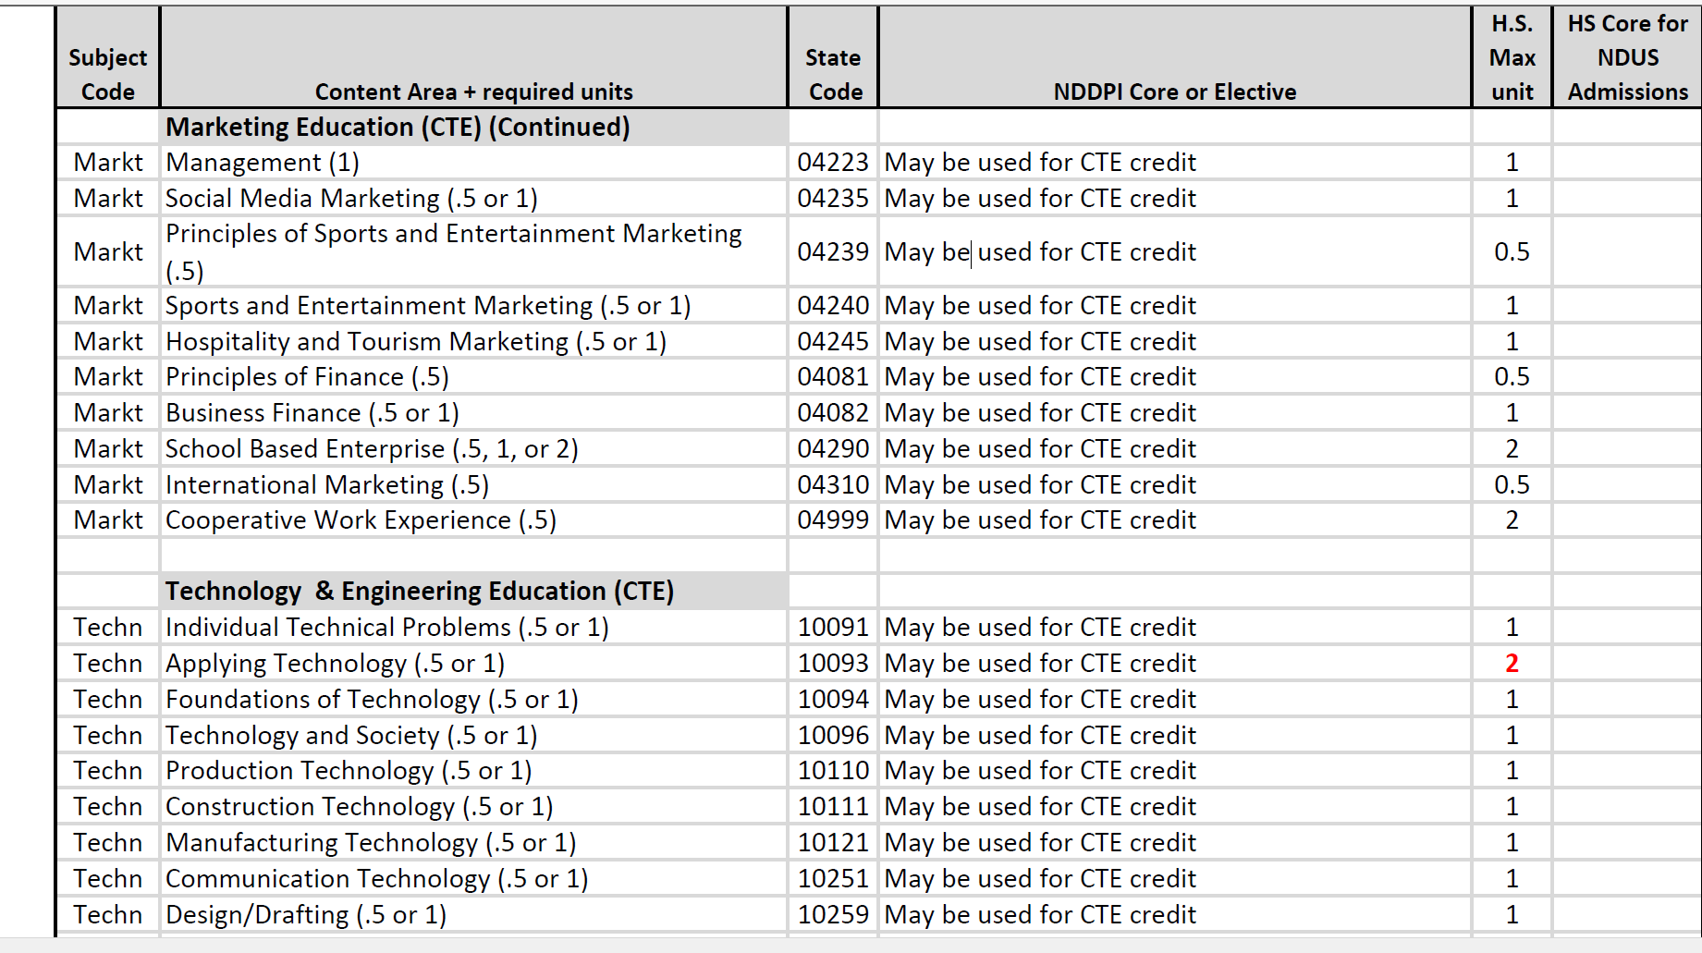

Slide 28
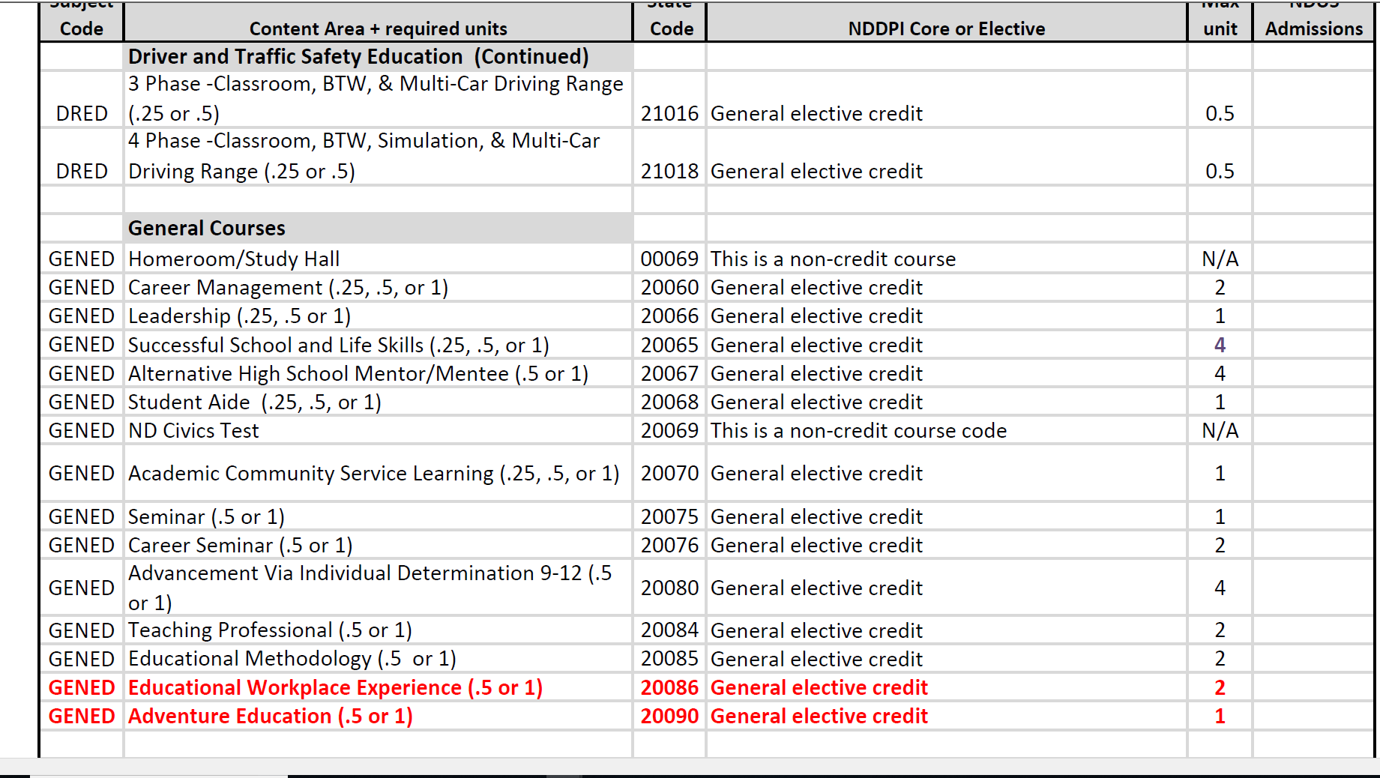
Alignment chart photo- general education

Slide 29

Which scholarship should students plan classes for?
If possible, BOTH
    Academic and CTE courses if possible
Sometimes students limit themselves to just one or the other
    Leave options open
    If students plan for Academic, but don’t get a 24 on the ACT, they can take the WorkKeys and get the CTE if they have the required 4 CTE credits

Slide 30
Scholarship Application Window
Applications open Monday, January 4, 2021
Applications close Friday, June 4, 2021
    By June 30, 2021, students will be notified of their scholarship status
Make sure students applications are complete
    Entering ACT/WorkKeys scores
    Selecting the correct scholarship
    Entering correct SSN

Slide 31
Scholarship Webinars

Slide 32
Scholarship Webinar
Webinar for school administrators and counselors was Thursday, August 27
The webinar is now posted on the DPI website for your reference!
    DPI website
    Parents/Students
    Scholarships
    Scholarship Webinar for School Counselors and Administrators ( August 27, 2021)

Slide 33
Scholarship Parent/Student Facebook Live
Thursday, December 3, 7:30 PM Central Time
Target Audience: Students and Parents
    NDDPI Facebook Page
    Please pass info on to your students and their parents

Slide 34
Individual School Presentations
I am willing to do scholarship presentations for students and/or parents
    Face-to-face or virtual
    During the school day, in the evening, or both!
If interested in having a presentation for your school, get in contact with Jim Upgren

Slide 35

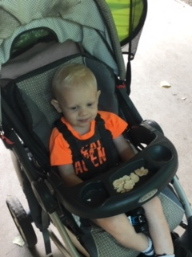
Please Contact me with Questions!
Jim Upgren, Assistant Director of School Approval and Opportunity
North Dakota Department of Public Instruction
701-328-2244
jimupgren@nd.gov

