Slide 1
Catching up with Campus Connection
2022 NDASFAA Spring Conference
Notes:
CT

Slide 2
Agenda
Introductions
What is this session about?
Navigation Tips & Tricks
Basic Terms
Customizing your Campus Connection
Shortcuts & Tools
What’s new since Fall 2020?
Looking Forward
NDHEUG 2022
Open Discussion
Notes:
CT

Slide 3
Introductions
Who are we?
Who are you?
Institution
Title
How long have you been in FA?
Notes:
CT

Slide 4
What is this session about?
Tons of changes
Institutional
Workplace/office space
Retirements/departures
Regulatory Changes
Both temporary and permanent
We’ve been busy!
Notes:
CT

Slide 5
Survey Says!
In November 2021 we surveyed the NDUS FA Community about navigation:
Navigation ease in FA was rated a 8.1364 (0 to 10)
Navigation in NDU FA menus was rated a 6.2273 (0 to 10)
72% of respondents did not want the NDU FA menu reorganized
Notes:
CT
(Read slide)
While we didn’t change any of the menus as a result of the survey it did give us many great suggestions for improvements to navigation which we will highlight later in the presentation.

Slide 6
Navigations Tips & Tricks
Notes:
SB

Slide 7
Common Verbiage
Homepage: A collection of Tiles for easy navigation. There are both delivered and personal/customizable Homepages.
Tiles: A navigation icon found on a Homepage. Can be a direct link to a page or collection of pages.
Page Tiles: A Tile that is tied to a single page.
Notes:
SB
Campus Connection has many ways to navigate and we want to start with some common language to help you customize your experience.
First let’s talk about Homepages. Homepages are one of the most common ways to get around is through the use of Tiles like those in the screenshot below. You may have delivered Home pages and you can also create your own custom Homepages.
Tiles are on Homepages and are really the method you use to navigate from Homepages. There are really two forms of tiles, the first is a Page Tile which will take you to a single page like the Manage Pell Payment Tile below.

Slide 8
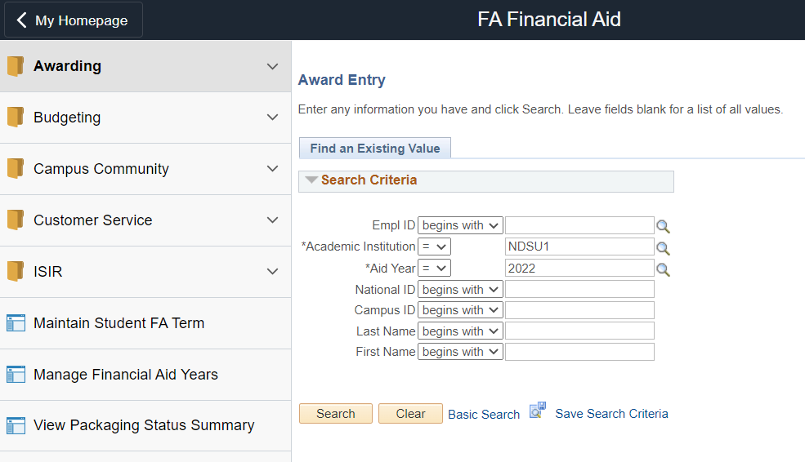
Common Verbiage
Navigation Collection or NavCollection: A collection of pages, grouped together for easy navigation. NavCollections are usually associated with Tiles, but Tiles don’t always have NavCollections. Created/maintained by CTS.
Notes:
SB
The second type of possible tile you might see will have a Navigation Collection, or NavCollection, attached. A NavCollection is a collection of pages grouped together for easy navigation. These are useful tools as the pages load much quicker than navigating via other methods. It’s important to note that Oracle delivers many NavCollections and Tiles and CTS, in conjunction with the Campus Solution User Groups have developed NDUS collections as well. We’re going to go over some FA specific Tiles in a little while

Slide 9
Common Verbiage
Favorites: A collection of pages you refer back to often and want easy access to.
Navigation Bar or NavBar: A control panel that provides quick access to pages and folders in CS.
Notes:
SB
Some other terms we will use throughout are Favorites. Which you will likely recognize. Favorites are a personal collection of pages you refer to often.
The Navigation Bar or NavBar is a control panel that offers quick access to pages, folders in the Navigator, Recent Places, your Favorites, and other items. You can access the NavBar by clicking on the compass in the top right-hand corner.

Slide 10
Navigating with Homepages
Favorites on steroids or shared favorites
Delivered Homepages:
Campus Solutions Administrator Homepage
Faculty/Advisor Homepage
Student Homepage
Homepages are based on roles.
Security applies! You won’t be able to access content from a Tile that you can’t get to any other way.
Able to create/personalize your own Homepage
Add Public Tiles (with NavCollections)
Add Page Tiles
Notes:
SB
We can think of homepages as shared favorites or delivered tiles and navigations. We have several delivered homepages. The Campus Solutions Administrator homepage are delivered for staff with Campus Solutions administrator roles from the different modules. The faculty/advisor homepage will be available for those users with the faculty role. And the student homepage are delivered for all students and those with the Campus Solutions administrator roles as well.
Homepages are based on roles and your security will apply. You won’t be able to access content from a tile or homepage that you can’t get to any other way.
You also have the ability to create and personalize your own homepages. You are able to add public tiles with attached nav collections. You’re also able to add page tiles that will link you out to a specific page in Campus Solutions.

Slide 11
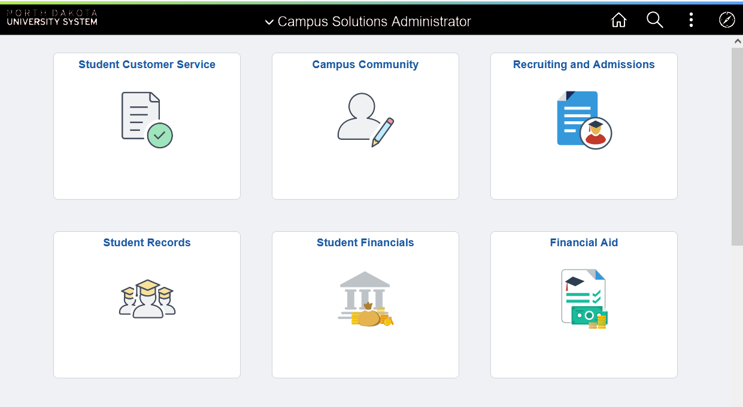
Campus Solutions Administrator Homepage
Notes:
SB
Here’s a screenshot of the Campus Solutions Administrator Homepage. Your Homepage may look different than the one you see here as it will be based on your security and added tiles.

Slide 12
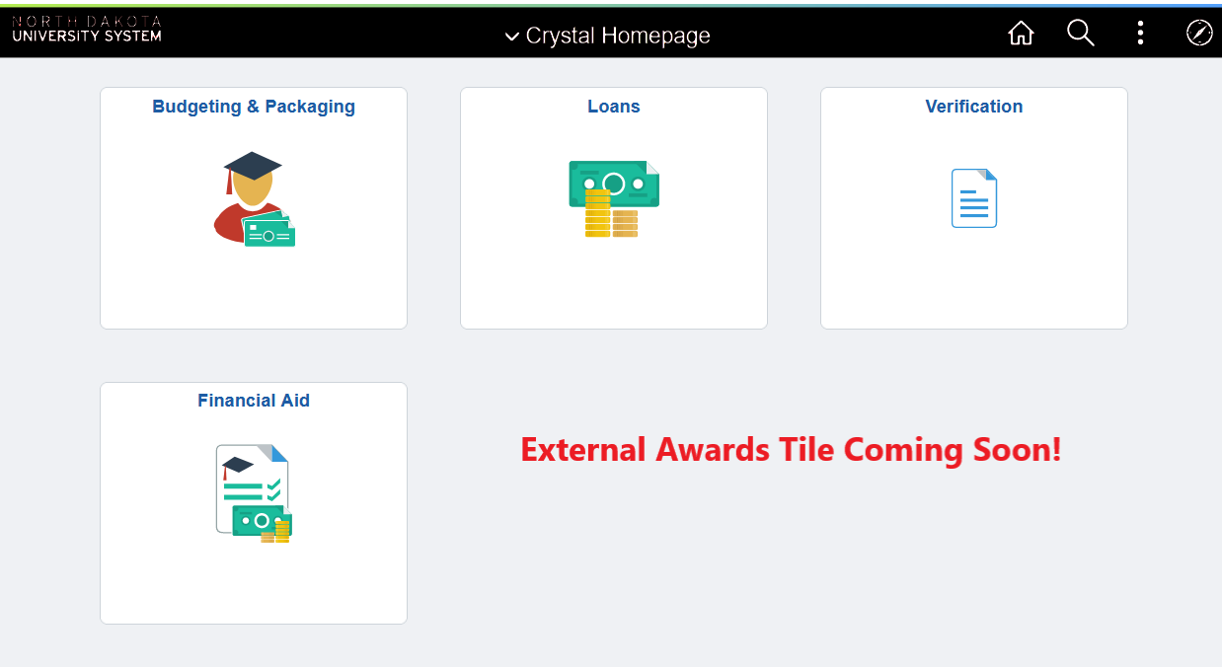
Financial Aid Tiles
Financial Aid Tile Document
Notes:
CT
We have four custom FA Tiles and one that is coming soon. Back in November 2021 when we conducted our survey we updated all of these tiles with lots of great suggestions from the community.
Budget & Packaging
This includes all of the basic components for those who run mass budgeting and mass packaging. It also has a folder for Item Type Creation
Loans
Includes folders for both Alternative Loans and Direct Loans
Verification
Includes the regular pages for verification processors, and the setup required
Financial Aid
This is the tile that is found on the Campus Solutions Administrator Homepage. It is designed for quick processing, with front end staff in mind
External Awards
Coming soon! This will have all of the pages associated with processing External Awards through the batch process
We have a document that lists all of the pages that are included in these Tiles that we try to keep up to date. We also conducted a FA Campus Connection Navigation Survey in Fall 2021 where we collected recommended updates to these Tiles. We will likely survey the user group again in 2023 to make sure we are keeping up with your needs. But if you find something is really needed please reach out to us.

Slide 13
Customizing Your Campus Connection
Notes:
SB

Slide 14
Personalizing Homepages
Click “three dot” icon
Click Personalize Homepage
Add Personal Homepage
Add, delete, or move Tiles
You’re able to rearrange delivered Homepages and add Tiles, but you cannot delete delivered Tiles.
Notes:
SB
Read the slide

Slide 15
Personalizing Homepages Demo
Notes:
SB
Demonstrate:
Reorganizing an existing Homepage on the homepage and in the Personalize Homepage
Adding a Homepage and adding tiles from Personalize Homepage
Deleting Tiles
Adding a page Tile
Deleting personal Homepages
Making a default Homepage
What are some homepages you have or you think you might go back and build?

Slide 16
Shortcuts and Tools
Notes:
CT

Slide 17
Shortcuts and Tools Demo
Query and Process Monitor in NavBar
New Window in Tile/Nav Collections
Searching in Process Monitor
Run Control Searches
% for searching
No Return to Search? Use Add
“T” for today’s date
Searching in the Process Monitor
Finding a query, report, or process?
Training & Documentation page
Search Bar
Notes:
CT
Query and Process Monitor in NavBar
Add most common pages to NavBar
Not too many!
You can also change the order of the icons in the NavBar
New Window in Tile/Nav Collections
Searching in the Process Monitor
Run Control Searches
Financial Aid > Loans > Process Loans
Show what we see a lot
Talk about recommendations for Run Controls
Comm Gen
3C
% for searching
Use for searching for Run Control
No Return to Search? Use Add
User Process Loans/Loan Origination
“T” for today’s date
Query 218
Running query to HTML
Finding a query, report, or process?
Training & Documentation page
Search Bar

Slide 18
Navigation Resources
NDUS Campus Connection 9.2 Documents:
Job Aids
Training Videos
Keyboard shortcuts (handout)
Notes:
CT

Slide 19
What’s new since Fall 2020?
Notes:
CT
We’re going to run through all of our major developments and changes since Fall 2020. These might be high level overviews but please stop us if you have questions. All of these processes are documented on our Training & Documentation page as well.

Slide 20
NDU Academic Works Extract
NDU Applications > NDU Financial Aid > Process > NDU Academic Works Extract
Massive extract on current and future students
Includes admission and records data
Financial Aid Need calculation and high/low/medium ranges
Can be used for other scholarship processes
Notes:
CT

Slide 21
AY Rollover is now AY Prep
Revised our AY Rollover into bite sized sections that are done as needed:
AY Creation
ISIR Load
FA Term Prep
Budgeting & Packaging Prep
Disbursement Prep
Notes:
CT

Slide 22
Budget Formula & Budget Item Queries
Queries: NDU_FA_0306_01 and NDU_FA_0306_02
Both queries can be used for updating, maintaining, and documenting your budget creation process.
Query 306_01: Returns Budget Formulas
Query 306_02: Returns Budget Items
Notes:
CT

Slide 23
FA Comprehensive Data Query
Queries: NDU_FA_0308
Massive query that returns award data and FA Term data for every student with an active FA Term for the prompted AY and term.
Can be used for award adjustments
May take a few minutes to run for larger institutions
Notes:
SB

Slide 24
NDU Collaborative FA Term Update
NDU Applications > NDU Financial Aid > Process > NDU Collaborative FA Term Update
Finds students who have Collaborative Enrollment on the Collaborative Student Page who do not have remote credits reported for that term.
When run “live” it will update FA Term appropriately
Produces the following CSVs:
Collaborative Mismatch
FA Term Update
No AY
Notes:
SB
Collab_FA_Term_Mismatch: Students whose total enrollment on the NDU Collaborative Student Info page does not match the prompted terms/institutions’ Remote Credits. These students will need to be reviewed manually to determine FA Term needs to be updated.
Collab_FA_Term_Update: Student with enrollment on the NDU Collaborative Student Info page who do not have remote units, whom the process will (if run in simulation) or has updated FA Term data for.
Collab_FA_No_AY: Returns students who have collaborated enrollment on the NDU Collaborative Student Info page but do not have an active FA Term row for the prompted term or aid year.

Slide 25
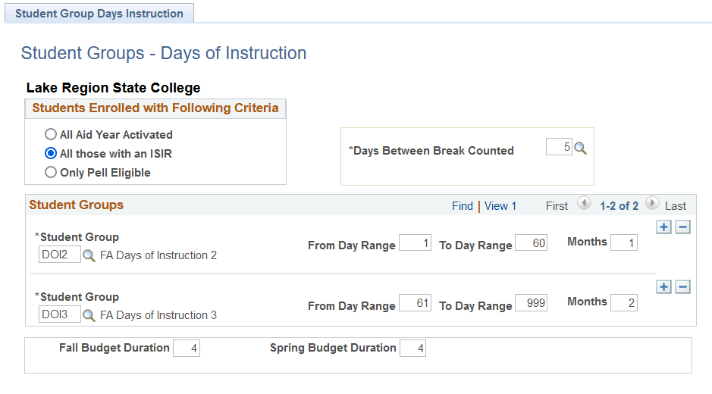
NDU Days of Instruction
NDU Applications > NDU Financial Aid > Process > NDU Days of Instruction
Does two things based on your setup:
Assigns a Budgeting Student Group
Updates FM Budget duration for Academic and Non-Standard Period
Eliminates need to manually update Budget Duration and click INAS button on ISIR page during summer term
Notes:
SB
Read the slide

Slide 26
Grade Level Change Query
Queries: NDU_FA_0307
Identifies undergraduate students who had a grade level change between terms from freshmen to sophomore or sophomore to junior and have an ISIR on file for prompted aid year two.
Use this query to increase aid for eligible students who had a grade level change between terms.
Notes:
SB
Read the slide

Slide 27
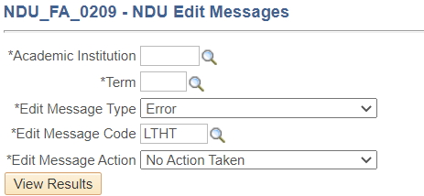
LTHT With Loans UEM
Ran by CTS overnight
FA Term does not update FA Load after withdrawals and students with unaccepted loans who subsequently accepted them were being incorrectly disbursed when they were no longer halftime.
This process runs overnight to assign a User Edit Message (UEM) of LTHT to students in this situation. Disbursement rules were updated so loans would not disburse if this UEM was unresolved.
Run query NDU_FA_0209 to identify students with this UEM.
Notes:
CT

Slide 28
NSLDS Financial Aid History
Ran by CTS in May and August
Due to early FAFSAs NSLDS data used for awarding may be out of date.
Financial Aid History (FAH) helps us get an updated NSLDS record for all students we have an ISIR for before packaging continuing students (May) and disbursement (August)
After the process is run CTS notifies the list to review the two following reports:
Loan Aggregates Reports
Pell Aggregate Reports
Notes:
CT

Slide 29
NDU Loan Aggregates Reports
NDU Applications > NDU Financial Aid > Report > NDU Loan Aggregates Reports
Produces several CSVs:
Subsidized Overaward
Combo (sub plus unsub):
Dependent
Independent
Gradudate
NSLDS Override
Run after NSLDS FAH (May and August)
Notes:
CT
We updated this to be called the “loan aggregate report”
NDU_FA_0277_SUBSD_ALL: Students who’s total subsidized aggregates plus their current (prompted year) subsidized loans that exceed $23,000.
NDU_FA_0277_COMBO DEP: Dependent students who have a combined total aggregate plus both their current (prompted year) subsidized and unsubsidized loans that exceed $31,000.
NDU_FA_0277_COMBO INDEP: Independent students who have a combined total aggregate plus both their current (prompted year) subsidized and unsubsidized loans that exceed $57,500.
NDU_FA_0277_COMBO GRAD: Graduate students who have a combined total aggregate plus their current (prompted year) unsubsidized loans that exceed $138,500.
NDU_FA_0277_NSLDS_OVR: Students who have an override on the Update Incoming Aggregates page (Financial Aid > Awards > Aggregates) that has a date that is before our latest copy of NSLDS History (Financial Aid > Awards > View NSLDS Loan Data). This can be used to review students who have new NSLDS data than the data that was overridden. It will be particularly important to review these following Financial Aid History (FAH) data pulls, which are done in May and August for the Aid Year that begins in August.

Slide 30
NDU Pell Aggregate Reports
NDU Applications > NDU Financial Aid > Report > NDU Pell Aggregate Reports
Produces two CSVs:
Pell Aggregate Report
NSLDS Override
Run after NSLDS FAH (May and August)
Notes:
CT
Pell_Aggregate_Report.csv: Returns students who have an LEU equal to or greater than the prompted value who have Pell offered at your institution for the prompted aid year.
Pell_Override_Report.csv: Returns students who have a NSLDS record loaded on or after the prompted effective date (from ISIR, TSM, or FAH) that has a date that is greater (newer) than the override date and time on the student’s Pell Aggregate type at your institution on the Update Incoming Aggregates page

Slide 31
NDU Overaward Report
NDU Applications > NDU Financial Aid > Report > NDU Overaward Report
Added functionality for a “legal overaward” exclusion
Students with FLO Service Indicator will not show on the report with overawards that are the same as the legal overaward amount
Notes:
SB

Slide 32
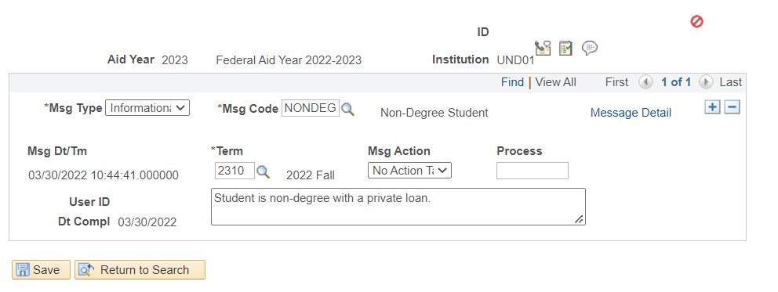
NDU Ready Package
NDU Applications > NDU Financial Aid > Process > NDU Ready Package
Added functionality to exclude students who are non-degree seeking but have had FA Term artificially created using the NONDEG User Edit Message (UEM).
Assign to students and NDU Ready Package will skip them.
Notes:
SB

Slide 33
R2T4 49% Exception
FINANCIAL AID > RETURN OF TITLE IV FUNDS > CREATE WORKSHEET
For programs offered in modules the 49% exception check box has been added. Check this box if the student has successfully completed one module or a combination of modules with a combined length of at least 49% of at least 49% of the countable number of days in the payment period or period of enrollment. Results in 100% earned aid.
Notes:
SB

Slide 34
Student AY Reset
Ran by CTS overnight
We created a process to clear out students’ default Aid Year from their User Defaults.
This is automatically being set when they visit the Student Financial Aid Tile and select an AY
Students would then get confused and not know how to go to another year.
This forces them to the AY selection every time (daily).
Notes:
SB

Slide 35
Looking Forward
Notes:
CT

Slide 36
Future Changes
CFP Veterans Benefits
INAS from Oracle
TDClient
RFI for Course Fundability
FAFSA Simplification Act
Pell Working Group
Pell UEM
Program Improvements (development changes only):
C-Code/I-Code Processing
Verification
PeopleTools 8.59
Notes:
CT
CFP Veterans Benefits
College Financing Plan has a new section to satisfy the veteran’s requirements. This section requires us to report Veteran’s Educational Benefits. CUSAD will be meeting to discuss and make decisions about what changes need to happen both at the campus level and from our side (systems) to make sure we are meeting this requirement.
INAS from Oracle
Starting with the ISIRs for AY 2024 Oracle and the College Board will no longer be providing the functionality we know as INAS. This functionality is what we use to calculate an EFC within Campus Connection. They will instead of a plugin that calculates it. Our hope is that this will be seamless for you all but this may change how we do things and will definitely impact CTS as we work to install and understand that new functionality.
TDClient
Every day we send and receive dozens of files with the Department of Education. Currently CTS personnel in our Data Center, who we refer to as Production Control, manually log into that software, EDConnect, and send/receive those files before kicking of jobsets in Campus Connection to process the files. We are working on a project of moving to a different product that the Department of Education provides called TDClient which would automatically (prompted by jobs in Campus Connection) send/receive files without having to have a human do that work.
RFI for Course Fundability
We are in the process of looking for an option to ensure that the classes a student is receiving aid for are counting towards their degree program. There is currently no delivered functionality that can do this. This will be a multi-phased project that will include campus business processes and considerations before any product is purchased or developments are made.
FAFSA Simplification Act
Goes without saying that this will create major impacts for the Campus Connection. We are anxiously awaiting information from Oracle and FSA about these changes.
Pell Working Group
The Pell Working Group is a new group that has met three times already and is reviewing all of current Pell queries and reports we provide. This group has already started suggesting major improvements to the items we provide.
Pell UEM
Did you know Pell grants can disburse in Campus Connection without an accepted origination file? This new UEM will help us make sure that we are disbursing Pell grants for students we have accepted originations for only. This should significantly help with reconciliation.
Program Improvements (development changes only):
C-Code/I-Code Processing
Verification
PeopleTools 8.59
Breadcrumbs! And we don’t know what else. PeopleTools are the framework and sometimes have impacts to pages.

Slide 37
NDHEUG 2022
Notes:
SB

Slide 38
Notes:
SB

Slide 39
Past Presentations in the FA Track
Collaborative with Student Finance and Financial Aid - 2019
Loan Processing Tips – 2019
Financial Aid and 9.2 - 2019
Query Writing for Financial Aid - 2019
Automating Census Processing – 2019
FA General Communications – 2017
ISIR Load and the Suspense Management Report – 2017
NSC to NSLDS – 2017
FA and Perceptive Content - 2017
Reconciliation - 2017
External Awards – 2015
Reconciliation – 2015
SAP Best Practice – 2015
Direct Loan Issues/Errors – 2015
Notes:
SB

Slide 40
Idea Generation for 2022?
Notes:
SB

Slide 41
The average American eats 71 pounds of ketchup each year.
-tasteofhome.com

Slide 42
Open Discussion

Slide 43
Survey

