Slide 1
My path
Vice Provost of Strategic Enrollment Management at the University of North Dakota
  University Admissions, Student Finance, One-Stop Student Services, Military & Veterans Services, International Center, Army ROTC, and Air Force ROTC
  4 years in Enrollment Management
  12 years in Financial Aid, 6 as Director
  1 year as the Business Manager Student Union

Slide 2



Slide 3
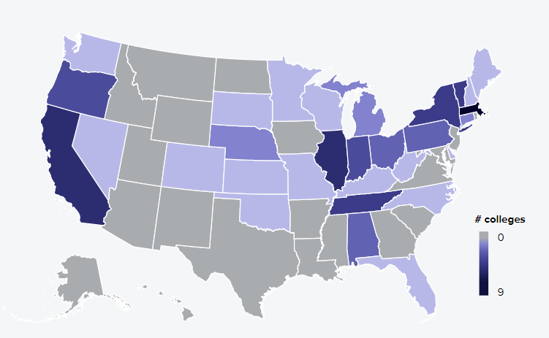
Future of Higher Education
How familiar are you with the higher education landscape?
Do you know if your campus is having conversations about recruitment and retention efforts?
Graph – Number of colleges
that have closed since 2016
(Higher Ed Dive)

Slide 4
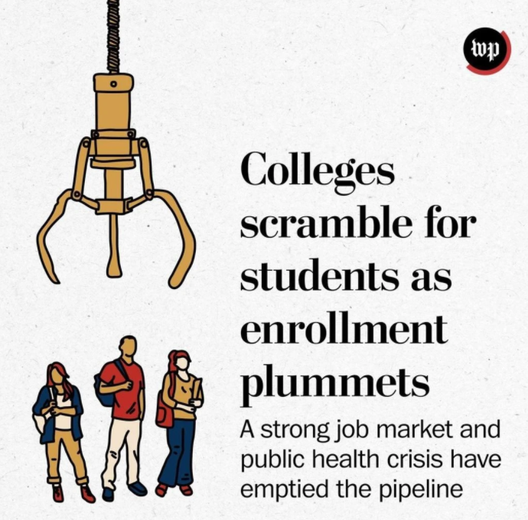

Slide 5
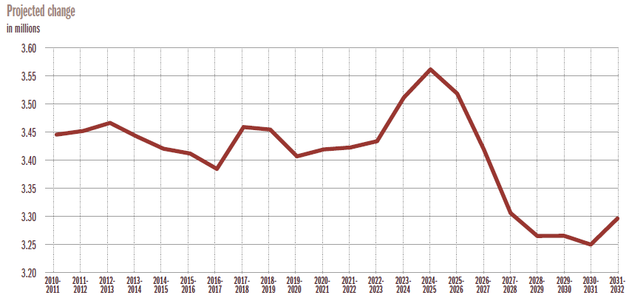
High School Graduates
Looming Enrollment Crisis – The Chronical of Higher Education

Slide 6
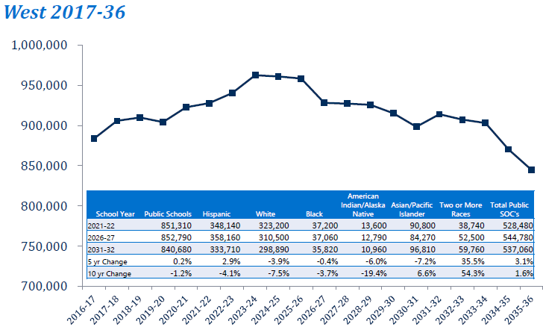
High School Data from Knocking Door

Slide 7
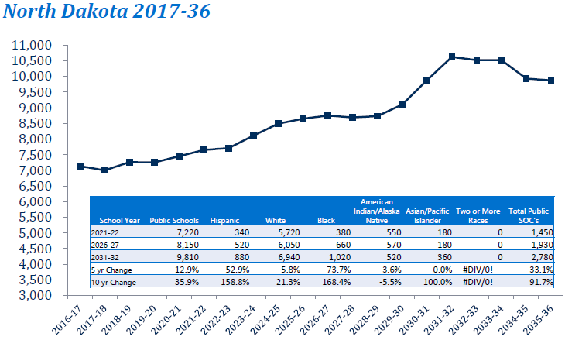
High School Data from Knocking Door

Slide 8
North Dakota
7,650 high school seniors expected to graduate in spring 2022
The ND high school graduate average college going rate is 76.4% (5,844)
Roughly 20% (1,169) of high school graduate leave ND for college
There are 24 institutions of higher education in ND
5,844 – 1,169 = 4,675 / 24 = 194 students per campus

Slide 9
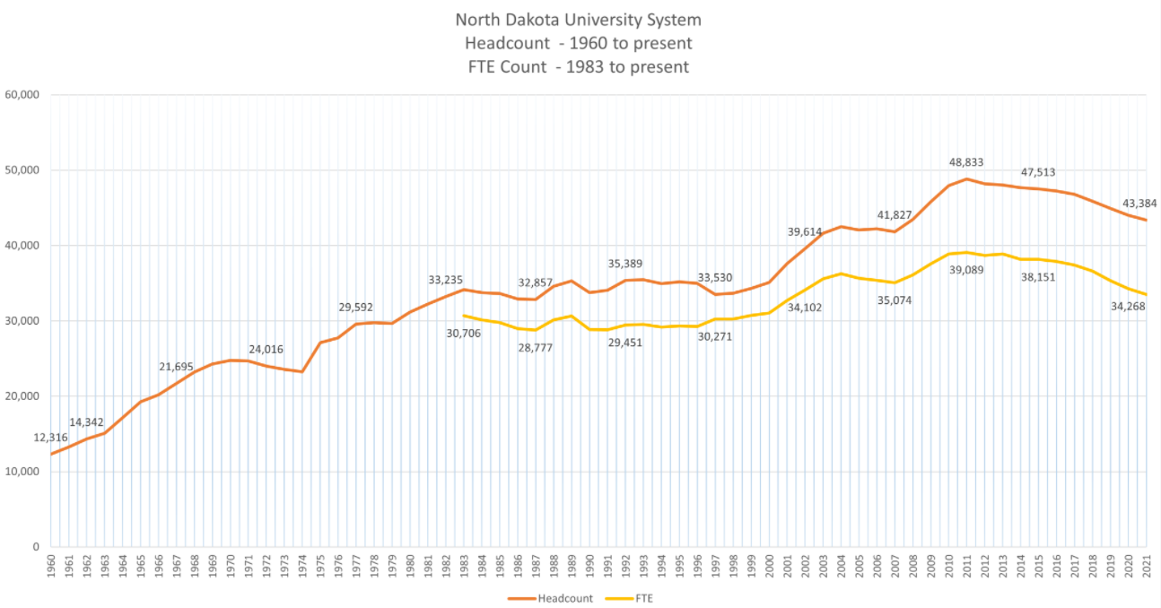

Slide 10
Adult Learners
36 Million adults have some college but no degree
Top Concerns
  Affordability – worried they cannot afford college
  Do not thing they can balance demands of college with other life obligations (job, family, etc.)
  Scared of the technology
  Job market is currently an employee’s market

Slide 11
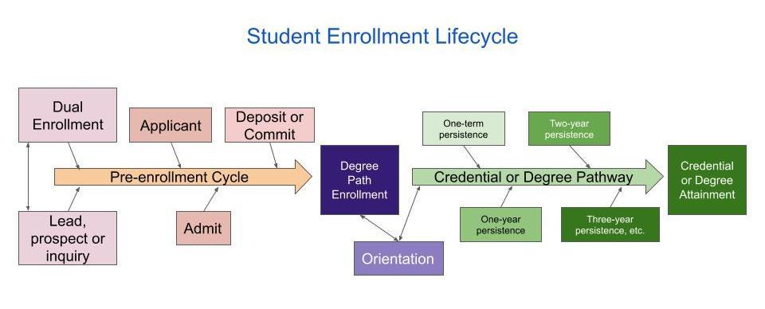
Enrollment Management

Slide 12
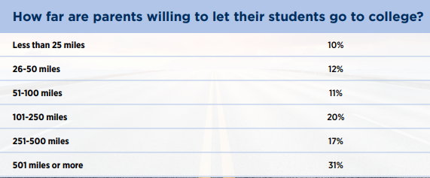
Distance From Campus (Ruffalo Noel Levitz)

Slide 13
Importance of Student Financial Aid
Two main factors students use when deciding
  Academic major
  Affordability
    Do you know your current discount rate?
    Do you know your incoming student FAFSA filing rate?
    Does your office award new student scholarships?
    Do you work with Admissions and Marketing to communicate financial aid options?

Slide 14
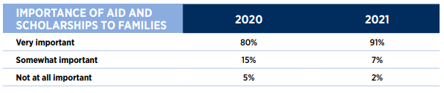
College Financing
9 out of 10 families say financial aid & scholarships are very important
Ruffalo Noel Levitz: 2021 Prospective Family Engagement Report

Slide 15


Slide 16
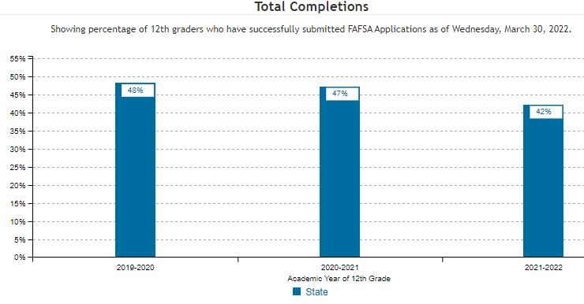
FAFSA Filing Rates
National College Attainment Network (NCAN) Research
  84% of high school seniors who complete FAFSA enroll
  127% likelihood to enroll for low-income high school seniors
  Graph – ND Insight

Slide 17
Student Categories – FAFSA Filing Rates
First-year Freshmen
Transfer Students
Current Students
First-year Pell Eligible Students
Returning Pell Eligible Students

Slide 18
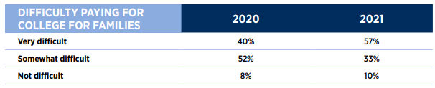
Haves and Have Nots
Nearly 60 percent of 2021 prospective families estimate that paying for college will be
“very difficult” compared to 40 percent in 2020.
Ruffalo Noel Levitz: 2021 Prospective Family Engagement Report

Slide 19
Returning Student Efforts
Does your institution have a retention goal?
Do you have a student satisfaction survey? If so, do you address their concerns and communicate those changes?
Among students who started in 2010, 39.6% did not receive a degree within eight years. (RNL)

Slide 20
Retention
Financial aid – Have you assessed EFC, merit aid, or other financial indicators of students who do not retain.
Outstanding Balances – Do you work with the Business Office to get a list of students with outstanding balances:
  Verify they completed FAFSA?
  Have they accepted all institutional, federal, state aid?
  Are they Pell Eligible or lower income students?

Slide 21


Slide 22
Retention
Returning students will not automatically re-enroll. We need to continue to recruit our current students.
Outreach efforts?
  Do you email, text, or call?
  Do you know the open rates of the communications sent?
How to does your campus communicate about upcoming registration?
Do you send specific communication about the date/time their registration opens?
Do you have a registration event that includes financial aid, registrar, business office, advisors/faculty to help students with holds and registration?

Slide 23


