Slide 1
Addressing Special Circumstances through Professional Judgment
Professional Judgment Panelists
Becca Dobry, University of Nebraska Kearney
Chris Meek, Dickinson State University
Kelsey Walter, Lake Region State College
Laurie Weber, Minot State University

Slide 2
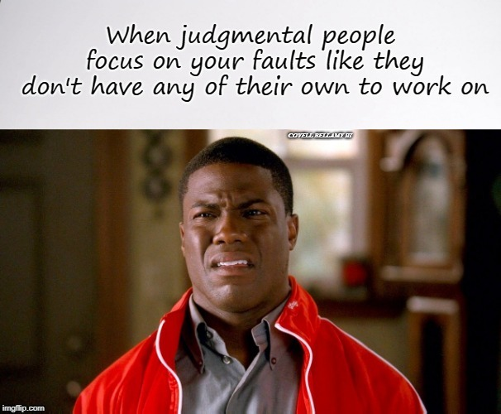

Slide 3
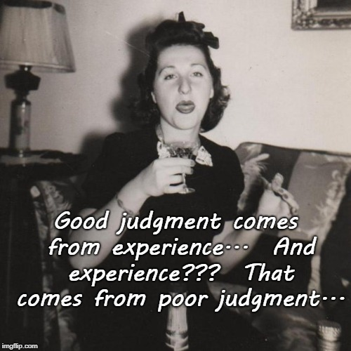

Slide 4
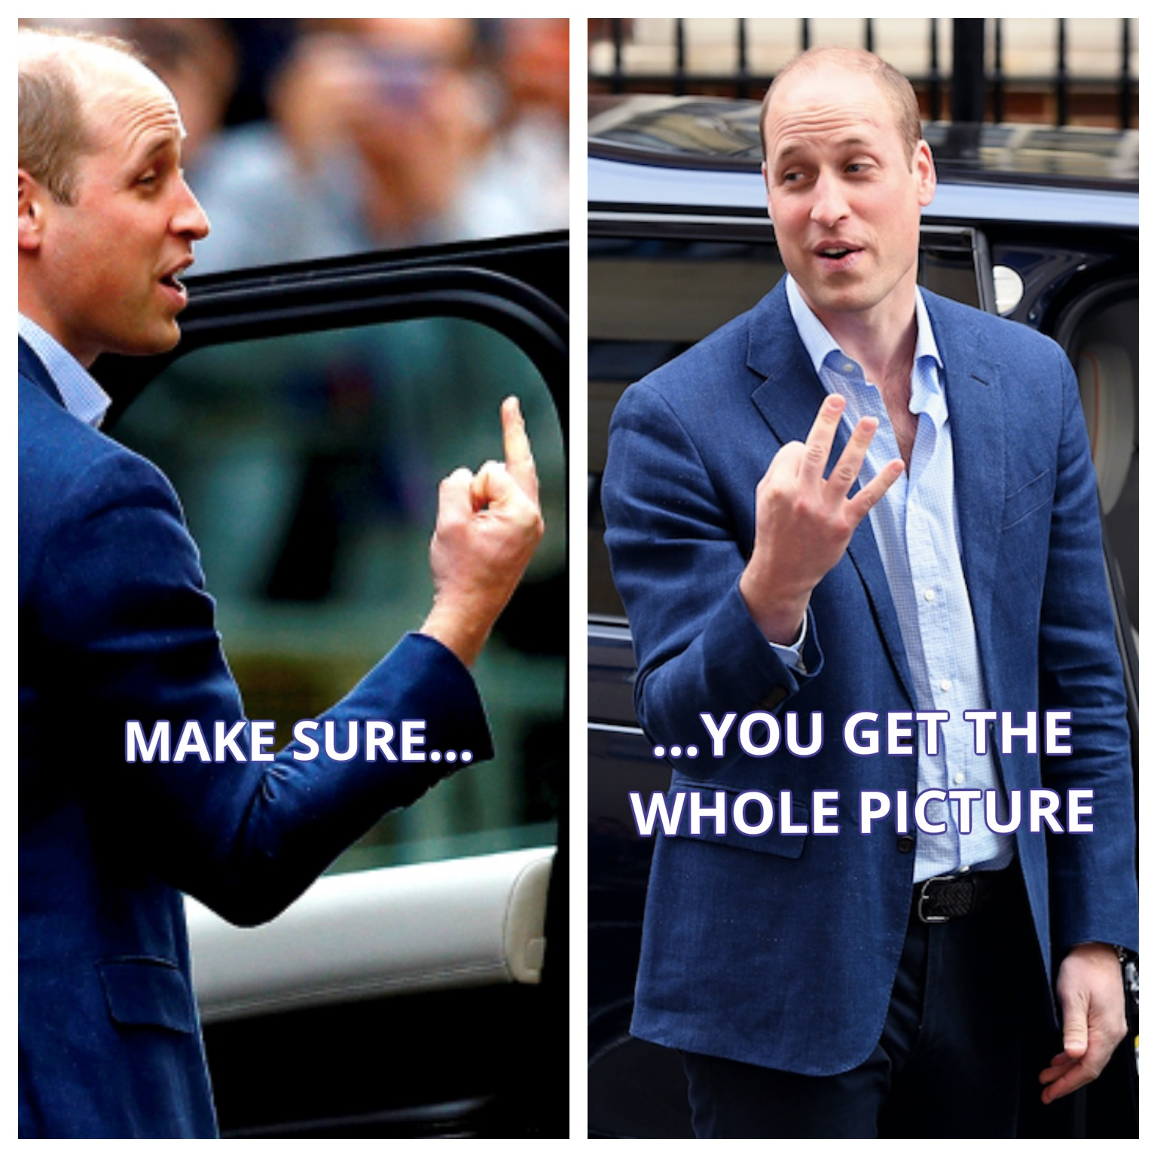

Slide 5


Slide 6
Session Goals
Define professional judgment (PJ) and discuss its significance
Review current statute and some areas where PJ may be exercised
Examples for group discussion

Slide 7
HEA Section 479A
Section 479A of the Higher Education Act of 1965 establishes the authority for the financial aid administrator (FAA) to exercise discretion in a number of areas when an applicant has special or unusual circumstances.

Slide 8
Definition of Professional Judgment
PJ is the discretion granted to financial aid administrators by law to override dependency status and make adjustments to need analysis, including data elements used to calculate the expected family contribution (EFC) and costs within the cost of attendance (COA) components.

Slide 9
Principles of Professional Judgment
All PJ decisions must be made on an individual, case-by-case basis
PJ policies and procedures should be in writing
PJ policies and procedures should provide a framework and guidelines for identifying circumstances that may trigger a PJ review
Documentation is key

Slide 10
Principles of Professional Judgment
The law does not:
Require you to apply PJ when you encounter special circumstances;
  However, recent DCL has “encouraged” use of PJ (See Gen-21-2)
Restrict your authority to exercise PJ in just those situations; or
Permit you to make across-the-board adjustments

Slide 11
Decision-Making Questions for PJ’s Include:
What constitutes special circumstances?
Is the student and/or family actually experiencing special
circumstances?
What documentation is needed?
a) institutional form
U of Nebraska Kearny example
b) supporting documentation
c) secondary review documentation for purposes of an audit

Slide 12
Common Areas of Professional Judgment
Dependency Status
Need Analysis
a) Loss of Employment
b) Divorce of dep student’s parents or indep student
c) Death of dep student’s parent or indep student’s spouse
Must set the PJ flag on ISIR when making PJ adjustments
Cost of Attendance
a) Unusual uncovered medical/dental expenses
b) Elementary or secondary school tuition for student’s siblings or dependents
c) Extraordinary dependent care expenses
Denial or Reduction of Federal Direct Student Loan or Direct PLUS
Direct Unsub Loan for Dependent Student Without Parental FAFSA Data

Slide 13
Dependency Status Adjustments
Financial aid administrator has PJ authority and responsibility
PJ decisions are made only in response to student’s unusual circumstances
Decisions must be based on adequate documentation
May only override dependency status from dependent to independent (not vice versa)
Determinations of homelessness, unaccompanied youth, etc. are NOT the same as dependency status adjustments

Slide 14
Case Study 1
Jan’s mother had AGI and income from work of $52,000 in 2020 but lost her job during 2020 due to the pandemic. She started a new job after a period of unemployment, but her 2021 AGI is $38,000. At this point, she expects to continue to work at her present job with similar income continuing into 2022. What would you do? What would you do if Jan’s mother had become unemployed again in January 2022?

Slide 15
Case Study 2
Emily is an incoming freshman at Private U. Private U is a small Christian college. Emily is the oldest of 6 children. Her family is eager for her to continue her faith formation while working towards a teaching degree at Private U. However, her family is nervous about assisting Emily with her college costs as her five younger siblings are currently enrolled in private Christian primary and secondary schools. Emily’s mother reaches out to Private U’s Financial Aid Office to discuss their financial situation and to see what options are available to assist Emily. What would you do?

Slide 16
Case Study 3
Our student, Alan, is seeking additional financial aid because he feels his medical expenses are excessive and creating hardship for his family. In 2020, Alan had $3550 in medical expenses that were paid out of pocket. He is married, has two children, and is the only member of his household in college, so his IPA is $41,420. The IPA calculation indicates that 11% of the IPA is intended for medical expenses. $41,420 X 11% = $4556. What would you do? What would you do if Alan’s medical expenses were $6000?

Slide 17
Case Study 4
Abby grew up on a farm in rural North Dakota where her parents raise cattle. She’s starting her Freshman year this fall at the community college studying Agriculture Technology. From year-to-year the family’s income can vary greatly based on the yield from their cattle. In 2020, her family had a great year on farm with good profits. But, this past year was a particularly brutal winter on the plains. Abby’s family lost half of their cattle herd in the great blizzard of 2021. She asks the financial aid office if they can use her family’s 2021 income instead of 2020, since they expect it to take a few years for their cattle herd to replenish. What do you do?

Slide 18
Case Study 5
Ahmed is a 2nd year student who does not meet any of the typical conditions to be considered independent. His parents are refusing to complete the FAFSA and are willing to sign a statement indicating that they have ceased providing financial support to the student. Ahmed wishes to be considered eligible for the Unsub Loan Only option. He has mentioned that his parents are still providing his health insurance because it doesn’t cost them anything extra to keep him on their group family insurance plan but they don’t provide any other financial support. His parents did provide their information on his FAFSA for his first year of college and he qualified for loans only that year. What do you do?

Slide 19
Case Study 6
Ivan’s a dependent student. His parents are seeking your help because they can no longer afford to help him with college expenses. His parents have provided an extensive breakdown of all their expenses, which include payments for recently purchases new boat, camper, and lake cabin. What would you do?

Slide 20
Case Study 7
Sarah is a third year student. Her parents made the painful decision to divorce and have been maintaining separate residences since April 2021. Her parent’s divorce will be finalized in summer 2022. When Sarah and her mother completed her FAFSA in October of 2020 her parents were married. Now that her parents are no longer together, she’s wondering if there are any options to help her and reaches out to her school’s financial aid office. What would you do?

Slide 21
Case Study 8
Independent student Tanner (single, no children) has experienced a loss of income which is impacting his household budget significantly. His AGI in 2020 was $100,000 but dropped to $80,000 in 2021. What would you do?

Slide 22
Case Study 9
Jake is a senior in high school living with Bob “dad” who is actually not legally his father. His bio mom was married to Bob but divorced him 2 years ago. Jake then lived with mom but moved back with Bob because mom was abusive and dealing with addiction issues. Jake moved out and back in with Bob and has been living with him ever since. What would you do?

Slide 23
Case Study 10
Ashley is a senior in high school who grew up living with her grandparents, but they didn’t adopt her or have legal guardianship. Her biological mother was sent to prison when Ashley was 2, and she never knew her bio dad. What would you do?

Slide 24
Case Study 11
Jose completed and submitted a FAFSA in spring 2021. His parents are divorced and he resided with dad throughout high school. Dad’s info was used on the FAFSA. In late spring, dad became ill and passed away. Student has contact with mom, but he hasn’t lived with her in the past and most support came from dad. What do you do?

Slide 25
Case Study 12
Harriet is in her third year of her undergraduate program and has not lived with her parents since she graduated from high school. She has been working and is supporting herself without assistance from her parents, including having health insurance through her own employer. She can document that she has been paying her own expenses and is “independent” and wants to be considered independent on the FAFSA. She has regular and typical contact with her parents. What would you do?

Slide 26
Audience Situations?
Tell us about your most challenging PJ situations

Slide 27
Resources
Chapter 5 Special Cases from the Application and Verification Guide
  Special-Cases.pdf (ed.gov)
NASFAA Monograph 26 Professional Judgment in Eligibility Determination and Need Analysis, July 2020
  Monograph 26: Professional Judgment in Eligibility Determination and Need Analysis (nasfaa.org)
NASFAA Professional Judgment Self Study Guide
FSA Verification Activity 2: Professional Judgment, Dependency Overrides and Homeless Youth Determinations
  Verification | Knowledge Center
FSA Professional Judgment Live Webinar recording March 9, 2022
  Course: Training Videos, Section: Student Eligibility (ed.gov)

Slide 28
Questions??

