Slide 1
Securing FA Data
2022 NDASFAA Spring Conference
Notes:
SB

Slide 2
Agenda
Introductions
General Security Best Practices
Financial Aid Data Security
  Definitions
  What governs us?
Resources
Notes:
SB

Slide 3
Introductions
Why did we choose this topic?
Caveat:
  We aren’t policy professionals
  We do not specialize in Data Security
  We do not know everything
  Products we mention
Notes:
SB
Do we know everything about securing FA data? No
Good basic knowledge, things change, important info for everyone to avoid negative consequences
We don’t look good in orange

Slide 4
General Security Best Practices
Notes:
SB

Slide 5
General Security Best Practices
DON’T
DO
Email sensitive information such as SSNs. This includes images that contain such data.
Use the same password for personal and work systems.
Click on links or open attachments from unknown sources.
Use home or mobile devices for work related items unless they are secured.
Store unneeded documents with sensitive information on your device.
Use secure file transfer systems to send sensitive information if necessary.
Save passwords in a safe and secure method, like a Password Safe/Vault
Be aware of scam or phishing emails
Keep all your personal and professional devices up to date with the latest software and anti-virus updates.
Keep documents with sensitive information in them in secure ways such as secure file shares and servers.
Notes:
SB
This is a very wordy slide but it’s some good dos and don’ts for you to refer to.

Slide 6

General Security Best Practices
Pop Quiz
Notes:
SB
Instead of going through the details of that we thought it would be more useful to test your knowledge.

Slide 7
Financial Aid Data Security
Notes:
SB

Slide 8
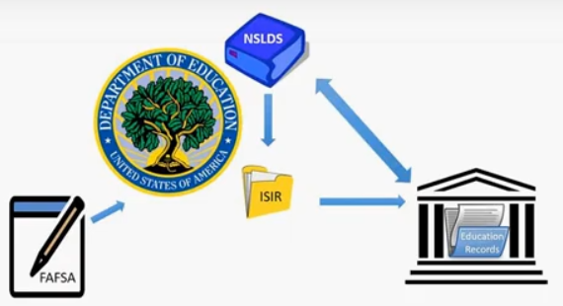
Types of FA Data
FAFSA Data / ISIR Data
Award Data
NSLDS Data
Notes:
SB
Three main types of FA data
FAFSA/ISIR data – provided by the student and has basic rules governing it
NSLDS data – provided by DOE and has more complex rules governing
Award data – created by the school using FAFSA and NSLDS data – has multiple levels of rules governing it
All part of the student's educational record
Flow of these records

Slide 9
What is “FAFSA Data”?
According to FSA and PTAC, “FAFSA data” include all of the following:
Whether or not the student has filed a FAFSA
All answers to the questions by the student and parent on the FAFSA
The ISIR and the SAR
Key processing results (such as C-Codes)
EFC
Student’s financial aid history as reflected with NSLDS
ISIR data to determine award eligibility, and the resulting awards and disbursement data
Federal Work-Study (FWS) awards and pay dates
Information in or sent to COD
Notes:
SB
NOTE: FAFSA Data includes NSLDS Data but NSLDS Data has some of its own regulatory controls.

Slide 10

What is PII?
Personally Identifiable Information (PII)
Information that can be used to identify the individual.
De-Identification = the removal of PII
Notes:
SB
FERPA’s definition of PII includes any information that, alone or in combination, is linked or linkable to a specific student that would allow a reasonable person in the school community to identify the student with reasonable certainty

Slide 11
What governs us?
Federal
State
Institutional/Organizational
Departmental

Slide 12
Institutional and Departmental
Policies and Procedures

Slide 13
State
ND State Board of Higher Education Policy 1202.3
  1203.7 NDUS Data Classification and Information Security Standard

Slide 14
Federal
Family Educational Right and Privacy Act (FERPA)
Higher Education Act (HEA)
Privacy Act
Student Aid Internet Gateway (SAIG) Agreement
Notes:
Note: Where multiple laws may apply, the stricter provision applies

Slide 15
FERPA
Education records may be disclosed in connection with financial aid for which the student has applied or which the student has received, if the information necessary for such purposes as to:
Determine eligibility for aid
Determine the amount of the aid
Determine the condition for the aid
Enforce the terms and conditions of the aid
Notes:
FERPA: Applies to all institutions receiving Federal funds under any program administered by the Secretary of Education and gives parents and eligible students rights to access to their educational records. It also protects personally identifiable information (PII) from the educational record from unauthorized disclosure. Requires written consent before sharing PII, unless exception applies (such as for audits, evaluations, third-party vendors)

Slide 16
Higher Education Act (HEA)
Applies to both FAFSA/ISIR Data but applies additional provisions on NSLDS Data
“FAFSA/ISIR data, and any data derived from FAFSA/ISIR data (including data in the NSLDS) may only be used for the application and administration of aid awarded under Federal student aid programs, state aid, or aid awarded to eligible institutions..”
HEA prohibits nongovernmental researchers or policy analysts from accessing PII from NSLDS. It also prohibits the use of NSLDS data for marketing purposes.
  Can be de-identifiable data.
Notes:
“Administration of aid” includes audits and program evaluations

Slide 17
Privacy Act
Governs the collection, maintenance, use, and disclosure by federal agencies of records contained in their systems.
This includes have proper safeguards for ensuring security and confidentiality of these records.
  This is done through the SAIG Agreement
Generally, prohibits federal agencies from disclosing records from their systems without written consent, unless it is for statistical research or reporting purposes and is not individually identifiable.
Notes:
In cases where the institution seeks to disclose student financial aid data that was obtained directly from a system of records of the Department to another entity for statistical research purposes, the disclosing entity (e.g., the institution) must provide the Department with a written assurance that the data obtained from the Department’s system of records have been properly de-identified, and the receiving entity (e.g., the researcher) must provide the Department with a written assurance that the data will only be used for statistical purposes. These written assurances must be sent to PTAC (at PrivacyTA@ed.gov) before an institution discloses an individual student’s financial aid data obtained directly from a system of records of the Department to another entity for statistical research purposes without the student’s written consent.

Slide 18
Student Aid Internet Gateway (SAIG)
Agreement
The SAIG allows authorized entities to exchange data electronically with the Department. This is a contractual agreement between the department and the institution receiving financial aid.
“Access, disclosure, and use of data is limited to ‘authorized personnel.’”

Slide 19
Let’s test your knowledge!

Slide 20
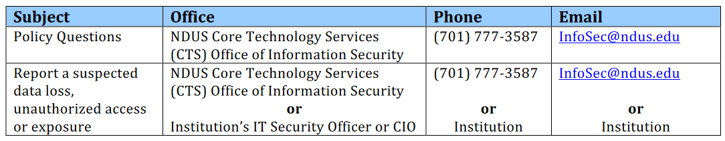
Resources
Privacy Technical Assistance Center- https://studentprivacy.ed.gov
  Guidance on the Use of Financial Aid Information for Program Evaluation and Research
NASFAA
  Data Sharing Decision Tree
NDUS – Core Technology Services (CTS) Office of Information Security

Slide 21
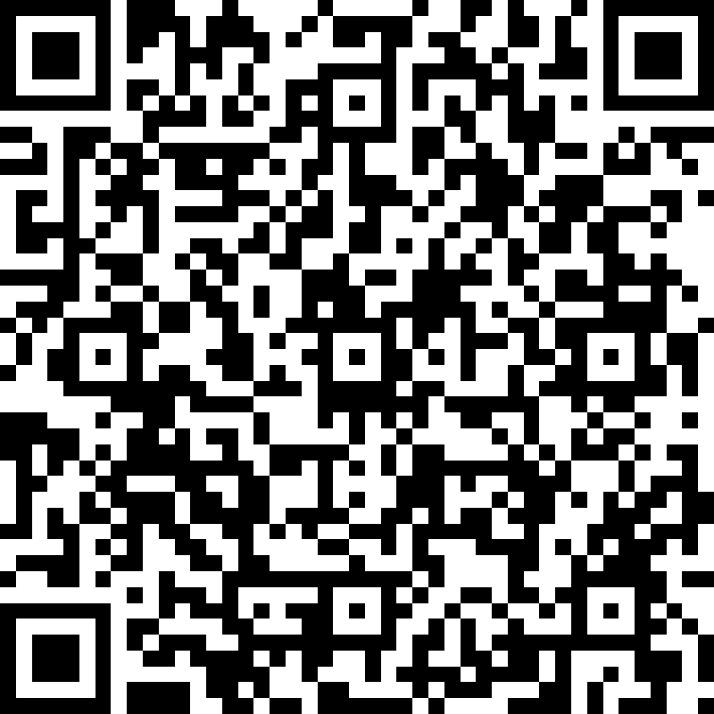
Survey

