Slide 1
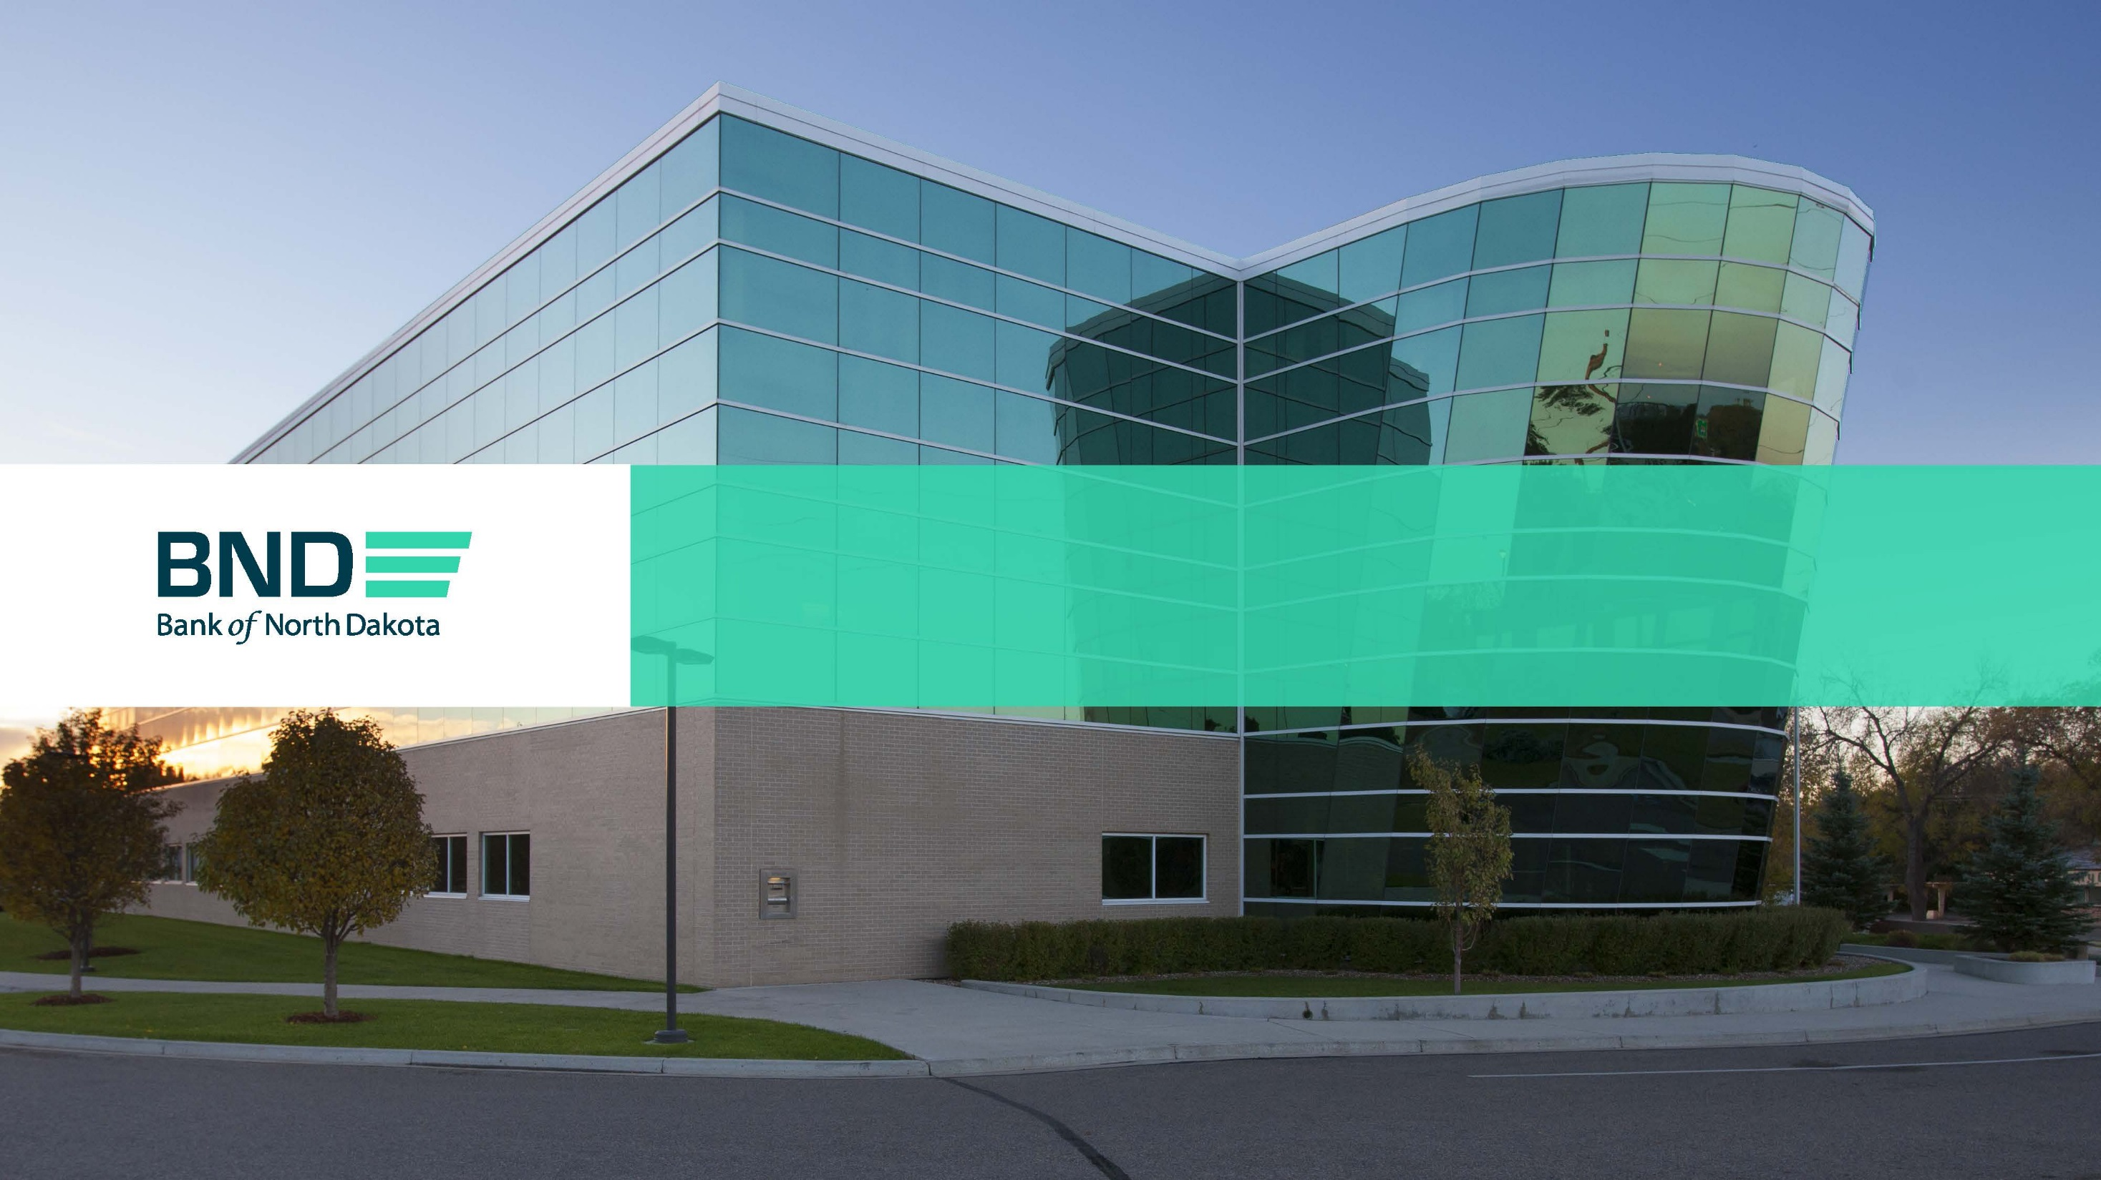
BND Update to NDASFAA – March 2023

Slide 2
History
Offered the first federally insured student loan in the U.S. in 1967
Continued to offer a successful program of federal student loans through 2010. Servicing continued until selling the federal portfolio in 2018.
Started the DEAL (Dakota Education Alternative Loan) in 1997
Created the DEAL Consolidation programs in 2007, expansion in 2014

Slide 3
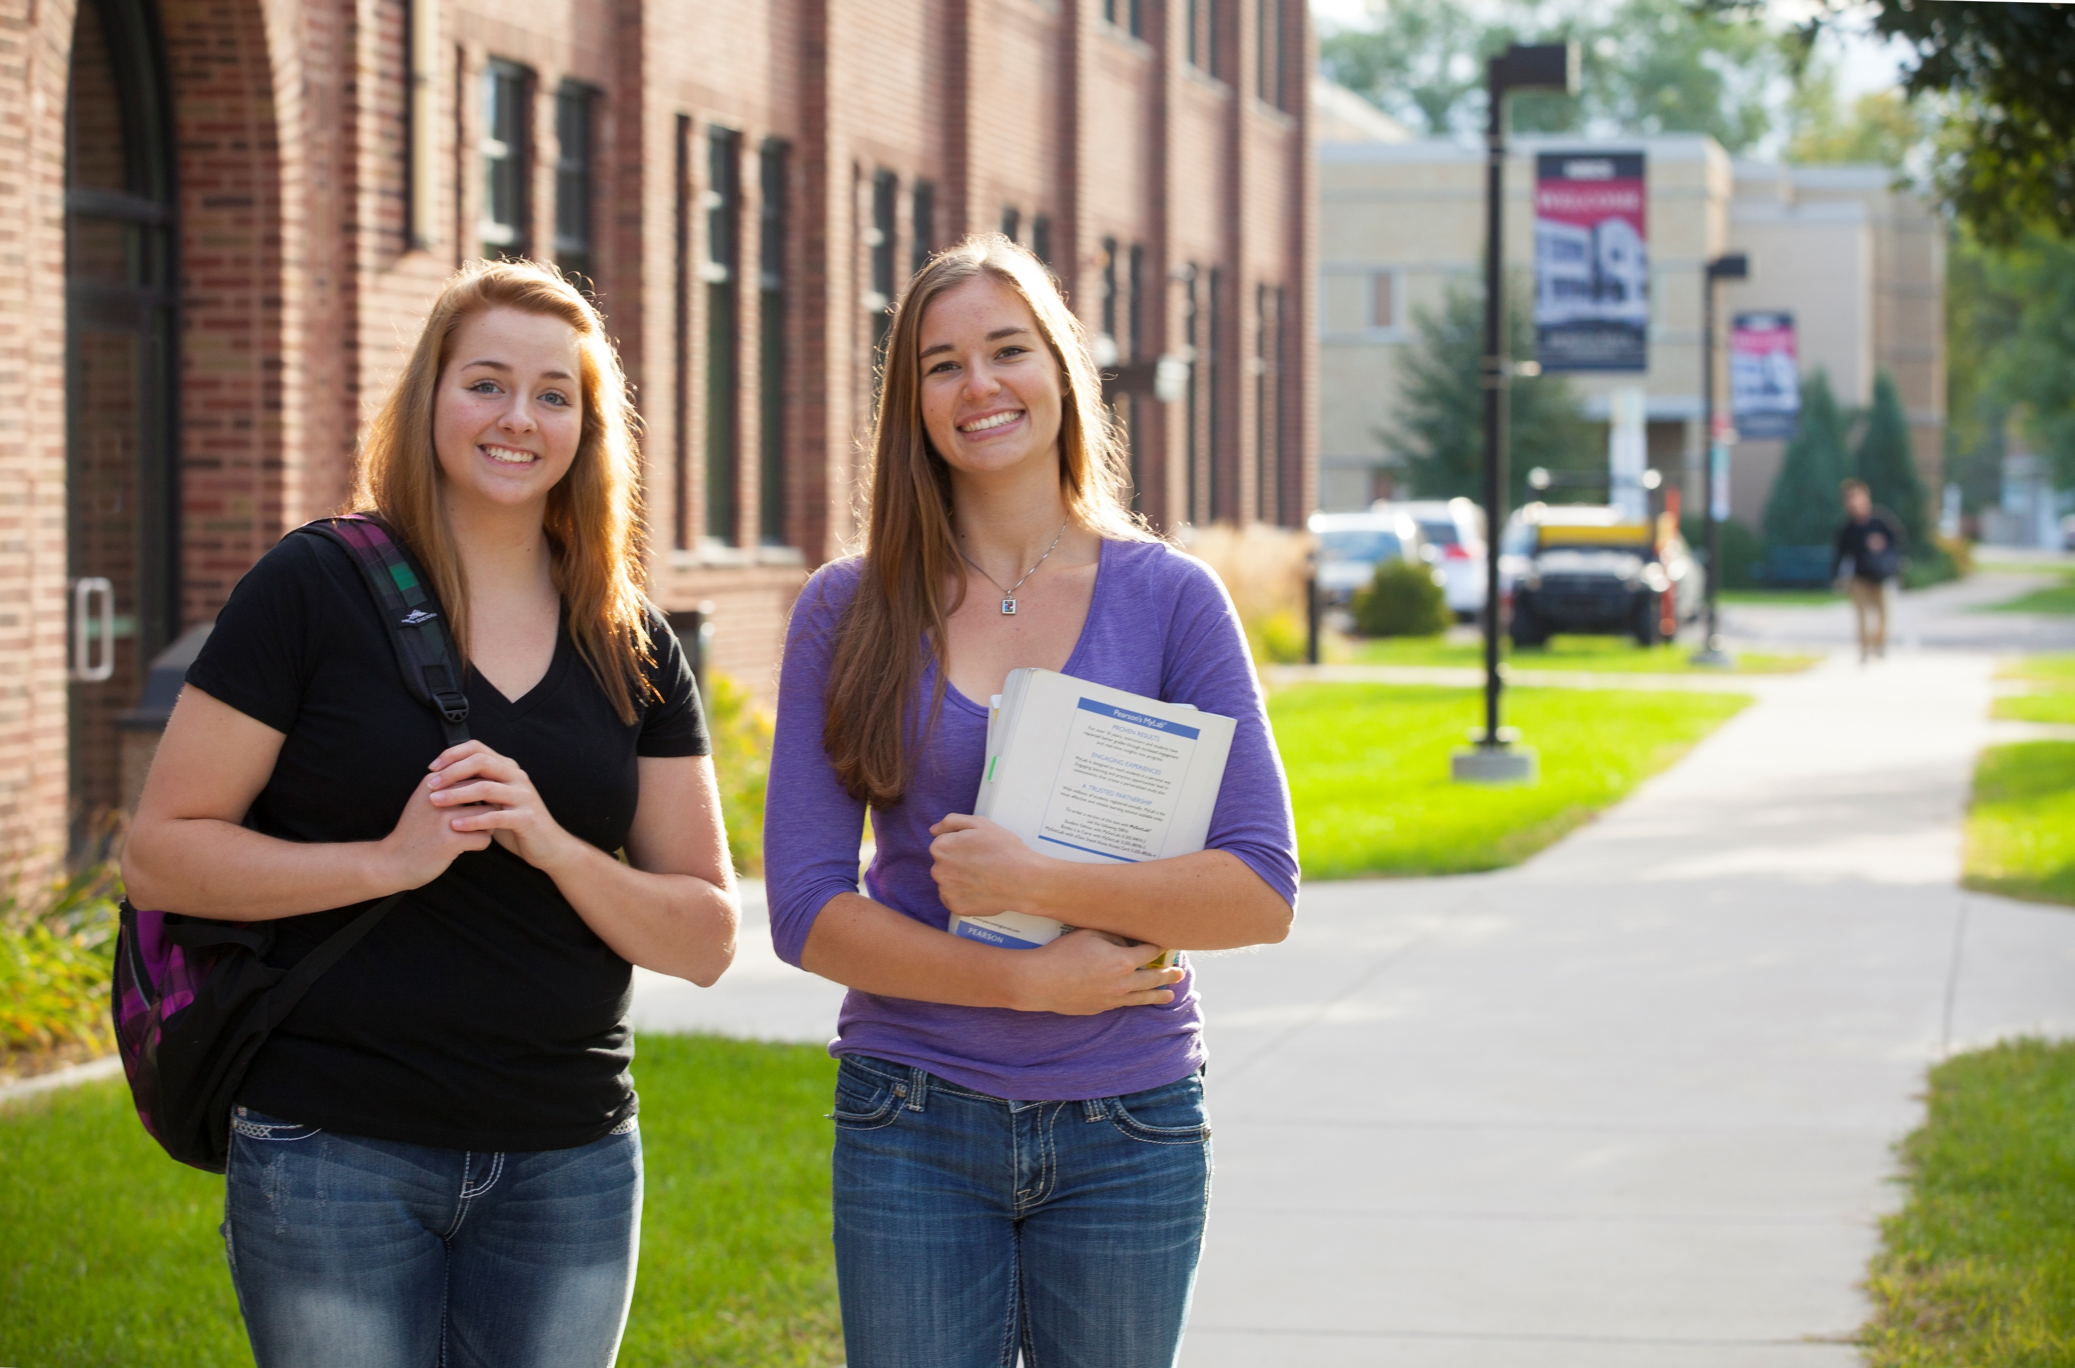
Current BND Student
Loan Portfolio
Loan portfolio is $1.1 Billion
  In School – $619 Million
    ~79,000 loans
  Consolidation – $495 Million
    ~13,000 loans
73,000+ borrowers and cosigners served by BND
  ND Residents or Students of ND Schools encompass nearly 70%
Average borrower balance
  In School - $19,631
  Consolidation - $40,248
BND disbursed $82 million in 2022

Slide 4
Current Programs and Rates
DEAL, DEAL Consolidation and DEAL One
ACIL (Addition Counselor Internship Loan) program created in 2015
CEAL (Career Education Alternative Loan) program created in 2020
Program | In State | Out of state
DEAL DEAL One Consolidation DEAL Consolidation CEAL | 6.29% Fixed 6.29% Variable | 7.29% Fixed 7.29% Variable
Addiction Counselor Internship | 6.00% Variable | N/A
Rates effective April 1, 2023

Slide 5
Financial Literacy – Be Confident
Financial preparedness and how to pay for college continues to be a concern for borrowers
BND supports utilizing grants and scholarships first, savings, and federal loans
  BND can help close the gap that remains
Launched our Be Confident campaign this fall
  bnd.nd.gov/confident
  Includes resources on determining how much debt you should take on, how student loans work, career discovery tools, and financial basics

Slide 6
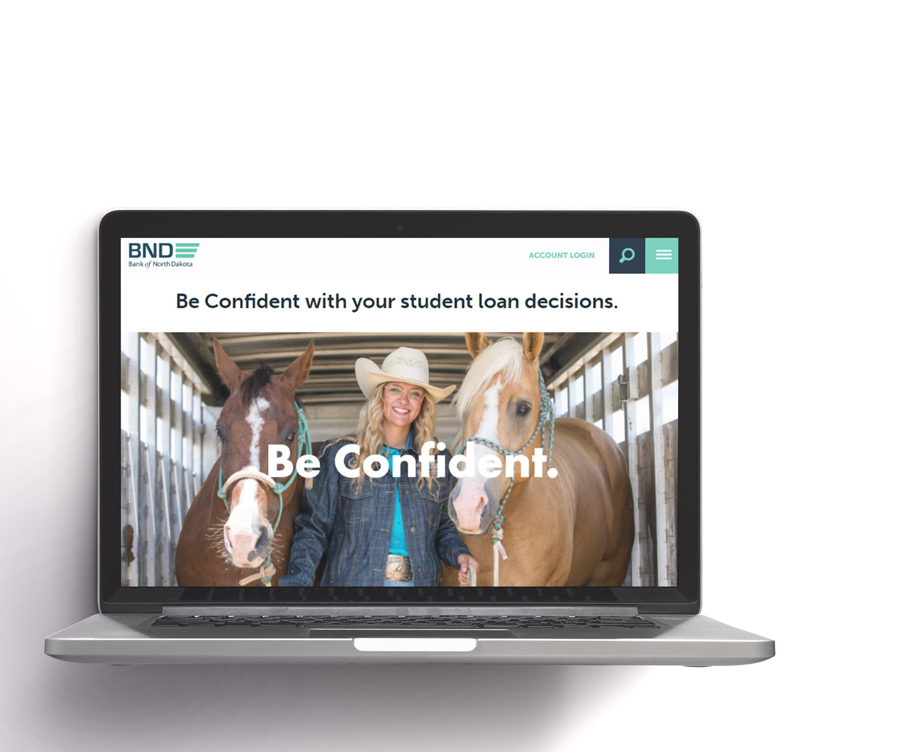


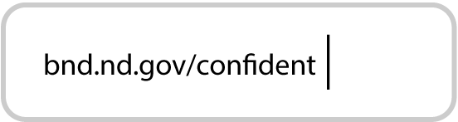
Be Confident Visuals

Slide 7

North Dakota Dollars for Scholars
NDDFS is a 501(c)3 organization administered by Bank of North Dakota dedicated to creating scholarship opportunities.
Funding for scholarships comes from generous donors around the state
Scholarships are available for high school seniors AND current college students who graduated from a North Dakota high school
In 2023, NDDFS will award slightly over $215,000 in scholarships to students in North Dakota!
NDDFS scholarships are open from January 1-April 1.
  Local chapters may have different deadlines.

Slide 8
College SAVE
State’s 529 plan
$25 to open an account
  Can open an account for your own or other children
  Can open an account for children living in or out of state
  Qualified contributions may be used for in and out of state colleges
Match programs
  New Baby Match: $200 for every newborn in ND when account opened by 1 year of age
  BND Match: $300 match based on income requirements
    $150,000 or below MFJ AGI / $100,000 or below Single AGI
  Kindergarten Kickoff Match: $100 for 5 – 6-year-olds in North Dakota
    New and existing account owners are eligible

Slide 9

Questions?
Education Market Leadership
Josiah Rauser, Leader of Student Loan Customer Service
  701.328.5762 jrauser@nd.gov
Tyler Giffey, Leader of Quality Assurance
  701.328.5868 tgiffey@nd.gov
Jerrett Grimes, Leader of Origination
  701.328.5709 jgrimes@nd.gov
Jennifer Bickel, Leader of Processing
  701.328.5726 jenbickel@nd.gov
Cindy Sanford, Leader of Education Outreach
  701.328.5792 cindysanford@nd.gov
James Barnhardt, College SAVE Director
  701.328.5882 jbarnhardt@nd.gov
Lance Hill, Financial Literacy Coordinator
  701.328.5619 lrhill@nd.gov
Kelvin Hullet, Chief Business Development Officer
  701.328.5689 klhullet@nd.gov

