Slide 1


FAFSA Simplification
Catherine Mueller
March 2023

Slide 2
Agenda
Introduction to FAFSA Simplification
Changes
Impact
Issues
New process and schedule for implementation
Need Analysis
2

Slide 3

Disclaimer
The goal of this presentation is to provide accurate and up-to-date information on FAFSA Simplification. However, it should be noted, that not all guidance has been issued. This information in this presentation is subject to change and is not legal advice or guidance on policy implementation.
3

Slide 4
Two Major Changes
Need Analysis
Process

Slide 5

Changes
Biggest change to the FAFSA in decades
Streamline the application and needs assessment
  Shorter form
  Enhanced data sharing with IRS
  EFC becomes SAI
  Predictability for Pell Grant eligibility
  Change in income and assets
More students eligible for need-based aid
  Will some no longer be eligible?
5

Slide 6

Need for simplification
Length and complexity of the FAFSA
Students discouraged from applying for aid and pursuing postsecondary education
Lack of transparency and predictability
6

Slide 7

When will the
new simplified
FAFSA for 2024-25
be released?
December XX, 2023

Slide 8
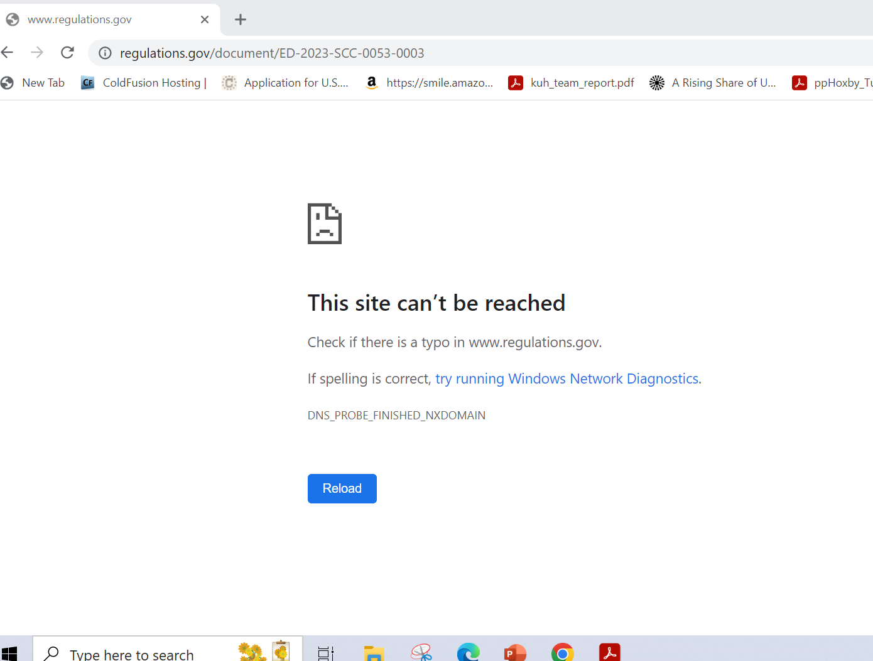
Comments on new FAFSA
Deadline to submit comments is May 23
https://www.regulations.gov/document/ED-2023-SCC-0053-0003

Slide 9

Process
SAR becomes the FAFSA Submission Summary
Elimination of the save key
Removal of ability to access a FAFSA form through student personal identifying information (PII)

Slide 10
Process
Limited skip logic
Consent required for Federal Tax Information (FTI)
List of colleges expanded (up to 20 on online form now)
Elimination of the Data Retrieval Tool

Slide 11
Process
Collection of spouse information and use of roles (student, student spouse, parent, parent spouse, preparer)
Unusual circumstances and special circumstances definitions aligned with Higher Education Act

Slide 12
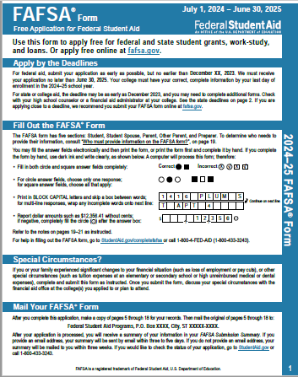
FAFSA Scenario
Scenario 1: Dependent Non-filer with 2 parents who are MFJ and FTI was obtained
Note: This scenario outlines the FAFSA® form web experience for a dependent student (who didn’t file a tax return) with married parents who filed their income taxes together and for whom we were able to get tax information from the IRS.

Slide 13
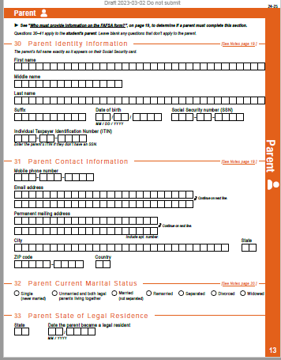
Determing the parent
“Who’s My Parent Wizard” view: this view helps the student identify which parent(s) to invite to their FAFSA using a combination of questions.
Invite Parent view: Student provides their parent(s) identity and contact information so that the system can email the parent(s) an invitation to access the FAFSA form.
  First name
  Last name
  Date of birth
  Social Security number
  Email address
Who is considered a legal parent on the FAFSA form?
Legal parents are biological or adoptive (regardless of gender), or as determined by the state (for example, if the parent is listed on the birth certificate). Grandparents, foster parents, legal guardians, widowed stepparents, aunts, uncles, and siblings are not considered parents on this form unless they have legally adopted the student.
Which parent should include information?
information in the Parent section, and the Other Parent section should be skipped.
Contact 1-800-433-3243 for assistance completing questions 30–46 or visit StudentAid.gov/fafsa-parent.
• If the parents are divorced or separated, answer the questions about the parent who provides the greater portion of the student’s financial support, even if the student does not live with them. If this parent is remarried as of today, answer the questions about that parent and the stepparent.
• If the student’s widowed parent is remarried as of todayIf the student’s parent was never married and does not live with the student’s other legal parent, or if the parent is widowed and not remarried, that parent should only provide their own,

Slide 14
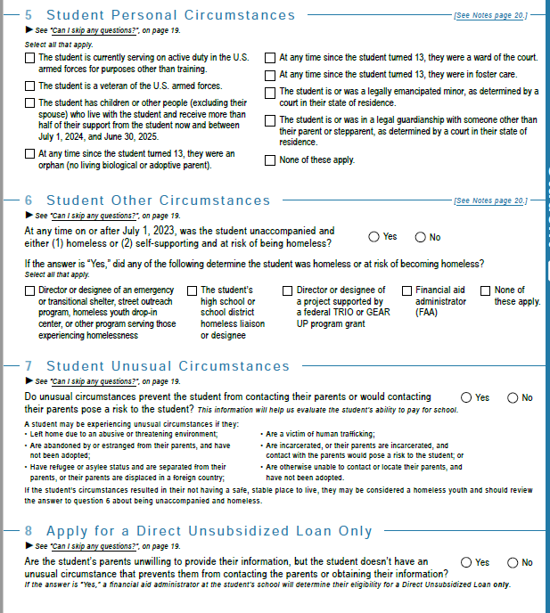
Student Status
Dependency
Special or unusual circumstances
Unsubsidized Loan Only option

Slide 15

FADDX (DDX) to replace DRT
Future ACT requires reliance on tax return information
FADDX – Future Act Direct Data Exchange
Specifies what the IRS can disclose
Changes the income information included on the FAFSA and changes the calculation
Authorization must be granted
Department and IRS still making decisions on how the process is going to work.
15

Slide 16

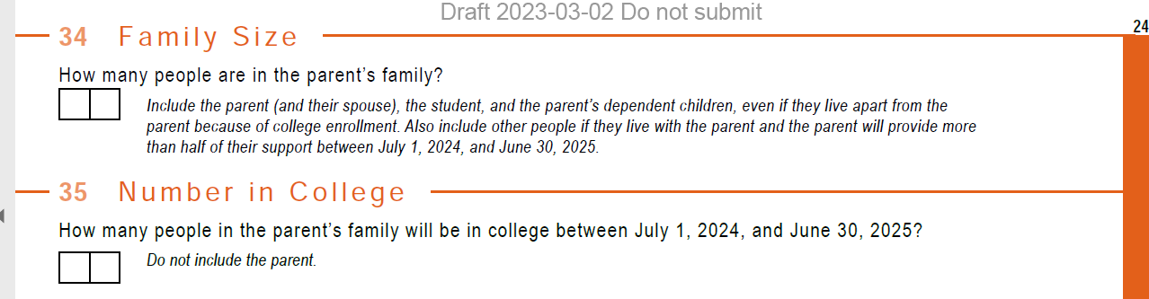
Family Size
Number in College

Slide 17
ASSET REPORTING
Criteria to exempt some students/families from asset reporting modified:
AGI threshold increases to 60,000
No schedules filed or only with certain parameters
Exemption based on federal means-tested benefit to continue
Asset changes
Child Support
Net worth of family farms and small businesses
17

Slide 18

Investment value
Investment value means the current balance or market value of these investments as of today. Investment debt means only those debts that are related to the investments.
Business and/or investment farm value includes the market value of land, buildings, machinery, equipment, inventory, etc. Business and/or investment farm debt means only those debts for which the business or investment farm was used as collateral.

Slide 19

NUMBER IN COLLEGE
Number in college eliminated as a factor
Parent contribution portion no longer divided when two or more children are in college at the same time.
Decrease aid eligibility for middle and high-income students
19

Slide 20

FSA ID
New FAFSA/FSA ID will have roles:
  Student
  Student Spouse
  Parent
  Parent Spouse
  Preparer
New consent requirements
  FSA ID is required to provide that consent
  Consent is necessary to pull data directly from IRS
  Spousal consent is needed when parents file MFS but not when MFJ
20

Slide 21

NEED ANALYSIS

Slide 22

Student
Aid Index
Needs fewer formula factors
Requires less information
More data imported from IRS
Generally, same procedure for calculations
22

Slide 23

STUDENT AID INDEX
Determining award amounts with SAI
  Maximum Pell
  Minimum Pell
  Based on SAI
SAI can be a negative number
23

Slide 24

FINANCIAL FACTORS
Some untaxed income no longer considered
  Reduces the amount of information a family must provide
  No longer considered will be cash support or any money paid on the student’s behalf
Other income categories eliminated
  Federal education tax benefits only type required to be reported
Income Protection Allowance
Number in college
Assets
24

Slide 25
STUDENT AID INDEX – MAXIMUM PELL
Non-tax filers
Single-parent filers whose AGI is < 225% of poverty line
Non-single student or parent filers whose AGI is < 175% of poverty line
Students eligible for maximum Pell Award (based on AGI) qualify for Auto-Zero SAI – unless calculated SAI is negative.
25

Slide 26
STUDENT AID INDEX – MINIMUM PELL
Minimum Pell Award for Dependent Students
  Parent is a single parent whose AGI is < 325% of poverty line
  Parent is a non-single parent whose AGI is < 275% of poverty line
Minimum Pell Award for Independent Students
  Student is a single parent whose AGI is < 400% of poverty line
  Student is a non-single parent whose AGI is < 350% of poverty line
  Student is a non-parent whose AGI is < 275% of poverty line
26

Slide 27
PELL GRANT BASED ON SAI
Pell Grant calculation for student ineligible for maximum Pell:
  Pell Grant award = maximum Pell award – SAI (rounded to the nearest $5)
  Negative SAI counts as zero
  Pell Grant award = $0 when as result of the calculation the amount is < minimum Pell award – unless the student qualifies for auto-minimum Pell award
  Minimum Pell award = 10% of total maximum Pell amount
27

Slide 28

NEW FORMULA
COA – SAI – OFA = Need
New formula of
COA – SAI – OFA = Need
(OFA is Other Financial Assistance)
will replace current formula of
COA – EFC – EFA = Need
28

Slide 29
PARENT INFORMATION
Dependent students with married parents
Student will report information on the parent who provides the greater portion of the student’s financial support
Dependent students with remarried parent
Students will continue to provide information about parent and stepparent
Unable to provide parent information
ED to establish procedures where household size not accurately reflected
Dependent students with divorced or separated parents
Students will provide information about both parents
Students will receive a provisional SAI
Family size will be determined by the tax return
29

Slide 30
INCOME PROTECTION ALLOWANCE (IPA)
Increased with FAFSA Simplification
Reduces the amount of income considered in calculating SAI
Streamlined across number of dependents
For parents of dependent students – IPA levels increased about 20% above current levels
For students – IPA levels increased about 35% above current levels
Independent students
Without dependents – IPA levels increased about 35% above current levels
With dependents:
Married – IPA levels increased about 35% above current levels
Single – IPA levels increased about 60% above current levels
30

Slide 31

IMPACT ON INSTITUTIONS
Awarding policies
  Institutional funds
    Pell eligibility or percent of financial need
Communications and Outreach
  New Cost of Attendance rules
Professional judgment policies
Financial aid budgets
  Analyze past data
  Analyze possible funding needs
    Increase budget
    Adjust packaging policies
31

Slide 32

Communication to Students and Families
Mapping Your Future is developing a strategic communications plan to inform students and families.
  Printed materials
  Presentations
  Recordings
  Website

Slide 33

ISSUES
Can the changes be implemented in time for the 2024-25 FAFSA?
When will guidance be issued?
What will be the impact on students who lose Pell eligibility?
Will institutions be expected to help those students with institutional funding?
33

Slide 34

DISCUSSION
34

Slide 35

THANK YOU
Contact us at:
(800) 374-4072
feedback@mappingyourfuture.org
MappingYourFuture.org

