Slide 1
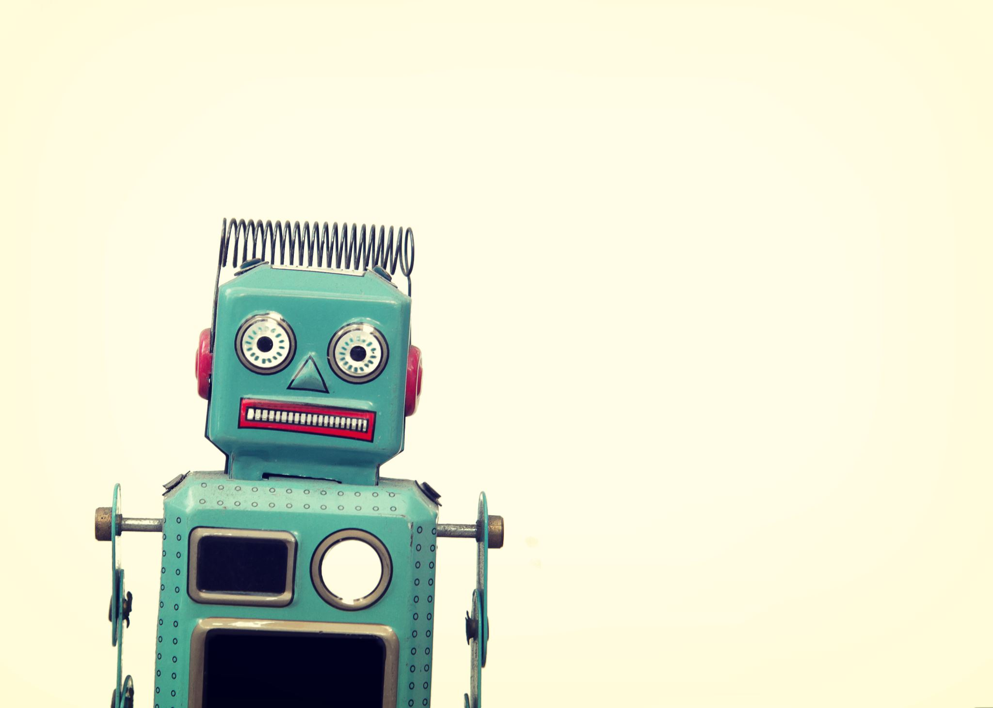

GENERATIVE AI –
THINGS WILL BE GREAT.
WELL, MAYBE.
Catherine Mueller
March 2023

Slide 2
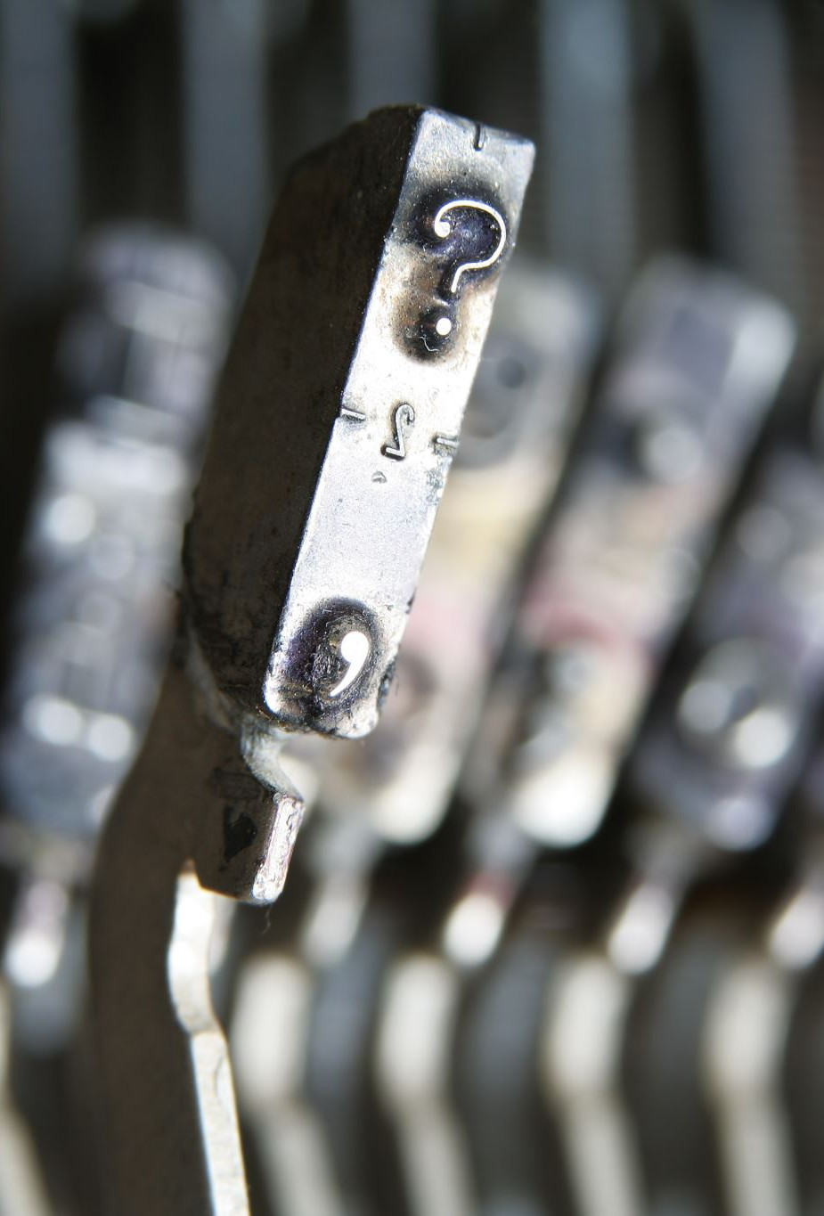
IN the News
Why We're Obsessed With the Mind-Blowing ChatGPT AI Chatbot – CNET
ChatGPT Bing’s wild side: Times when Microsoft’s AI got a little too crazy with users – the Financial Express
Top 10 Most Insane Things ChatGPT Has Done This Week – Springboard
The Brilliance and Weirdness of ChatGPT – The New York Times
OpenAI's new ChatGPT bot: 10 dangerous things it's capable of – Bleeping Computer
Bing's AI Is Threatening Users. That's No Laughing Matter – TIME
The new Bing is acting all weird and creepy — but the human response is way scarier – Business Insider

Slide 3
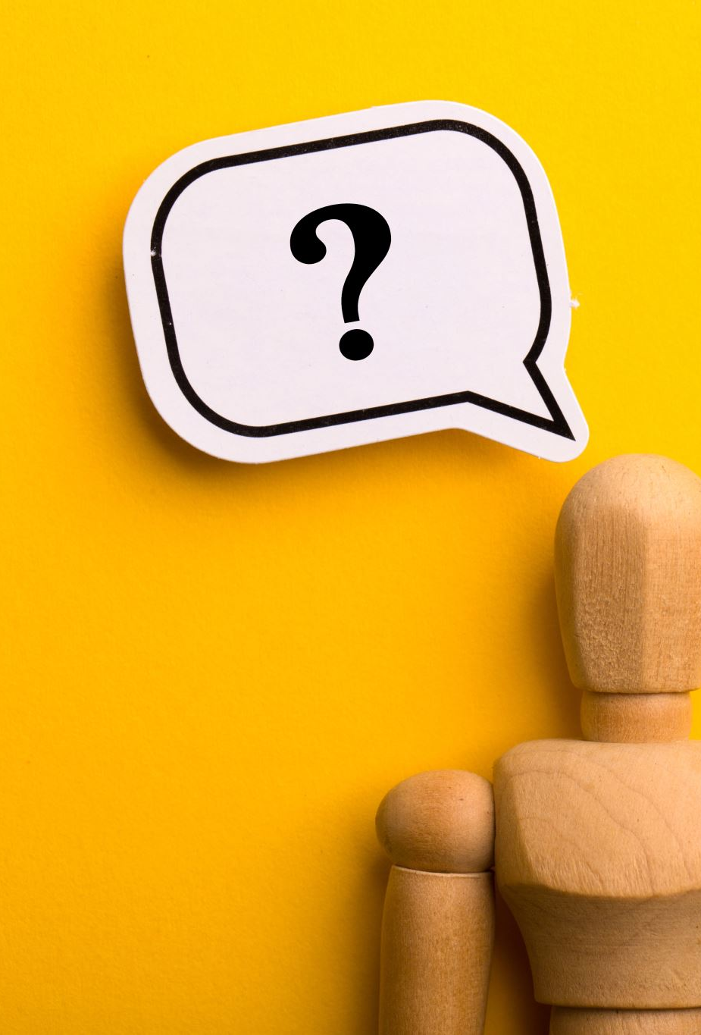
What is generative AI?
Generative Artificial Intelligence
Generates all types of content – text, images, and other media
Builds on past technology
Makes artificial intelligence easier to employ
Can increase productivity
Creates several ethical concerns

Slide 4

AI is Not New
Birth of AI: 1950-1956
This range of time was when the interest in AI really came to a head.
Alan Turing published his work “Computer Machinery and Intelligence” which eventually became The Turing Test, which experts used to measure computer intelligence.
The term “artificial intelligence” was coined and came into popular use.
-Tableau https://www.tableau.com/data-insights/ai/history

Slide 5
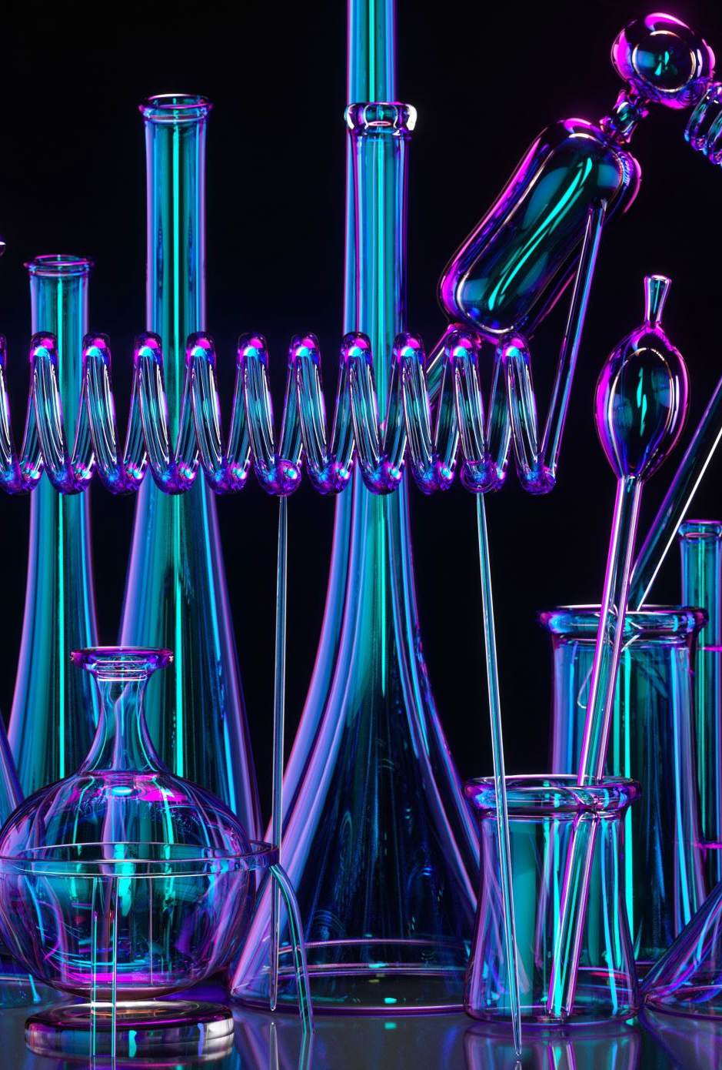
Generative AI Tools
DALL·E 2
  DALL·E 2 is an AI system that can create realistic images and art from a description in natural language.
ChatGPT
  A trained model, which interacts in a conversational way. The dialogue format makes it possible for ChatGPT to answer follow-up questions, admit its mistakes, challenge incorrect premises, and reject inappropriate requests.
Bard
  Bard seeks to combine the breadth of the world’s knowledge with the power, intelligence and creativity of our large language models. It draws on information from the web to provide fresh, high-quality responses.
And many more!

Slide 6

How can it be Used?
Implementing chatbots for customer service and technical support.
Deploying deep fakes for mimicking people or even specific individuals.
Improving dubbing for movies and educational content in different languages.
Writing email responses, dating profiles, resumes and term papers.
Creating photorealistic art in a particular style.
Improving product demonstration videos.
Suggesting new drug compounds to test.
Designing physical products and buildings.
Optimizing new chip designs.
Writing music in a specific style or tone.
Source: https://www.techtarget.com/searchenterpriseai/definition/generative-AI

Slide 7

Content
Created after user inputs keywords, phrases or topics:
Articles
Press releases
Blogs
Videos
Illustrations

Slide 8
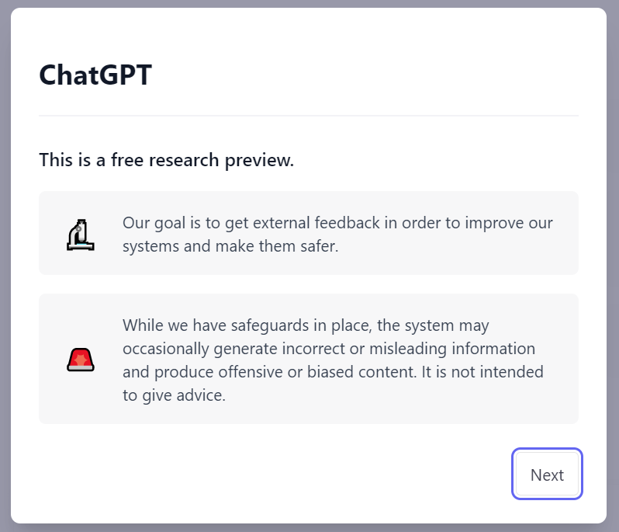

Caution

Slide 9

Ethical issues
Unknown Capabilities
Bias and Toxicity
Data Leakage
Hallucination
Lack of Transparency
Copyright Controversies
https://www.bcg.com/x/artificial-intelligence/generative-ai

Slide 10
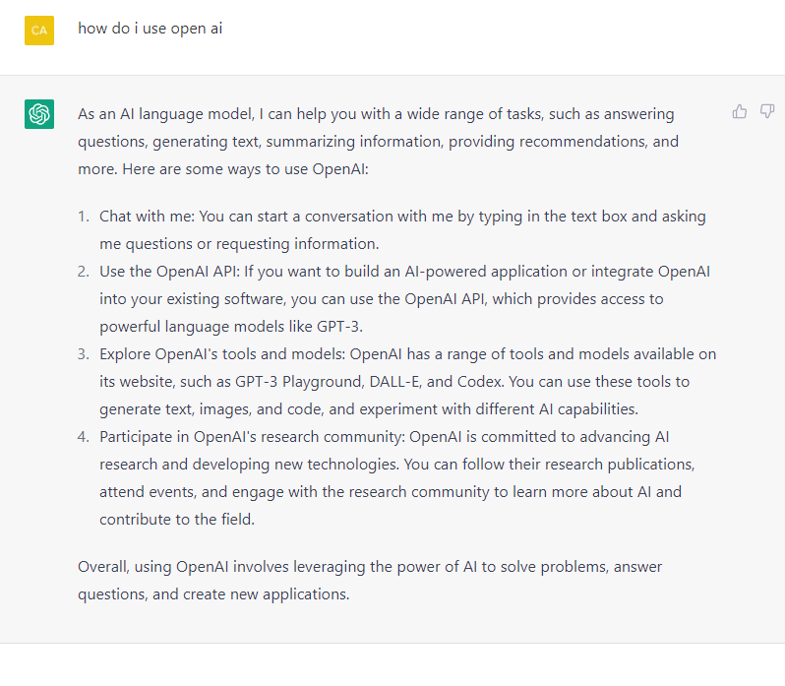
What can it do for me?
Someone to talk to
Build applications
Explore tools and models
Participate in research

Slide 11


What can AI Do for Financial aid?

Slide 12
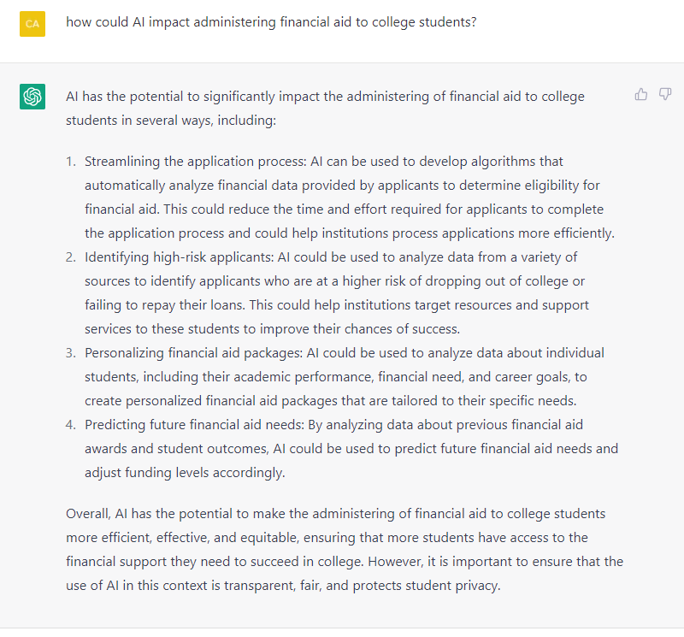
Financial Aid and AI
Streamline the application process
Identify high-risk applicants
Personalize financial aid packages
Predict future financial aid needs

Slide 13
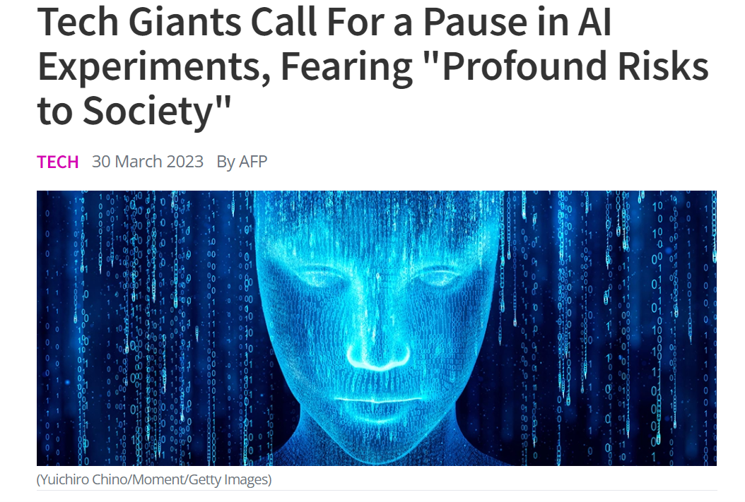
News
“An open letter, signed by more than 1,000 people so far including Musk and Apple co-founder Steve Wozniak, was prompted by the release of GPT-4 from Microsoft-backed firm OpenAI.”
https://www.sciencealert.com/tech-giants-call-for-a-pause-in-ai-experiments-fearing-profound-risks-to-society

Slide 14
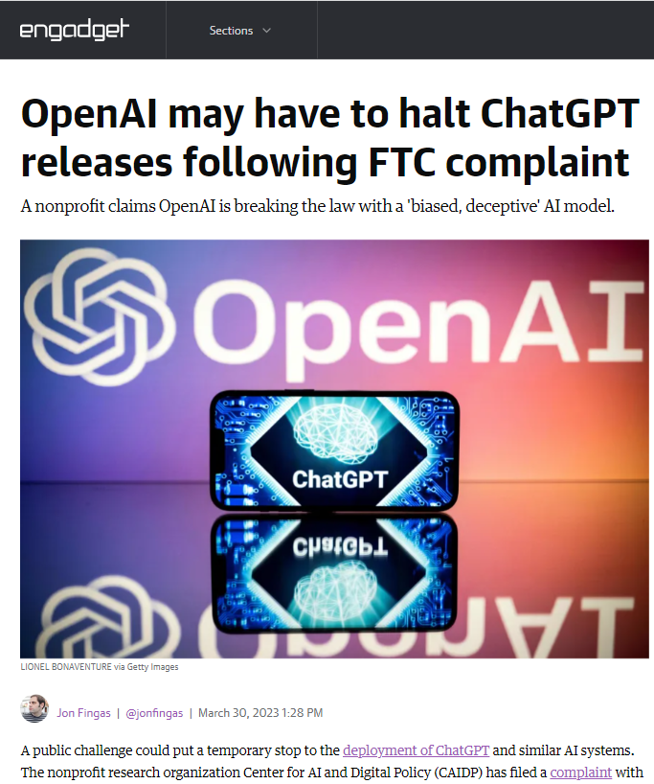
NEWS
“A public challenge could put a temporary stop to the deployment of ChatGPT and similar AI systems. The nonprofit research organization Center for AI and Digital Policy (CAIDP) has filed a complaint with the Federal Trade Commission (FTC) alleging that OpenAI is violating the FTC Act through its releases of large language AI models like GPT-4. That model is "biased, deceptive" and threatens both privacy and public safety, CAIDP claims. Likewise, it supposedly fails to meet Commission guidelines calling for AI to be transparent, fair and easy to explain.”
https://www.engadget.com/openai-may-have-to-halt-chatgpt-releases-following-ftc-complaint-172824646.html

Slide 15

Discussion and Demo
Have you tried AI?
What are the benefits?
What are the risks?
What is the potential?
Are you concerned about the ethics of AI?

Slide 16
Sources
How generative AI is changing creative work Harvard Business Review https://hbr.org/2022/11/how-generative-ai-is-changing-creative-work
36 AI content generators to explore in 2023 Tech Target https://www.techtarget.com/whatis/feature/AI-content-generators-to-explore
The 6 best alternatives to ChatGPT https://www.makeuseof.com/best-alternatives-chatgpt

Slide 17
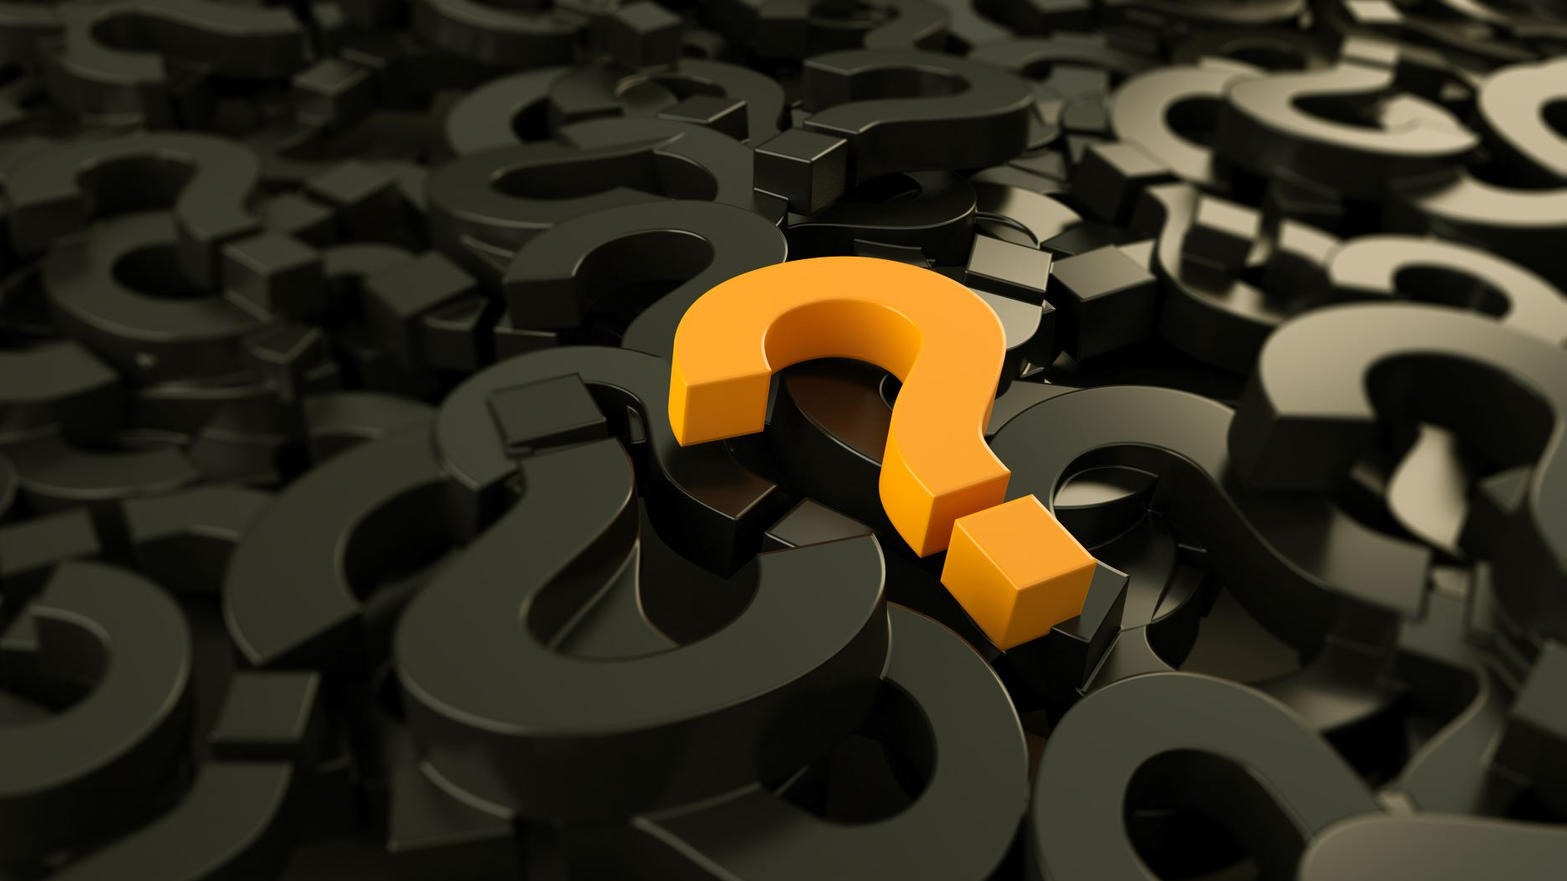
DISCUSSION
17

Slide 18

THANK YOU
Contact us at:
(800) 374-4072
feedback@mappingyourfuture.org
MappingYourFuture.org
18

