Slide 1
Big changes are coming….it’s time to prepare now!
Presented by:
Brad Barnett, MS, AFC®, CPFM, FAAC®
Associate Vice President for Access & Enrollment Management
Director of the Office of Financial Aid & Scholarships
^{NASFAA National Chair}

Slide 2
High level overview of changes

Slide 3
Consolidated Appropriations Act, 2021
There are many changes that will impact the landscape of financial aid eligibility
We will focus on those related to FAFSA simplification and federal methodology for the purpose of this discussion
Before doing that, here are some highlights of a few other areas changing:
Drug convictions and Selective Service Registration
Subsidized Loan Usage Limits
Pell Grants for Incarcerated Students
Professional Judgment
Provisional Independent Student Status
Cost of Attendance
Data Sharing (Authorized from the Future Act, 2019)

Slide 4
FREE APPLICATION FOR FEDERAL STUDENT AID (FAFSA)REDESIGN
The 2024-25 FAFSA will be available in December 2023
The FAFSA has been “simplified”
Removing existing questions (e.g., certain untaxed income fields, drug question, and others)
Adding new fields (e.g., untaxed foreign income that was exempt from U.S. tax or for which a foreign tax credit was received, capturing tax schedules, and others)
Redefining existing fields (e.g., number in college collected but no longer counts in FM calculation, small business/farm value, determination of custodial parent, calculation of number in the household, and others)
Federal Methodology changes (e.g., automatic -$1,500 SAI for non-tax filers, use of federal poverty levels, lowest SAI can be -$1,500 whereas EFC was $0, qualifications to meet Simplified Needs Testing, and others)
Data sharing between the IRS and ED for tax information

Slide 5
Student aid index (sai) replaces the expected family contribution (efc)
The EFC will no longer exist
A new SAI will be calculated as a result of the data on the FAFSA
Broadly speaking, the SAI will create higher levels of financial need for most FAFSA filers
Like many other federal programs, the federal poverty level thresholds will be used in many cases for the purposes of “means testing”
One of the most impactful changes…the number in college is no longer factored into the need equation
This will impact the financial need levels of students at JMU, as well as students across the country

Slide 6
benefits
A streamlined and easier FAFSA for students and parents
Increase the number of Pell Grant students, as more students will be Pell Grant eligible based on these changes
Potential reduction in the need to verify tax information on the FAFSA since the majority of it will come through a direct data sharing process between the IRS and ED

Slide 7
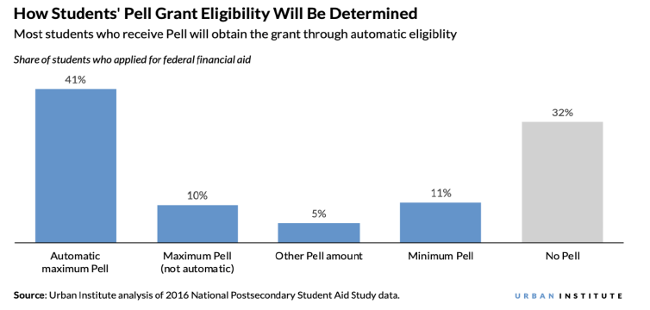
More pell grant students
According to Urban Institute, under SAI approximately 2/3 of undergraduate FAFSA filers will be Pell eligible

Slide 8
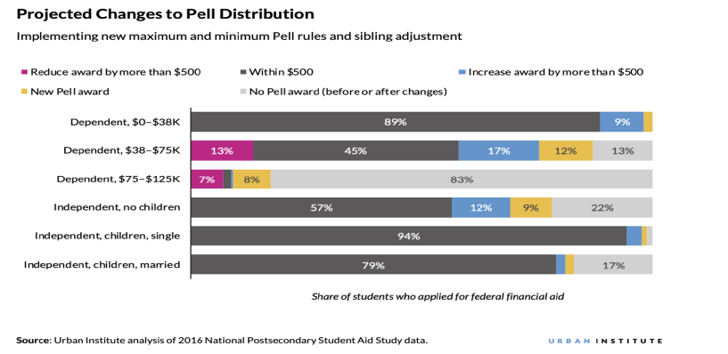
Pell grant distribution

Slide 9
concerns
Strain on the VSFAP and institutional grant programs with the addition of new students
Some students who are currently receiving VSFAP and institutional grants will lose eligibility after already committing to JMU based on receiving an expected level of grant assistance
Addition of the new FAFSA elements may create confusion for some, and potentially decrease financial aid eligibility for others (e.g., small business, family farms, foreign income, etc.)

Slide 10
Course of action
JMU participated in the beta testing of the NASFAA SAI Tool that has since been rolled out to all NASFAA members (we’ve been a part of this from the beginning)
Use the tool to evaluate the potential impact on our students
Consultation with SCHEV of the anticipated strain on VSFAP
Questions about the current allocation model
The 2024-25 allocations are based on two year old data, which will not show the same level of need we will see during that year
Preparing the campus for a potential need of additional institutional grant dollars

Slide 11
Preparation IS KEY…ACROSS THE UNIVERSITY
The new FAFSA and SAI are “game changers” as it relates to federal methodology and the associated financial need levels of our students
The federal aid programs, state aid programs (VSFAP) and our institutional need-based grant/scholarship programs all use the federal methodology as defined by the FAFSA to determine the “financial need” of our students
We will see an increased need for VSFAP and institutional grant dollars as a result of this change

Slide 12
Sai tool
Data from the 2020-21 and 2021-22 undergraduate FAFSA’s was loaded into the tool, providing us with two years worth of data to review
The output gathered from the tool shows us:
Estimated impact on the number of Pell Grant eligible students
Estimated SAI for each student compared to their current EFC

Slide 13
Sai TOOL LIMITATIONS
This can only provide an estimation and should not be considered an exact representation of what will happen
There are data elements that will be on the new FAFSA that do not exist right now (e.g., small business value, farm value, specific tax schedules, federal housing assistance, etc.)
Due to lack of certain data elements, the tool makes some assumptions regarding a student’s status and eligibility (e.g., All AGI < $60k will qualify for Simplified Needs Test, etc.)
We need to wait until the end of the 2022-23 year to review the 2022-23 FAFSA data in the tool, so at this time we are unsure the impact the Common App will have at JMU as it relates to the FAFSA/SAI changes
The tool does not account for a FAFSA Priority Filing Date

Slide 14
Jmu evaluation

Slide 15
Current grant awarding policy
VSFAP and most institutional grants are awarded based on a percentage of remaining need
VSFAP and institutional grants are awarded to qualifying in-state students with an EFC < $15,500 and who meet the March 1st FAFSA Priority Filing Date
The formula is:
Cost of Attendance (COA) – EFC – Pell Grant – FSEOG – Institutional gift aid known at the time of packaging = Remaining Need x VSFAP%
Freshmen VGAP Example:
$30,792 COA - $0 EFC - $6,895 Pell Grant - $500 FSEOG – $1,000 JMU Scholarship - $2,000 University Grant = $20,397 Remaining Need x 32% VGAP = $6,527 VGAP award

Slide 16
Sai ANALYSIS GOALS
The goal of the analysis is three-fold:
Discover the impact on the number of Pell Grant eligible students at JMU
Attempt to find a corresponding SAI to the EFC cutoff used for VSFAP and institutional grants (If a $15,500 EFC is our cap now, what will that be when we move to SAI)
Calculate the estimated financial cost to the VSFAP and institutional grant programs based on the SAI

Slide 17
Current Pell grant and vsfap population
Percent of Current Students Receiving a Pell Grant:
Approximately 15% of the undergraduate student body
Approximately 25% of undergraduate FAFSA filers
Percent of Current In-State Students Receiving a State Grant:
Approximately 20% of the in-state undergraduate student body
Approximately 31% of in-state undergraduate FAFSA filers
This equates to approximately $36m in annual disbursements between these programs (40% federal, 35% state, and 25% institutional = 100% of funding)

Slide 18
Estimated change in Pell grant population
Estimated Pell Grant Population under SAI
A 30% increase in the number of Pell Grant eligible students
Approximately 20% of the undergraduate student body
Approximately 30% of undergraduate FAFSA filers
It’s important to keep in mind this is based on the evaluation of 2020-21 and 2021-22 FAFSA data
We do not know the impact going to the Common Application (Admissions) for the 2022-23 class will have at this time

Slide 19
Loss of Pell Grant
While the overall number of Pell Grant students will increase, there are some students who will fall out of eligibility based on the changes
If the students in the aid years below were subject to the SAI calculation instead of the EFC, this is number that would not have received a Pell Grant
2020-21 = 41 students (< 2% of the recipients)
2021-22 = 51 students (< 2% of the recipients)

Slide 20
Students losing pell Grant eligibility
Students committed to JMU based on receiving grants, even though JMU has no discretion over who receives a Pell Grant and how much they receive
Students will fall outside of grant range due to no fault of their own, and no changes in their family circumstances…it’s just different math being used to calculate the SAI (life is the same)
Options:
No longer fund them based on the overhaul to the FAFSA
Grandfather them until graduation
Grandfather them so they receive grants for a total of four years
Allow students to appeal for assistance based on the lost Pell Grant eligibility

Slide 21
Preferred Pell grant option
Due to the small number of students, allow students to appeal for assistance based on the lost Pell Grant eligibility
Review each appeal individually to determine what, if any, assistance should be provided to account for the lost grant
This will be handled through the Professional Judgment appeal process

Slide 22
CORRESPONDING SAI TO EFC
Analyzed all 2020-21 and 2021-22 FAFSA’s with an EFC of <$16k
Used $16k instead of $15,500 projecting for EFC increases in the awarding formula
SAI range for this population:
2020-21: -$1,500 to $51,036
2021-22: -$1,500 to $55,584
If we included all of the students with a SAI within these ranges in our grant packaging formula, it would add over 3,000 students to the population
Conclusion: There is no way to find an “across the board” corresponding SAI to EFC…the application and math are too different

Slide 23
Sample Reasons for differences
Exclusion of Number in College
Simplified Needs Test (exclusion of assets)
Assumption for <$60k AGI
Non-Tax Filing Status and automatic $-1,500 EFC

Slide 24
SAI SELECTED FOR PACKAGING
To make the remaining need formula work within our limited resources, we need to select a SAI cutoff to replace the current EFC cutoff
Since no corresponding SAI can be found, we have selected $16,000 as the new benchmark for these estimations
This stays true to our ”50% of COA” methodology

Slide 25
Estimated In-State ”State Grant” Recipients under SAI
Going to a $16k SAI versus a $16k EFC
2020-21:
Increases the total pool of eligible students by 86
460 of the eligible students did not have an EFC < $16k (gaining grant eligibility)
374 students had an EFC < $16k and a SAI >$16k (losing their grant eligibility)
2021-22
Increases the total pool of eligible students by 68
439 of the eligible students did not have an EFC < $16k (gaining grant eligibility)
370 students had an EFC < $16k and a SAI >$16k (losing their grant eligibility)

Slide 26
Efc to sai BREAKDOWN 2020-21
Estimated SAI Summary | Number in range
-$1,500 | 2,028
-$1,499 to -1 | 324
$0 | 70
$1-6,000 | 889
$6,001-9,000 | 384
$9,001-15,000 | 694
$15,001-16,000 | 125
Total | 4,514
Actual EFC Summary | Number in range
-$1,500 | 0
-$1,499 to -1 | 0
$0 | 1,132
$1-6,000 | 1,576
$6,001-9,000 | 590
$9,001-15,000 | 974
$15,001-16,000 | 156
Total | 4,428
54% SAI = $0 or less
26% EFC = $0

Slide 27
Efc to sai BREAKDOWN 2021-22
Estimated SAI Summary | Number in range
-$1,500 | 1,957
-$1,499 to -1 | 299
$0 | 98
$1-6,000 | 831
$6,001-9,000 | 318
$9,001-15,000 | 717
$15,001-16,000 | 122
Total | 4,342
Actual EFC Summary | Number in range
-$1,500 | 0
-$,1499 to -1 | 0
$0 | 1,125
$1-6,000 | 1,536
$6,001-9,000 | 526
$9,001-15,000 | 937
$15,001-16,000 | 150
Total | 4,274
54% SAI = $0 or less
26% EFC = $0

Slide 28
Students losing state grant eligibility
Students committed to JMU based on receiving grants and JMU’s awarding policy for making those offers (institutional discretion for much of this)
Students will fall outside of grant range due to no fault of their own, and no changes in their family circumstances…it’s just different math being used to calculate the SAI (life is the same)
Options:
No longer fund them based on the overhaul of the FAFSA
Grandfather them until graduation
Grandfather them so they receive grants for a total of four years
Allow students to appeal for assistance based on the lost state grant eligibility

Slide 29
Preferred state grant option
Due to the number of students, automatically grandfather them so they receive grants for a total of four years
Requirement that they meet the FAFSA Priority Filing Date
Requirement that they continue to meet the general eligibility rules to receive financial aid
Provide a flat award, such as $6,000 per year, as we cannot calculate an award based on the remaining need formula as many will not have any need based on the FAFSA/SAI changes
This means awards will go to students with no demonstrated need based on the FAFSA
Send a direct communication to the students informing them of this change
Notes:
Some students will come out ahead with this, others may not
Under EFC methodology, might receive higher or lower grant
Do not factor in number in college and/or try to manually do an EFC calculation
Workload to manually to do this would be large
The FAFSA data elements are changing and EFC tables not being updated, so no way to accurately calculate an EFC

Slide 30
Grandfathering estimated cost using 2020-21 Data
Additional Cost Per Year | Extra Student Cost | Grandfather Student Cost | Total Cost
2024-25 | $516,000 | $2,244,000 | $2,760,000
2025-26 | $516,000 | $1,481,040 | $1,997,040
2026-27 | $516,000 | $740,520 | $1,256,520
2027-28 (and on-going) | $516,000 | $0 | $516,000
Assumes average award of $6,000 per grandfathered student and equal distribution of students by grade level (e.g. sophomores, juniors, and seniors in 2024-25)
Notes:
Breakdown of students by grade level
Freshmen 2,673 - 29%
Sophomore 2,162 - 23%
Junior 2,230 - 24%
Senior 2,203 - 24%
Total 9,268 100%

Slide 31
Grandfathering estimated cost using 2021-22 Data
Additional Cost Per Year | Extra Student Cost | Grandfather Student Cost | Total Cost
2024-25 | $408,000 | $2,220,000 | $2,628,000
2025-26 | $408,000 | $1,465,200 | $1,873,200
2026-27 | $408,000 | $732,600 | $1,140,600
2027-28 (and on-going) | $408,000 | $0 | $408,000
Assumes average award of $6,000 per grandfathered student and equal distribution of students by grade level (e.g. sophomores, juniors, and seniors in 2024-25)
Notes:
Breakdown of students by grade level
Freshmen 2,830 - 30%
Sophomore 2,247 - 24%
Junior 2,071 - 22%
Senior 2,162 - 23%
Total 9,310 100%

Slide 32
closing

Slide 33
The “ask”
In order to fund the “grandfathered” students and newly eligible students, we are requesting an increase of the following in university grant dollar support:
2024-25 = $3m
2025-26 = $2m
2026-27 = $1m
2027 and beyond = $500k
Notes:
It’s hoped this request will be more than is needed due to the assumptions made in the SAI Tool
Many of these students will not have any financial need, which is important to consider when determining the source for these funds
Notes:
Mention UNC Chapel Hill has a permanent $8m hole they are trying to fill (shared by Jackie and Rachel at the SASFAA Annual Conference)

Slide 34
Risks of not funding these students
Students not being able to finish their education at education (e.g., transferring, dropping out, etc.)
Lack of desire of impacted students to partner with JMU in the future
Unpaid balances for students continuing (e.g., increase in receivables, collections, etc.)
Student/parent complaints
Reputational harm to JMU
Recruitment challenges in the future
News headlines of JMU’s lack of support for impacted students
Others

Slide 35
Caveats about the ask
The SAI Tool only provides estimated data based on the earlier discussion points, so the actual numbers in 2024-25 will be different (we cannot be certain as to what degree the variance will be)
This is predicated on a relatively consistent number of students meeting the FAFSA Priority Filing Date (any increase in that headcount will increase costs)
This does not take into account 2022-23 enrollment so we do not know the impact the Common Application may have on these figures
At this time, we do not know if Virginia will be providing any increases in VSFAP to account for these changes

Slide 36
Timeline
The new FAFSA will be available in December 2023
JMU will start receiving questions about eligibility once students/parents begin submitting the application
Students/parents who are likely to be concerned the most are those who will see higher SAI’s than EFC’s and are worried about losing their grant eligibility
In an ideal situation, JMU will have a decision made on the “ask” and funding by July 1, 2023 so we have time to train staff, prepare for the anticipated questions we will receive from students/parents, and craft our communications
We would like to be proactive in sending information to students/parents about the FASFA changes, and understanding what level of support we can provide will be important when crafting these messages

Slide 37
Thank you

