Slide 1
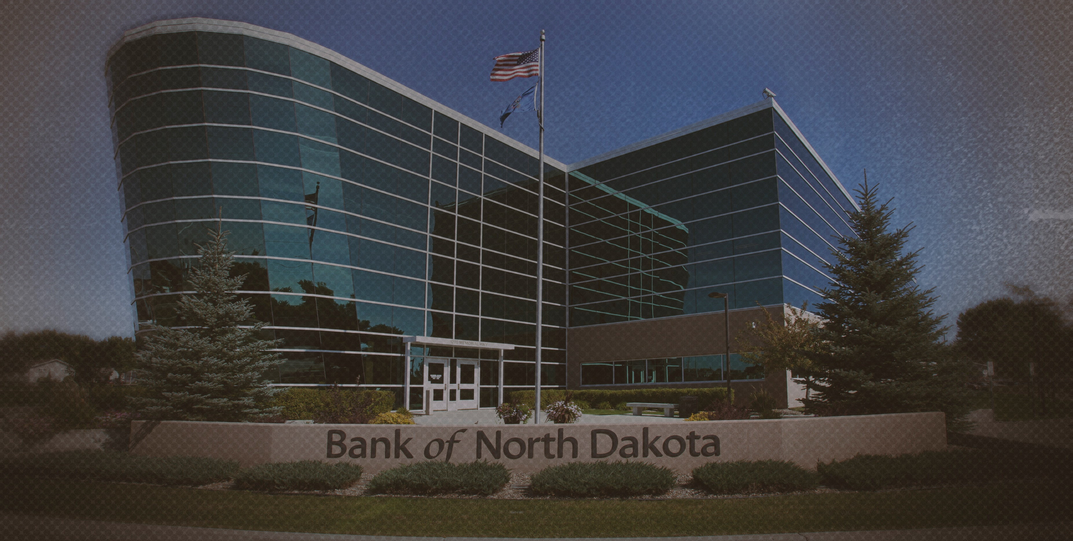

2024 NDASFAA Bank of North Dakota Update
Jennifer Bickel, Education Market Manager

Slide 2
Agenda
2023-24 Recap
What’s new at BND?
Items on our radar
Questions

Slide 3
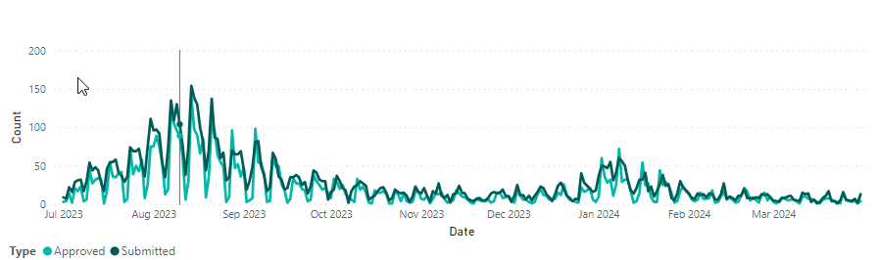
2023-2024 BND Education Market Recap
July 1, 2023 through April 1, 2024
BND approved 5,669 applications
  Total of 8,568 disbursements for a total of $56.7 Million
Over that same period our customer service teams
  Handled 15,229 phone calls
  Responded to 7,787 chats and emails

Slide 4
2023-2024 BND Education Market Recap
July 1, 2023 through April 1, 2024
FAFSA Presentations
  2023 – 15 schools (350 attendees)
  2024 – 12 schools (180 attendees)
College Application Month
  BND covered the cost for 2,317 applications to ND universities
Dual Credit (2023)
  Covered 781 courses for 608 students - $333,091.35
ND Dollars for Scholars
  1,575 applicants and 147 awarded totaling $260,700.
Financial Literacy
  31 events with a total of 2,331 participants

Slide 5

Smart With My Money
State-wide led financial literacy initiative
Online platform to help identify your money personality and tools to help navigate learning about financial concepts
BND is partnering with multiple partners to help identify where and how to build awareness
Student Loans identifying touchpoints with our customers where we can share the SWWM story

Slide 6
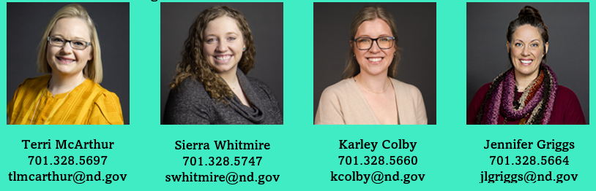
Origination Changes/Improvements
Changes to support the removal of Out of State/Out of State lending were in place April 1^{st.}
Improvements to Lookback loan processing in testing
Credit Guidelines and Customer Communication
Changes to U.S Citizenship requirements are in review
Identifying where we can leverage the SWWM tool

Slide 7
On the Horizon
FAFSA Rollout Implications
  Student Loans planning for a different kind of year
  Outreach team participating in activities to help get students over the finish line
    PSAs
    Materials for high school counselors
    Videos and Webinars

Slide 8

Questions?
Education Market Attendees
Jerrett Grimes, Leader of Origination
  701.328.5709 jgrimes@nd.gov
Terri McArthur, Origination Specialist
  701.328.5697 tlmcarthur@nd.gov
Roxy Jacobson, Student Loan Specialist
  701.328.5785 roxyjacobson@nd.gov
Lance Hill, Leader of Education Outreach & Financial Literacy
  701.328.5726 lhill@nd.gov
Amanda Woidyla, University & Student Development Coordinator
  701.328.5655 awoidyla@nd.gov
Kyle Patterson, Financial Literacy Coordinator
  701.328.9094 kdpatterson@nd.gov
Becca Larsen, University & Student Development Coordinator
  701.328.5034 rlarsen@nd.gov
Rachel LaForce, University & Student Development Coordinator
  701.239.8981 rlaforce@nd.gov
Jennifer Bickel, Education Market Manager
  701.328.5726 jenbickel@nd.gov
Notes:
Speaker: Dustin
Before I turn the presentation back over, I want to thank you in advance for the survey responses and our entire team is looking forward to the exciting future in commercial real estate services! Should there be any questions regarding the survey, to have the survey link sent to you, or if you have collateral valuation questions in general, we encourage you to reach out to us with the contact information above!
Back to you Todd!

