Slide 1

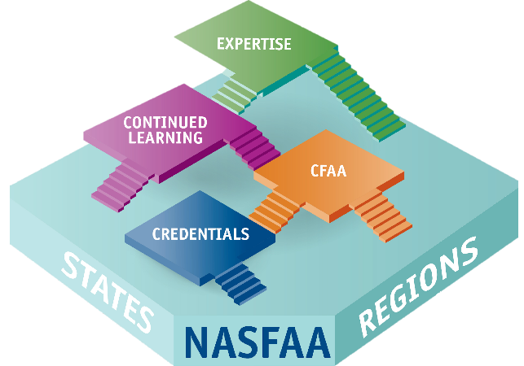



Certification Is More Than An Exam
Community
Certification is one part of a professional development ecosystem
Credibility
Continued Learning
Notes:
It’s More Than Just An Exam…
NASFAA’s Certified Financial Aid Administrator (CFAA) Program – which is how you earn the FAAC designation – builds upon the foundation of the work that you already do as a member of the financial aid community.
You begin accumulating knowledge and experience by working in the financial aid office, creating a solid foundation. You’re supported along the way by your state, regional, and national professional associations, through conferences, workshops and training events, and even mentoring by your peers.
You can follow any one of multiple pathways to becoming a financial aid expert leader… and earning the FAAC designation is just one step on your pathway toward expertise! The great thing is that you get to decide what your path to expertise looks like.
The opportunity you have now is to get recognition for what you’ve learned as you go… like milestones on a long journey. I want to point out that being an FAAC doesn’t mean that you’re a financial aid expert. The CFAA Program is meant to be part of your journey, and it shouldn’t stop there. The journey most certainly includes continuing education, which is part of the Recertification requirements.
So Get Certified as an FAAC and get ready to join a vibrant community of your peers who share your passion and commitment to financial aid administration. You’ll become a part of a strong network of professionals who have demonstrated their knowledge and proven their experience. Within this community, you can seek guidance, mentorship, and friendship. You will continue to grow and learn within a distinguished community of like-minded and skilled financial aid professionals.
Panel Question – What inspired you to become certified?

Slide 2
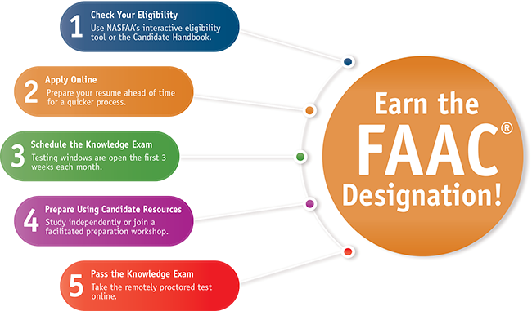
Get Started Today!
Notes:
Get Started Today
To earn the recognition you deserve, the process is straightforward:
First, check to make sure you meet the qualifying criteria, which were established by the Commission.
Once you’ve confirmed you’re eligible, you’ll apply online, schedule your exam, and start preparing.
Then you’ll need to take the exam! Once you pass, you’ll never have to take the exam again as long as you keep up with the recertification requirements and don’t let your FAAC designation expire.

Slide 3
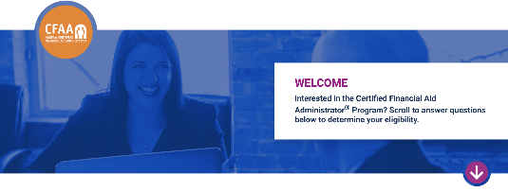
Check Your Eligibility
Professional financial aid experience and knowledge:
  5 years or more;
  3 years with at least 7 NASFAA credentials; or
  1 year with at least 12 NASFAA credentials
Hold a bachelor’s degree or have at least 10 years of experience
Attest to uphold NASFAA’s Code of Conduct and Statement of Ethical Principles
nasfaa.org/certification_interactive
Notes:
Check Your Eligibility
To qualify to sit for the certification knowledge exam, you do need to meet the qualifying criteria outlined on the screen.
There is an interactive tool to check whether you meet the eligibility requirements. The tool is free and completely anonymous and requires no commitment. It’s available to both members and non-members, which is important to note. You don’t have to be a NASFAA member to become an FAAC.
If you don’t meet an eligibility requirement, the tool will provide feedback on what you need to do to qualify, such as gaining more years of experience or earning more professional credentials.

Slide 4
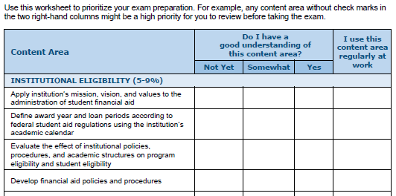

Self-Assessment Worksheet
Free to all candidates
Evaluate your readiness
Focus your review where it matters most
Key resources:
Notes:
Self-Assessment Worksheet
This free worksheet is available to everyone for free. It helps you explore each content area – or essential competency – on the exam.
Use this worksheet to identify what these content areas are and to pinpoint the areas where you might have limited experience or knowledge. We recommend reviewing the outline and asking yourself “Do I have a good understanding of the content area” and “Do I use this knowledge regularly at work?” and then focusing your preparation on the areas you may not be as familiar with.
Using this worksheet, you’ll gain a sense for how much prep time you’ll need before you take the exam. This is where you can be strategic! Do you want to spend time preparing first, before you apply to the program? Or do you want to apply, and then use some of your one-year eligibility period to prepare? Or maybe you’re ready to apply and book your exam right away because the worksheet helped boost your confidence and now you’re ready to go! The key is to find the strategy that will work best for you.

Slide 5
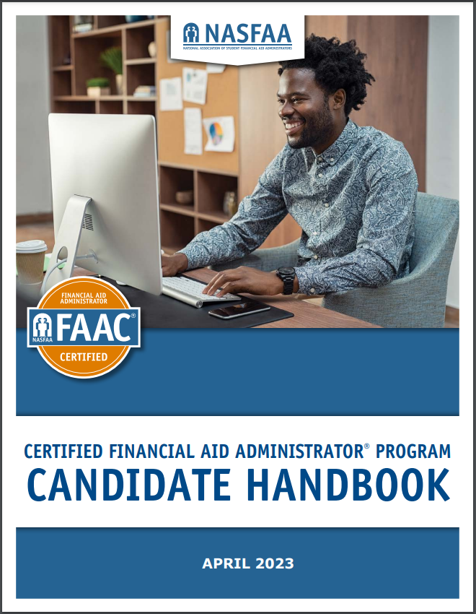
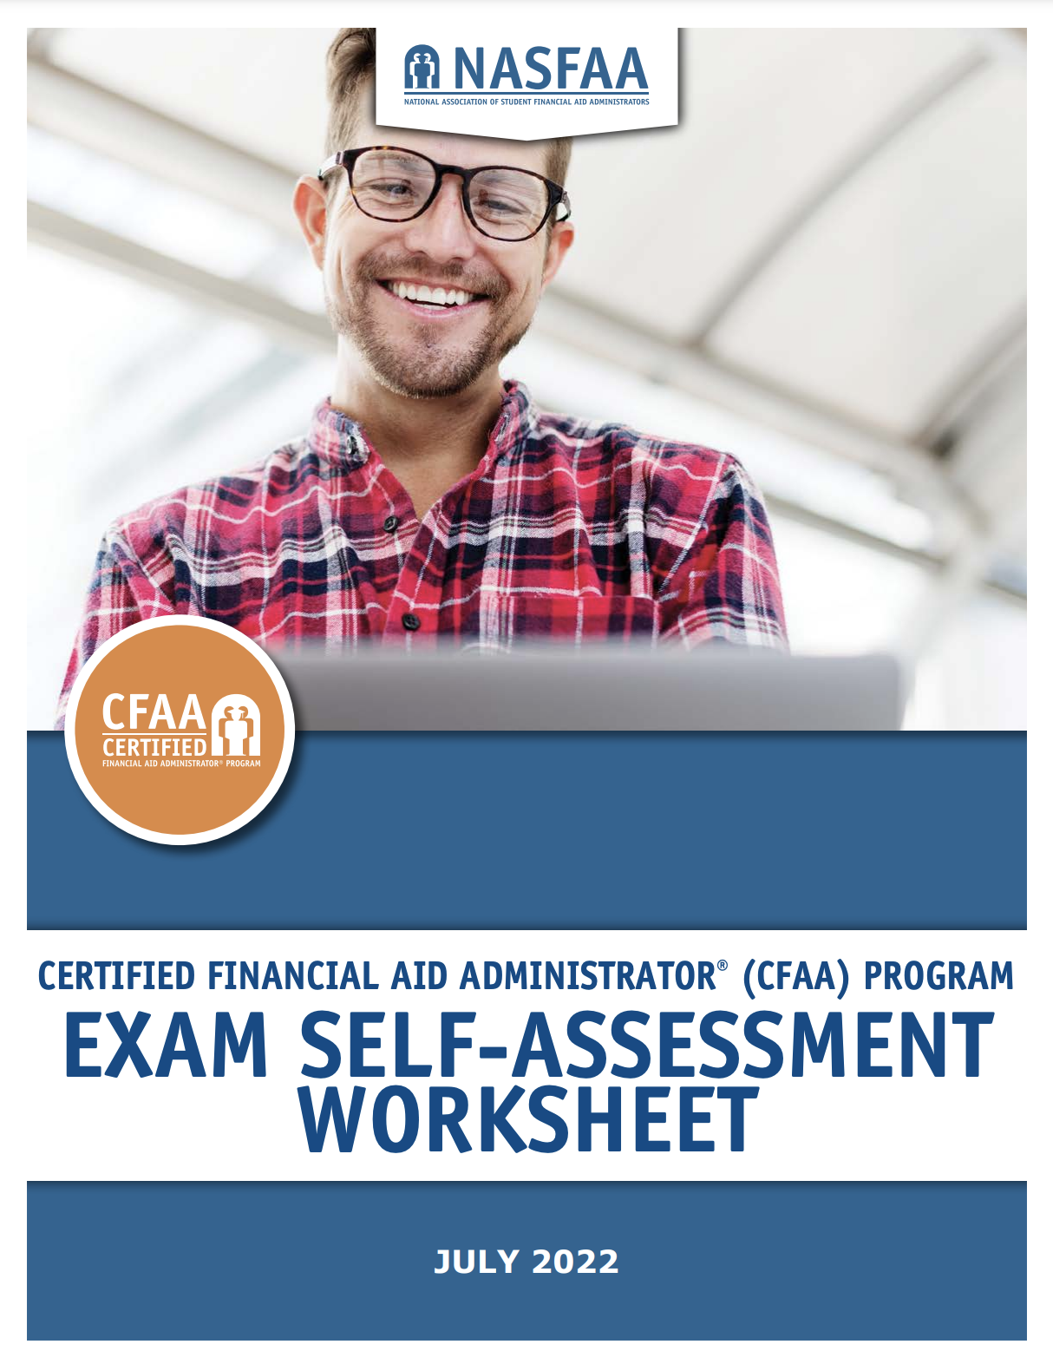
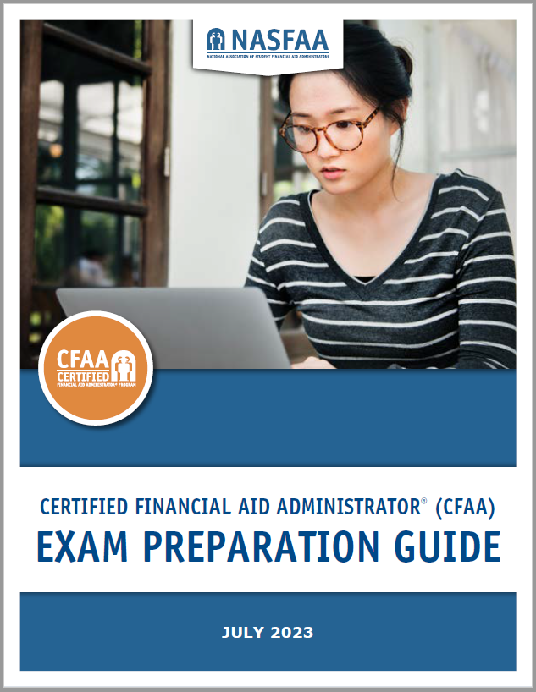
Preparation Resources: Self-Study
Your go-to resource!
Evaluate your readiness
Supplement your knowledge
Notes:
Preparation Resources
These resources help you to prepare for the exam.
The Candidate Handbook is your primary resource as you get ready to become certified. It covers everything from what’s on the exam, to how to apply, to technology requirements for the exam, to how and when you’ll recertify.
As I’ve mentioned, the free Exam Self-Assessment Worksheet helps you gauge how soon you’ll be ready for the exam.
NASFAA’s Exam Preparation Guide is useful in preparing to be a financial aid administrator, as well as for preparing to take the knowledge exam. Each lesson covers concepts directly relevant to the administration of Title IV aid, within the scope of the twelve major content areas in the Exam Content Outline. It includes assessments to gauge both knowledge and application of principles. Designed for use in conjunction with other generally available resources, including regulatory guidance provided by the U.S. Department of Education, the information will complement and enhance the knowledge you already have. AN updated Guide is published every year, and more often as needed.
Regional and state associations offer training workshops based on the Exam Prep Guide and their own resources. NASFAA’s Facilitator Guide helps them design their workshops and study groups, which is also updated annually.
Panel Question - How did you prepare for the knowledge exam?

Slide 6
Preparation Resources: Workshops
State and Regional In-Person Exam Preparation Workshops |  | NASFAA Online Exam Preparation Workshops
In-person workshop hosted by your state or region Facilitated by currently certified FAACs using NASFAA’s materials Approximately eight hours, with group discussion and activities Complimentary access: Exam preparation guide Practice test Knowledge exam Ask your state or regional association for more information |  | Virtual experience Facilitated by NASFAA training staff and currently certified FAACs Five weekly 90-minute Zoom meetings and optional “Ask Me Anything” sessions on Slack Complimentary access: Exam preparation guide Practice test Knowledge exam Register online at nasfaa.org
Notes:
Preparation Resources
These resources help you to prepare for the exam.
The Candidate Handbook is your primary resource as you get ready to become certified. It covers everything from what’s on the exam, to how to apply, to technology requirements for the exam, to how and when you’ll recertify.
As I’ve mentioned, the free Exam Self-Assessment Worksheet helps you gauge how soon you’ll be ready for the exam.
NASFAA’s Exam Preparation Guide is useful in preparing to be a financial aid administrator, as well as for preparing to take the knowledge exam. Each lesson covers concepts directly relevant to the administration of Title IV aid, within the scope of the twelve major content areas in the Exam Content Outline. It includes assessments to gauge both knowledge and application of principles. Designed for use in conjunction with other generally available resources, including regulatory guidance provided by the U.S. Department of Education, the information will complement and enhance the knowledge you already have. AN updated Guide is published every year, and more often as needed.
Regional and state associations offer training workshops based on the Exam Prep Guide and their own resources. NASFAA’s Facilitator Guide helps them design their workshops and study groups, which is also updated annually.
Panel Question – Did you or anyone you know attend an Exam Preparation Workshop through an association (in-person workshop) or through NASFAA (online workshop)?

Slide 7

NASFAA’s Professional Credentials
NOT required to pass the certification knowledge exam
Credentials demonstrate depth of knowledge in 16 topics
Multiple pathways
  NASFAA Self-Study Guide
  NASFAA U Online Course
  Professional Experience
  NASFAA Authorized Event
Notes:
NASFAA Professional Credentials
NASFAA’s Professional Credentials can be a helpful way to prepare for the knowledge exam, especially in areas you’re less familiar with. While they are not required if you already have five years or more of experience, we are seeing that candidates with five or more credentials have a higher success rate when taking the certification exam.
The key difference between these credentials and the certification is that credentials take a deeper dive into each of 16 different subject areas, compared to the certification program which requires greater breadth of knowledge.
You can qualify to take a credential through any one of several different pathways.
By the way, once you become certified, you can continue to earn or renew your credentials and earn recertification points for credentials you earn or renew.

Slide 8
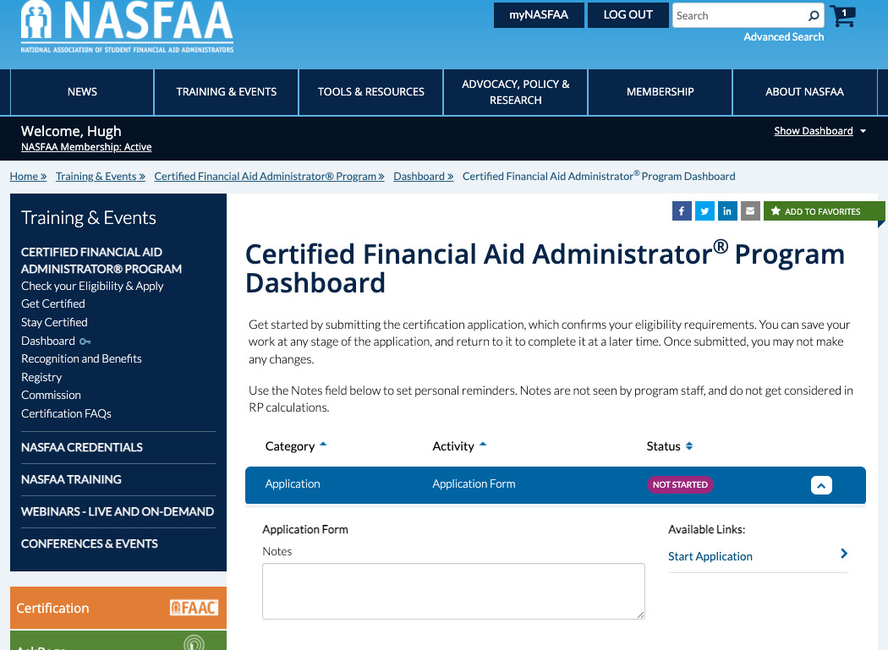
Apply Online
nasfaa.org/certification_dashboard
Notes:
Apply Online
Once you’re ready to apply, your next stop is your personal certification dashboard. This is your landing page for all things related to being an FAAC.
It’s easy to apply online and you typically get a response within a matter of days. Once approved, it’s also easy to purchase and schedule your exam for any testing window within your one-year eligibility period after your application is approved. You’ll receive all the instructions you need, and the certification team at NASFAA is standing by to help.
To confirm, you don’t have to be a NASFAA member to pursue certification. You will need a NASFAA account to login to view your personal dashboard and make your way through the application process and the recertification process later on.

Slide 9
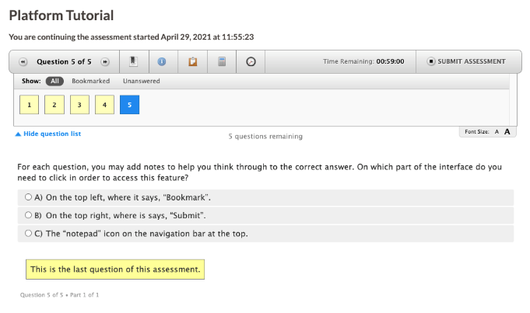
Taking the Certification Knowledge Exam
Approximately 115 multiple choice questions
Proctored remotely
Two hours
Platform tutorial
Multiple testing windows throughout the year
Notes:
Taking the Certification Knowledge Exam
The exam itself is a closed-book multiple-choice exam. It’s administered online using remote proctors, and you’ll have up to two hours. This means you can take the exam from your campus, or even from home as long as your setup meets the technical requirements.
A quick platform tutorial helps you learn how to use the testing center platform, which is very intuitive and user-friendly.
You’ll have multiple testing windows to choose from throughout the year. Just make sure to take your exam within your one-year eligibility window that begins when your application is approved. You can re-take the exam if you need to, for a fee, just not during the same testing window. So don’t schedule your first attempt during the last testing window in your eligibility period, just in case!
Panel Question – What advice do you have for those who haven’t done this yet?

Slide 10
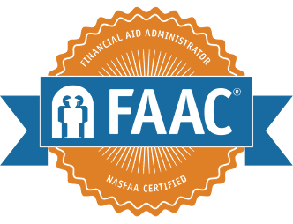
Congratulations, you passed!
Inclusion on the CFAA Program Registry
Add “FAAC®” to your name
Digital badge from Badgr
Certificate and Lapel Pin from The Award Group (TAG)
Utilize the Press Release Template
Join the FAAC Community on Slack
Notes:
Congratulations, you passed!
If you meet the eligibility requirements and take time to prepare using the approach we’ve already outlined, you’ll likely receive a congratulatory email immediately upon completing your exam!
You’ll find out your results immediately. All exam outcomes are held in confidence. NASFAA honors those who were successful by publishing the names and institutions of everyone who earns the certification in the Registry, which is available online.
Once you’ve passed the exam, you can add the FAAC® acronym to your name, adding that additional level of credibility we discussed earlier. You’ll be able to highlight your achievement on social media with your digital badge, and in your office with your new certificate and lapel pin. You can also promote your achievement more broadly using the customizable press release template. And most importantly, you’ll have the opportunity to connect with fellow FAACs through the community!
Panel Question – What’s been your experience as an FAAC? How has being an FAAC benefitted you?

Slide 11
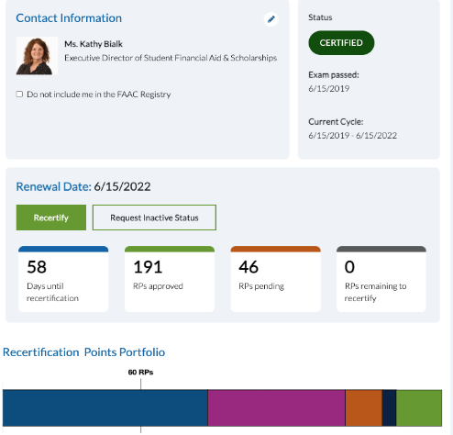

Maintain Your Certification
FAACs recertify every three years from original exam pass date
No exam needed to recertify!
Earn at least 60 RPs through continuous learning and professional growth activities
Leverage your need to recertify to justify investment in training
Sample FAAC®
Title of User
Notes:
Maintain Your Certification
You need to maintain your FAAC designation by recertifying every three years. Recertification is the most important phase of the program because it demonstrates that you are keeping your knowledge up to date, and that you’re continuing to engage in activities that support your long-term professional development and personal growth as a financial aid administrator.
I want to emphasize that you will not need to take the exam again, as long as you recertify before the end of your three-year recertification period. What you will need to do is earn recertification points (RPs) for activities related to your work in financial aid. Many of these activities are likely things that you’re already doing. You can view the list of activities online, even before you become certified, and plan from the beginning what your strategy will be for earning at least 60 RPs every three years.
You might be able to leverage your certification to create even more opportunities. FAACs have told us that the need to recertify helped them to get approval to attend training events and conference, and other opportunities such as leadership positions in their regional and state associations.
Panel Question – How have you earned RPs toward recertification? If you’ve recertified, what was your recertification experience like?

Slide 12
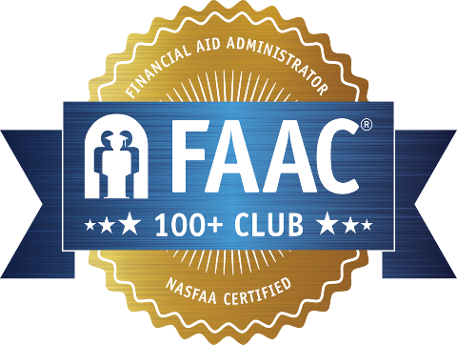
Join the 100+ Club
Special digital badge
Earn the 100+ Club lapel pin
Inclusion on the 100+ Club Registry
Discount on recertification
Notes:
Join the 100+ Club
FAACs who recertify with 100 or more RPs qualify to join the 100+ Club! A major benefit for this level of recertification is the 40% discount that is applied to the recertification fee, as well as additional opportunities and special recognition.

Slide 13
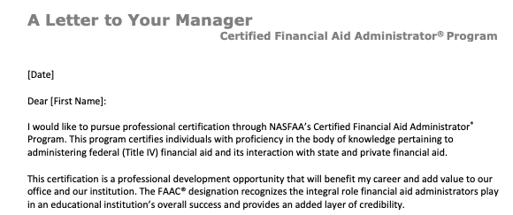
Make the Investment
nasfaa.org/certification_justification
Notes:
Make the Investment
NASFAA prepared a customizable justification letter for those interested in pursuing the FAAC designation. You can share this with managers and leadership at your institution to help explain the Program and encourage them to support your participation.
We’ve also prepared a customizable justification letter to request support for recertification, when the time comes.
Panel Question – In what ways did your school support your journey to becoming certified?
Panel Question - What final words of advice do you have for our attendees today?

