Slide 1
ND University System Update
NDASFAA Conference
April 11, 2024

Slide 2

Agenda
ND SAMS Update
Program Updates/Reminders
2025 Legislative Session

Slide 3

SAMS Project
ND State Aid Management System (ND SAMS)

Slide 4

Project Scope
Provide a single-source solution that encompasses all activities to effectively administer the ND state-funded grant, scholarship, and loan repayment programs
Application Management
Data Sharing
Eligibility Tracking
Payment
Communication
Reporting
Data Storage

Slide 5

Project Objectives
The ND SAMS project aims to design, develop, and implement a comprehensive state aid management system for the ND University System Financial Aid office (NDUSFAO) to streamline the administration of state-funded programs:
ND State Grant
ND Academic/CTE/ND Scholarships
ND Dual Credit Tuition Scholarship
Native American Scholarship
ND Scholars Program
ND Career Builders Scholarship
ND Career Builders Loan Repayment
Professional Student Exchange Program
2025-26 ND-MN Reciprocity (avail. March 2025)

Slide 6

Project Goals
Centralized Scholarship Management
Enhanced Operational Efficiency
Accurate and Transparent Processes
User-Friendly Interface
Adaptability and Scalability
Data Security and Compliance

Slide 7
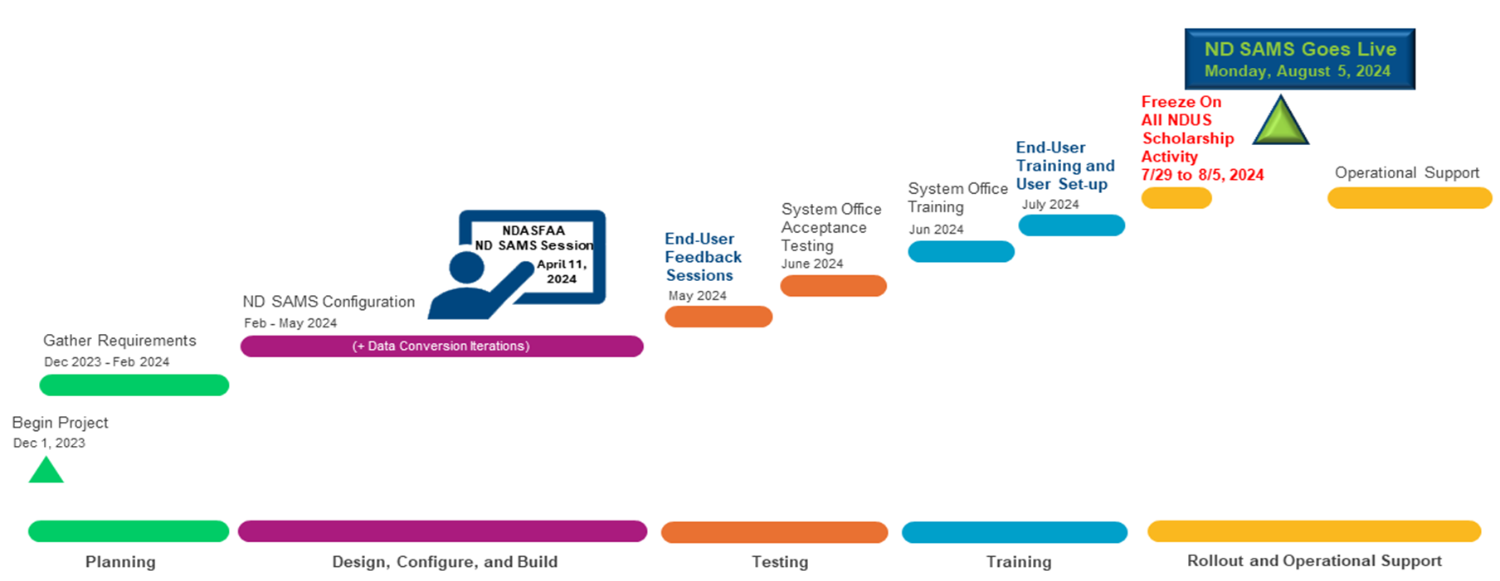
Project Timeline
We are here

Slide 8
What to expect?
Preview of the system
Guided demonstration of software
Foster discussion
Identify gaps or areas of concern
End-User
Feedback Sessions
May

Slide 9
What to expect?
Institutional processes
Demonstrate student self-service portal
Opportunity to ask questions/gain understanding
User manual
End-User
Training & Set-Up
July

Slide 10
What to expect?
No awarding, processing, payments or edits will be done by the NDUS FAO during this time of data conversion
Institutions may submit requests for changes (or hold); however, none will be acted upon during the freeze period
NDUS will have “look-up” capability only
Freeze Period
Scheduled for: 7/29 – 8/5

Slide 11

Common Questions on SAMS
Q - Will institutions be able to make edits to a student’s award in SAMS?
A - Yes, the system is being designed to include an institutional portal wherein institutional users will have some “write” capability.
Q - Can a student transfer their state aid in the system to a new school, or will they still call NDUS?
A - Both! Institutions will also be able to update!
Q - How will institutions be notified of student transfers?
A - There is a notification process built into SAMS whereby the new institution will receive a notification weekly of changes.

Slide 12
Common Questions on SAMS
Q – Will institutions continue to receive award information up until the go-live date?
A – Current business processes will continue up until the “freeze” date.
Q - How was the go-live date selected?
A - After careful consideration, it was determined that August 5th would be the best time to move everything over before the September financial aid payments.

Slide 13
Common Questions on SAMS
Q - Who can be a “user”? What will a user do?
A – The same users today can have access in SAMS! An institution may have users from the Financial Aid or Registrar Offices, or others critical to the award process, set up as a user. Users will assist in application processing, verification, and disbursement processes based on the needs of the various aid programs. Currently these functions are done in multiple systems. SAMS brings all the functions under one umbrella. Only individuals with a legitimate need should have access due to the nature of the data.
Q - Who do we contact if we have issues or questions?
A – The NDUS FAO is available to answer any questions now and post-implementation. Support hours will be available after implementation.

Slide 14
State Aid Program Updates
State Grant
  Target is late April/early May.
ND Academic/CTE/ND Scholarships
  Apprentices enrolled in a registered US Dept. of Labor apprenticeship program can now receive payment.
  2024-25 awards (new incoming freshman) – June/July.
  Forecast report in the SMS for returning students available following import of spring end-of-term reporting.
  When does the “ND” Scholarship start for NEW awardees?
    2024-25 - Academic, and CTE and ND can be awarded to incoming freshmen.
    2025-26 and beyond - “ND” ONLY to incoming freshmen.
    The Academic and CTE awardees (returning students) will have their eligibility paid out under their current program.

Slide 15
State Aid Program Updates
Native American Scholarship
  The revised Administrative Rules were effective 4/1 and will begin in the 2024-25 AY.
    Verification of “gaining admission” changed to “pursuing a degree or certificate”.
    “Valedictorian” category will no longer be awarded. All students will have to qualify on either merit or need.
    Removed the limit of the award to 6 academic years.
    Awards will be prorated if less than full-time enrolled for ALL students, regardless of grade level.
      The "final term" rule is no longer in effect.
      < 3 credits – no eligibility.

Slide 16
Reminders...
Summer award processing
  NDUS is accepting lists from institutions to evaluate eligibility.
  Which programs have funds?
    State Grant, Academic/CTE/ND Scholarships, Dual Credit Tuition Scholarship, Scholars, ND Career Builders Scholarship.
Cost of Attendance (COA) Limitation – For any state-funded program, awards may not exceed total COA, as determined by the institution, when considering all financial aid sources, regardless if need-based or non-need-based.
2025 Legislative Session – Begins January 2025.

Slide 17
Thank you for all you do!

