Slide 1
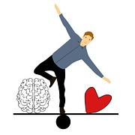
Burnout and
Self-Preservation:
Finding Balance
Kristine Paranica, NDSU Ombudsperson
Notes:
Both – welcome participants and introduce ourselves Burnout and Self-Preservation: Finding your balance

Slide 2
Objectives
Define stress and burnout
Identify support strategies to manage stress and burnout
Evaluate current level of wellness
Create a plan to decrease stress and burnout
Check-in:
On a scale of 1-10 (10 being highest, 1 being lowest), how would you rate your current stress/burnout?
Notes:
KP – objectives, JD – Check-in

Slide 3
Defining Stress
Stress is a feeling of emotional or physical tension, including frustration, anger, nervousness. Stress is your body's reaction to a challenge or demand (positive or negative).
Stress can be acute, episodic, or chronic
Chronic stress can increase risk of:
    anxiety, depression, memory/concentration losses
(World Health Organization, 2019)
Notes:
KP highlights slide – gives example re: gradual stuff

Slide 4
Stress Vs. Anxiety
Stress | Anxiety
Caused by past, current, or anticipated future demands and pressures, feeling overwhelmed Typically short-term and situational Stress can be motivating Common signs of stress include: Irritability, muscle tension, headaches, upset stomach, sweaty palms, rapid heartbeat, dizziness, changes in sleep, appetite, concentration | Fear based with intense feelings of worry and often hopelessness and/or helplessness Often a common reaction to persistent stress Typically long-term, at least six months, and does not always a known cause Common signs of anxiety include: Irritability, muscle tension, headaches, upset stomach, sweaty palms, rapid heartbeat, dizziness, changes in sleep, appetite, or concentration
(Block & Block, 2012)
Notes:
Jess talks through this slide highlighting differences

Slide 5
Activity: Small Group Check-in
  How do you typically react in stressful situations (e.g., behaviors, emotions, relational dynamics)?
  What have you noticed about other’s reactions in stressful situations in your department or on your campus?
  Identify current stressors in your department and/or on your campus.
Notes:
KP – offers small group activity (JD to add anything relevant) – ?Should we debrief or just go on?

Slide 6
Activity: Burnout Fact or Myth
Let’s check-in with thumbs up (fact) or thumbs down (myth):
There are so many more important issues than burnout.
Burnout is a sign of weakness.
Burnout is normal in activism.
Now we have to deal with more important things, when it’s over we can take care of ourselves.
Taking care of yourself when other people’s lives are at stake is selfish.
Burnout requires major work or life change.
A vacation or a day off will solve your burnout.
My burnout is only my responsibility.
Notes:
KP reads the fact/myth, JD gives the answers

Slide 7
Burnout by the Numbers
78% of employees report stress from work has led to other mental health concerns
80% of employees report workplace stress affects their relationships with friends, family, and coworkers
71% of employees report difficulty concentrating at work
56% of surveyed employees spent time looking for a new position (compared to 40% in 2018)
(Mental Health America, 2022)
Notes:
KP talks to this slide. **Based on ”The Work Health Survey.” Surveyed 11,301 US-based employees over 10 months in Oct 2020- Jul 2021 (reported data from 2021)
278 (4.04%) of responders identified as academic (profession, teaching assistant, researcher)

Slide 8
What is burnout?
Signs of Burnout:
Exhaustion:
  Drained, emotionally exhausted, unable to cope, down, lack of energy, no more cares to give
Cynicism:
  Critical of working conditions and colleagues, negativism, distancing, feeling numb, decreased empathy and compassion
Reduced performance:
  Negative about tasks, difficulty concentrating, listless, lack of creativity , reduced professional efficacy
“A syndrome conceptualized as resulting from chronic workplace stress that has not been successfully managed”
Refers specifically to the workplace and should not be applied to other areas of life
(Nagoski & Nagoski, 2020; World Health Organization, 2019)
Notes:
JD – talks through slide

Slide 9
Activity: Small Group Check-in
  What signs of burnout have you experienced? What does burnout ”look like” for you?
  What consequences of burnout have you and your department/campus experienced?
  Consider the previous identified stressors in your department or on your campus, are they associated more with stress or burnout at this point?
Notes:
KP – sets of small group check-in; both debrief (if time allows)

Slide 10
Unlocking the Stress Cycle
“The cure for burnout is not self-care.
The cure for burnout is all of us caring for each other.“
(Nagoski & Nagoski, 2020)
Knowing and following a well-defined and shared purpose so we can more easily recommit ourselves, see value in our work, and toward change.
Practice Compassion – giving grace to ourselves and others, our colleagues and students. At the institutional level, offer flexibility, to build community and find connections across identity groups informally, provide and use mental health resources, etc.
Deepen connections between you and others by reaching out. Use the Counseling Center, the Ombuds Office, and other resources to facilitate dialogue and workshops around these topics. Feeling like you aren’t the only one; being seen and heard are critical.
Pursuing Realistic Balance. Leaders can model work-life balance by committing to exercise, hobbies, free time, and avoiding weekend and evening email. Ensuring equity in workloads in departments and colleges.
(Pope-Ruark, R., 2022; Nagoski & Nagoski, 2020)
Notes:
KP/JD take turns with each?

Slide 11
Activity: Exploring Burnout Strategies
  What has worked for you? How have you managed burnout?
  How do (or can) you help others managing burnout? What can you department do as a whole to promote wellness?
  What do you need from your workplace to promote wellness?
Notes:
Together: Should we have small groups here or full group response?

Slide 12
What is wellness?
The Global Wellness Institute defines wellness as “the active pursuit of activities, choices, and lifestyles that lead to a state of holistic health.”
Wellness is...
  NOT passive or static
  About active intentions
  Holistic – in encompasses multiple dimensions of life
  An individual journey
Notes:
JD Presents

Slide 13
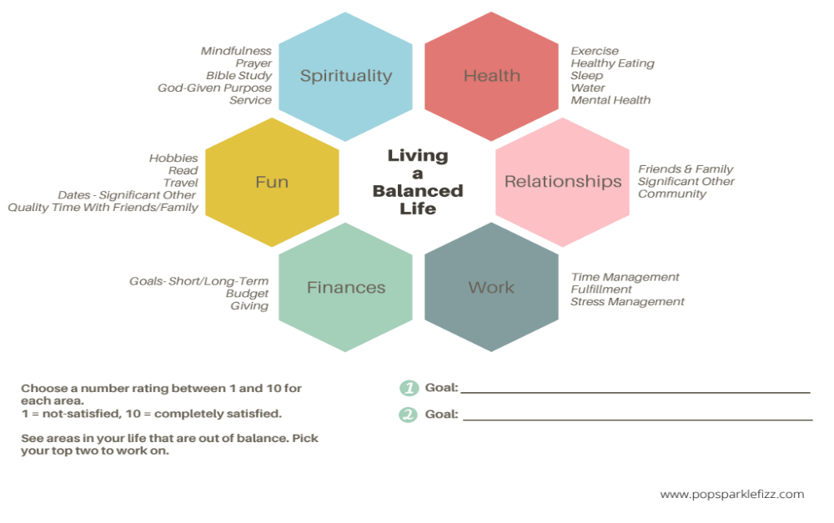
Closing Activity: Wellness Plan
Notes:
JD – sets up activity

Slide 14
References
Block, S. H., & Block, C. B. (2012). Mind-body workbook for stress: Effective tools for lifelong stress reduction and crisis management. Oakland, CA: New Harbinger Publications.
Global Wellness Institute (2021). What is wellness? Retrieved from: https://globalwellnessinstitute.org/what-is-wellness
Mental Health America (2022). Mind the workplace: Employer responsibility to employee mental health. Retrieved from: https://mhanational.org/sites/default/files/MTW_Report_2022.pdf
Nagoski, E. & Nagoski, A. (2020). Burnout: The secret to unlocking the stress cycle. Ballantine Books Trade: New York, NY.
Pope-Ruark, R. (2022). You’ve Burned Out. Now what? The Chronicle. Retrieved from: https://www.chronicle.com/article/youve-burned-out-now-what
Pope-Ruark, R. (2022). Unraveling Faculty Burnout: Pathways to Reckoning and Renewal. Johns Hopkins University Press: Baltimore, MA.
World Health Organization (2019). Burn-out an ”occupational phenomenon”: International classification of diseases. Retrieved from: https://www.who.int/news/item/28-05-2019-burn-out-an-occupational-phenomenon-international-classification-of-diseases
PowerPoint Template from: www.fppt.com

