Slide 1

2025 NDASFAA Bank of North Dakota Update
Jennifer Bickel, Education Market Manager

Slide 2
Agenda
2024-2025 Recap
What’s new at BND?
Items on our radar
Questions

Slide 3
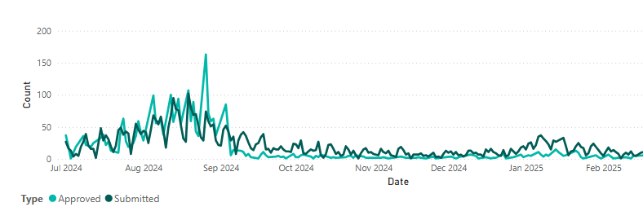
2024-2025 BND Education Market Recap
July 1, 2024 through March 25, 2025
BND approved 2,757 applications
  Total of 6,022 disbursements for a total of $ 40.87 Million
Over that same period our customer service teams
  Handled 12,479 phone calls
  Responded to 8,868 chats and emails

Slide 4
2023-2024 BND Education Market Recap
July 1, 2024 through April 1, 2025
FAFSA Presentations
  13 events – 230 attendees
College Application Month
  BND covered the cost for 2,110 applications to ND universities
Dual Credit (2024)
  Covered 1187 courses for 863 students
ND Dollars for Scholars
  1,125 applicants and 165 awarded totaling $279,200.
Financial Literacy
  50 events with a total of 4,195 participants

Slide 5
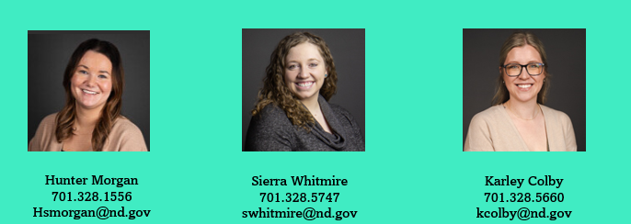
Origination Changes – Upcoming Activities
Removed lookback loan process
Changes to U.S Citizenship requirements are in progress
Incorporating Smart With My Money
Disbursement Process Review
Incorporating Chat into CampusDoor School Portal
Team Updates

Slide 6
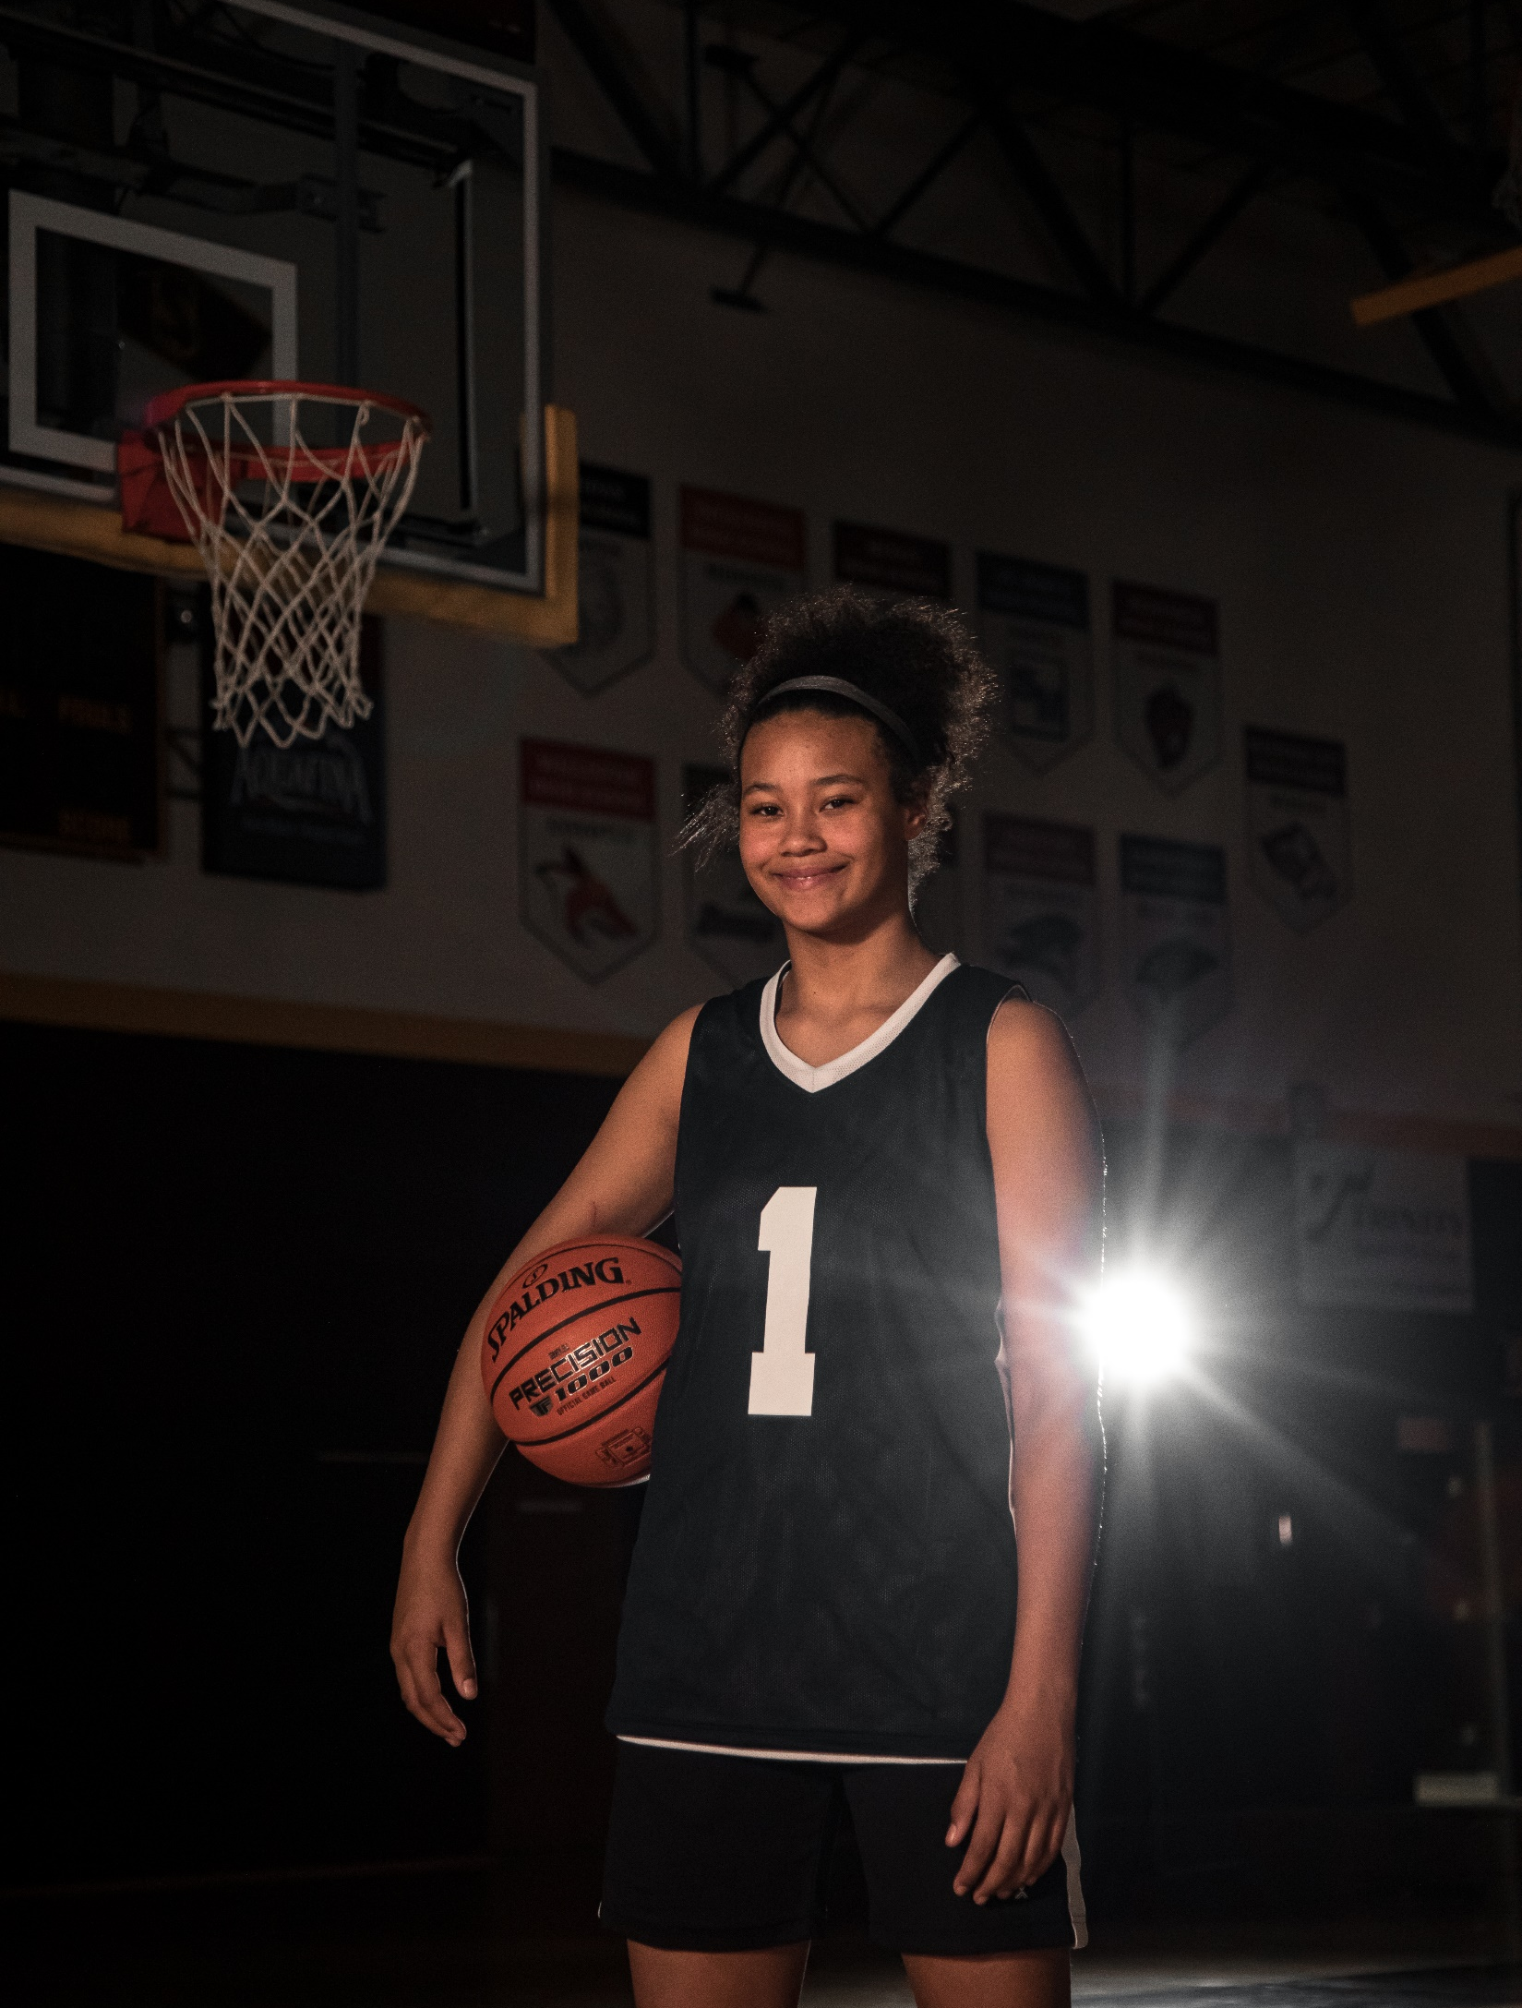
On the hunt for our next Be Confident story
Our Be Confident campaign is in it’s third year
Has focused on our high school ambassadors, looking for the next chapter
Refresh would tell the story of someone about to finish college/enter workforce
Do you know someone who fits?

Slide 7

Smart With My Money
Helped launch the state-wide led financial literacy initiative in 2024
Online platform to help identify your money personality and tools to help navigate learning about financial concepts
Williston State incorporated the site into financial literacy offerings on campus
Dickinson State also examining how to leverage this tool with their students

Slide 8
On the Horizon
Paying close attention to changes proposed by the Trump Administration
  Last year’s FAFSA challenges, BND response
BND launching a servicing platform RFP in April

Slide 9

What questions can we answer?
Education Market Attendees
Jerrett Grimes, Leader of Origination
  701.328.5709 jgrimes@nd.gov
Roxy Jacobson, Student Loan Specialist
  701.328.5785 roxyjacobson@nd.gov
Karley Colby, Origination Specialist
  701.328.5760 kcolby@nd.gov
Lance Hill, Leader of Education Outreach & Financial Literacy
  701.328.5726 lhill@nd.gov
Amanda Woidyla, University & Student Development Coordinator
  701.328.5655 awoidyla@nd.gov
Jocelyn Schneider, Education Outreach Coordinator
  701.328.6080 jdschneider@nd.gov
Jennifer Bickel, Education Market Manager
  701.328.5726 jenbickel@nd.gov
Notes:
Speaker: Dustin
Before I turn the presentation back over, I want to thank you in advance for the survey responses and our entire team is looking forward to the exciting future in commercial real estate services! Should there be any questions regarding the survey, to have the survey link sent to you, or if you have collateral valuation questions in general, we encourage you to reach out to us with the contact information above!
Back to you Todd!

