Slide 1
2025 NDASFAA Conference
Legislative & ND SAMS Fun

Slide 2

Agenda
3-Ring Circus - Legislative Update
Ring Toss - ND Sams Navigation &
New Features
Fortunes Told Here
- SAMS Small Group Discussion

Slide 3
2025 Legislative Update
ND Career Builders (NDCB) - tentative
SB2147
Graduates can now live within 50 miles of the ND border and still qualify if they work within ND.
Provides clarity on “private-sector donor” - Family members cannot support family members.
Changes repayment to both state & private-sector funds to just the state funds. The private-sector $ stay a scholarship.
Provides language for students to transfer between eligible programs of study.

Slide 4
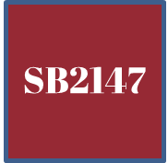
Legislative Intent – Limits on Aid - tentative
State scholarships & grants MAY be awarded in excess of total COA!
Notes:
Crystal

Slide 5
2025 Legislative Update
NEW – Supplemental State Grant - tentative
SB2147
  $2 million appropriated.
  Fills the tuition “gap” after base State Grant and Pell Grant.
  Student must first be awarded the base State Grant.
  Total family income <=$80,000.
  Deadlines & maximum tuition levels will be set.
  Amount will be pro-rated if # of applicants greater than funding.

Slide 6
2025 Legislative Update
Primary Funding Bill - tentative
SB2003
Funds all existing state grants and scholarships.
Adds State Grant eligibility for “ND residents” who are not graduates of a ND high school, homeschool, or ND GED, with a $1M appropriation to cover costs.
Additional $1M to cover anticpated shortfall in State Grant due to increased award amount in 2023 session.
Amends ND Scholars due to ACT changes. There will no longer be “four” scale scores to rank students as science is now optional.
$1.5M increase to Professional Student Exchange Program (PSEP) due to anticipated shortfall (impacts professional dentistry, optometry, veterinary medicine).

Slide 7
2025 Legislative Update
SB2221 – PASSED
Adds eligibility for Master of Science in Nursing to qualify for NDCB.
Other Bills
HB1404 - tentative & HB1098 - PASSED
Amended ND Scholarship criteria to earn scholarship. Not expected to generate additional recipients, but just a new pathway. Dept. of Public Instruction (DPI) impact.
HB1529 - PASSED
NDUS institutions: Requires in-state residency for tuition for Peace Corp. volunteers who have completed service.

Slide 8

Post-Session
Implementation & Updates
Notes:
Crystal
-SSIG Estimated Awards are in there now
-More reports are coming soon

Slide 9

ND SAMS Navigation & New Features
Navigation Review
Summer Processes
State Grant Tool
Future Attractions
  EOT Reports
  Single Sign On
Notes:
Kristin

Slide 10
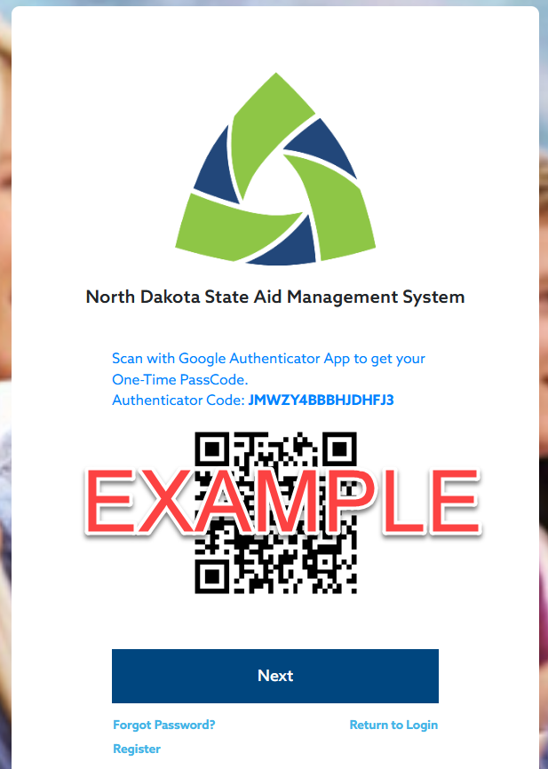
Logging In
Who has access and requesting access
Email invitation to register
Multi-Factor Authentication
Notes:
Kristin

Slide 11
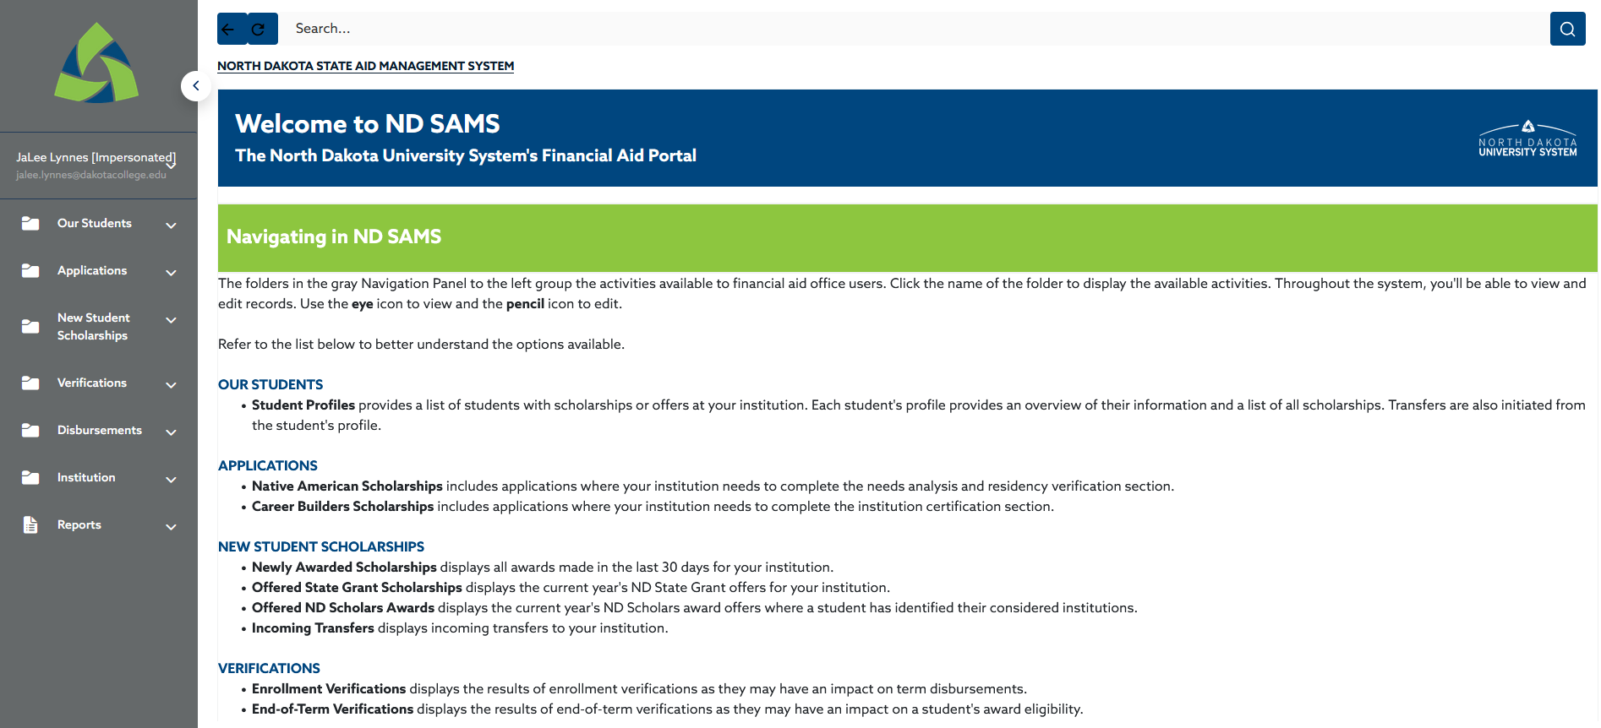
The Welcome Page
Provides details of what is in your menu
Customized to your role:
  Type of Institution
    Public
    Private/Tribal
    Clock Hour
  Office/Position
    Financial Aid Office
    Registrar
    Business Office
    Combined
Notes:
Crystal

Slide 12
Navigating to a Student Profile
Student Profiles provide applicant, award, and disbursement information for students attending your institution.
Use it to look up a student and find out more about their status, including results of Enrollment or End of Term Verification.
Notify NDUS of a Transfer
  From the Student Profile, click the three vertical dot icon
  Processed transfers will then show up on your Incoming Transfers Report under New Student Scholarships
Notes:
Crystal

Slide 13
Navigating to a Student Profile
TRANSFER PROCESS
Notes:
Crystal

Slide 14
Provide Application Information
Native American Scholarship Needs Analysis
Career Builder Scholarship Certification
Notes:
Kristin

Slide 15
New Student Scholarships
Get a list of all newly awarded scholarships
Review offered ND Scholars and State Grant
See completed transfer requests
Notes:
Crystal

Slide 16
Verifications
Two types of verifications:
  Enrollment Verification: Occurs after FA Census to verify eligibility for disbursement and make adjustments to award amounts based on enrollment for some programs.
  End of Term Verification: Occurs after the completion of the term to determine continued eligibility or renewal.
Requires information be provided by the institution.
For NDUS this is done through a data extract from Campus Connection.
For private, tribal, and clock-hour schools this is done through an upload process or individual updates.
Notes:
Kristin
For non-NDUS make sure to complete all students in the list.
If there is a Y in “DC or NDCB Cost Required” you MUST provide Tuition, fees, books & supplies. But you may provide that information for all students. For example if they get a scholarship later that requires that information it is already provided.

Slide 17
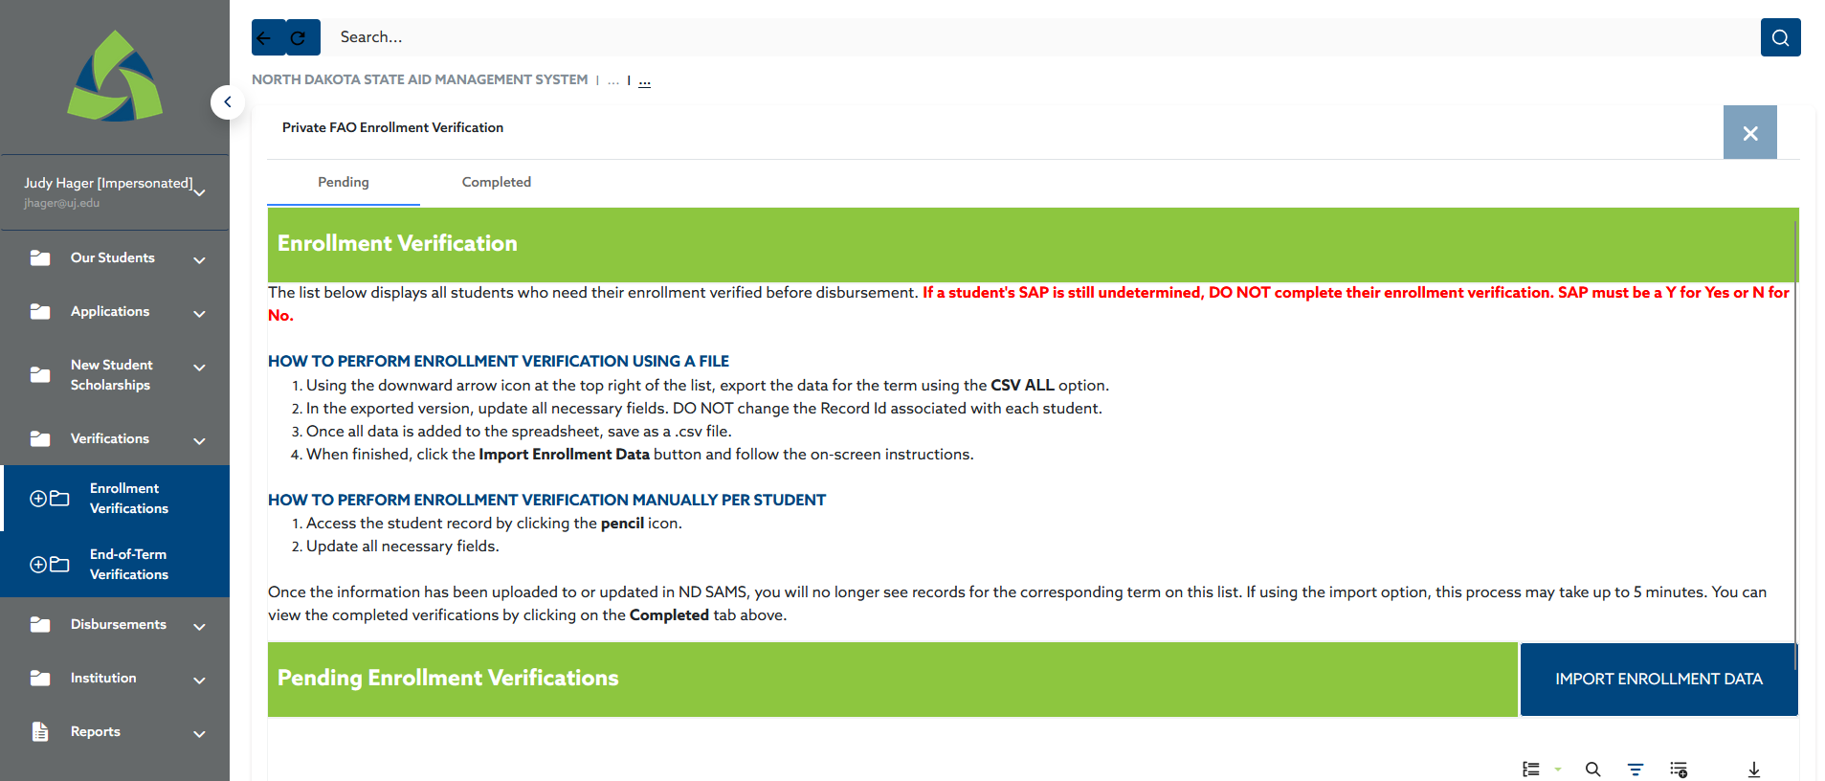
Verifications
For private, tribal, and clock-hour schools this is done through an upload process or individual updates.
Notes:
Kristin

Slide 18
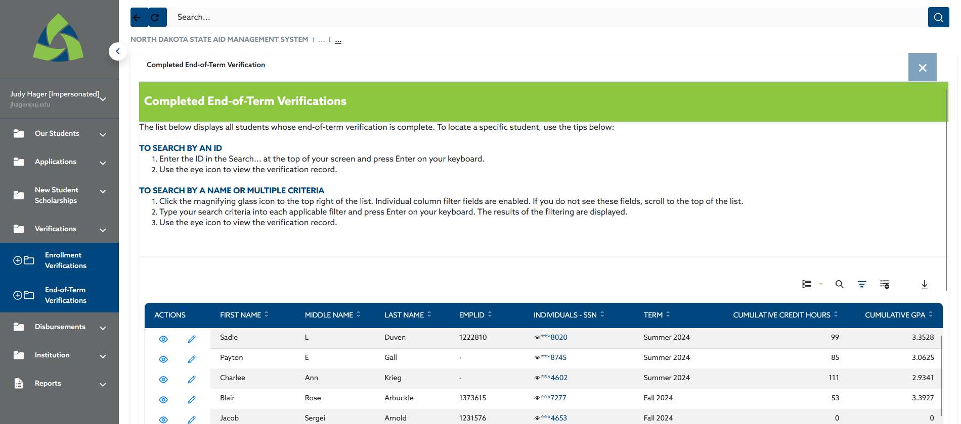
Verifications
For private, tribal, and clock-hour schools this is done through an upload process or individual updates.
Notes:
Kristin

Slide 19
Disbursements
Projected Disbursements: Awards estimated prior to Enrollment Verification. Useful for posting anticipated awards.
Disbursement Verification: Awards that have been made ready for payment after Enrollment Verification for your institution to review/disburse to the student and then request funds for.
Vouchers: Record of payment made for students.
  Disbursement Hold
  Max Allowed at Institution
Ineligible Disbursements: Awards determined to be ineligible for payment due to Enrollment Verification.
Notes:
Crystal
Talk about PDs and using to make anticipated awards
NDUS is importing this data into Campus Connection – more information to be released soon
Disbursement Hold – wanting put off disbursement, but they may be eligible to receive funds at a later date
Max Allowed at Institution – change to zero if the student is no longer eligible for disbursement (i.e. over COA)

Slide 20
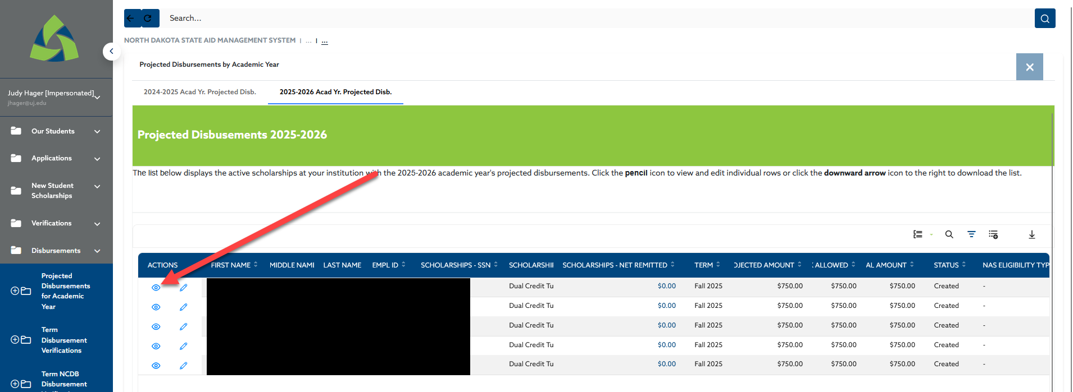
Adjusting Max Allowed at Institution
Have a student at your institution who can’t receive the full payment?
Adjust the Max Allowed at Institution to ensure correct disbursements!
Step 1
Notes:
Kristin
Step 1: Navigate to the Projected Disbursement and click the eyeball.

Slide 21
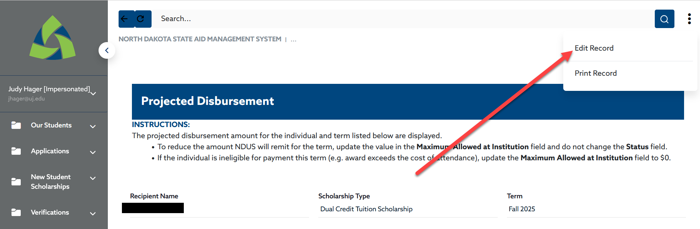
Adjusting Max Allowed at Institution
Have a student at your institution who can’t receive the full payment?
Adjust the Max Allowed at Institution to ensure correct disbursements!
Step 2
Notes:
Kristin
Step 2: Click the three dot icon and then Edit Record

Slide 22
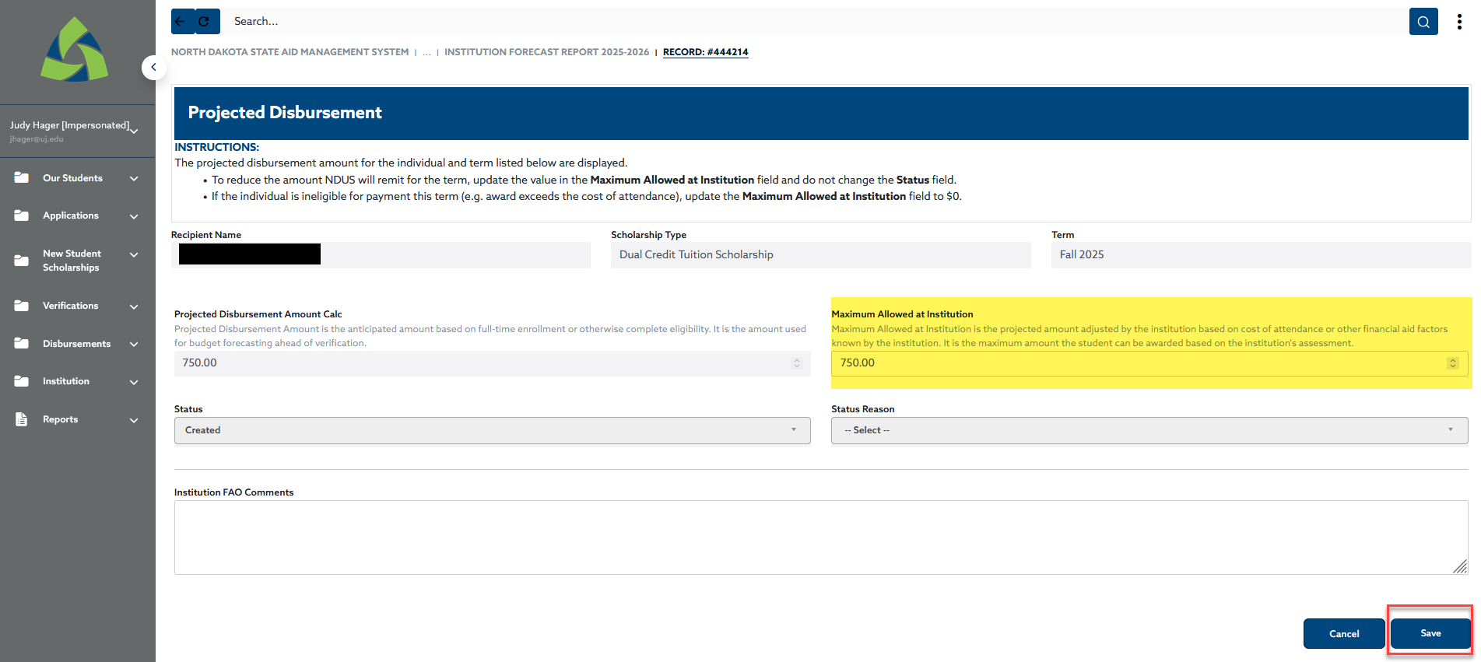
Adjusting Max Allowed at Institution
Have a student at your institution who can’t receive the full payment?
Adjust the Max Allowed at Institution to ensure correct disbursements!
Step 3
Notes:
Kristin
Step 3: Reduce the Maximum Allowed at Institution and Save
ADD a comment, initials, and date – this helps

Slide 23
Reports
Notes:
Crystal
-SSIG Estimated Awards are in there now
-More reports are coming soon

Slide 24
Summer Awarding
Notes:
Kristin

Slide 25



It’s not that different.
Request
Projected Disbursements
Enrollment Verification and Payment
Identify students who may be eligible for state funds and ask NDUS to review them.
Once processed by NDUS projected disbursements will be posted
Census processing and actual disbursements process as normal
Notes:
Kristin

Slide 26
Summer Awarding Steps
Create a list of students who you believe may be eligible for summer awards.
  Refer to eligibility criteria!
Request Summer Awards by uploading a list in ND SAMS
NDUS reviews, approves, and comments.
Summer Projected Disbursements available to post awards in your system
  Remember proration rules!
  Update Max Allowed at Institution (if applicable)
Following your FA Census, enrollment verification steps run (different for NDUS and non-NDUS)
Review final awards and request payment
Notes:
Kristin

Slide 27
Other Summer Tips
The Request Summer Awards page tells you who you have submitted to be reviewed by NDUS.
Utilize the Summer Projected Disbursement report to make awards in your system
Refer to the Comments on the Summer Projected Disbursement report for important information from NDUS pertaining to that student’s award.
Not seeing a Projected Disbursement for a student you submitted? Check the Not Approved report tab on the Summer Projected Disbursement page. Or contact NDUS.

Slide 28
Walkthrough
Notes:
Crystal

Slide 29
Estimating State Grant
Notes:
Crystal

Slide 30
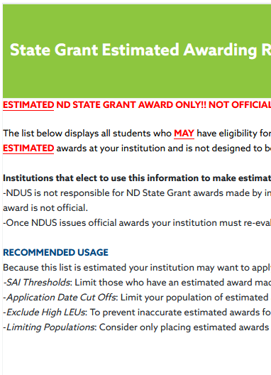
Get State Grant on early!
Use this report to make estimated State Grant awards before actual State Grant Awards are made by NDUS.
Notes:
Crystal

Slide 31
DISCLAIMER
Institutions that elect to use this information to make estimated ND State Grant awards understand and agree to the following.
  NDUS is not responsible for ND State Grant awards made by institutions using estimated data. Institutions assume the responsibility and risk if electing to award using this ESTIMATED information. Please provide your students with transparent language that the award is not official.
  Once NDUS issues official awards your institution must re-evaluate awards and communicate with students if no official award was made.
Notes:
Crystal

Slide 32
State Grant Estimated Awarding Report
Run the SSIG Estimated Awarding Report (in the Reports Menu)
Students in this list have an ISIR that is marked as eligible for State Grant
Standard awarding rules apply (LEU, prorations, awarding cutoffs)
Recommended Usage:
  SAI Thresholds: Limit those who have an estimated award made at your institution to those with an SAI below a designated threshold.
  Application Date Cut Offs: Limit your population of estimated awards to only those who have submitted their FAFSA on or before a specified date.
  Exclude High LEUs: To prevent inaccurate estimated awards for those who have high LEUs, exclude students with an LEU of 3.0 or higher.
  Limiting Populations: Consider only placing estimated awards on incoming freshmen or transfer students.

Slide 33
Walkthrough
Notes:
Crystal

Slide 34
Future Attractions
A sneak peek into features that will be coming soon.
Notes:
Crystal

Slide 35
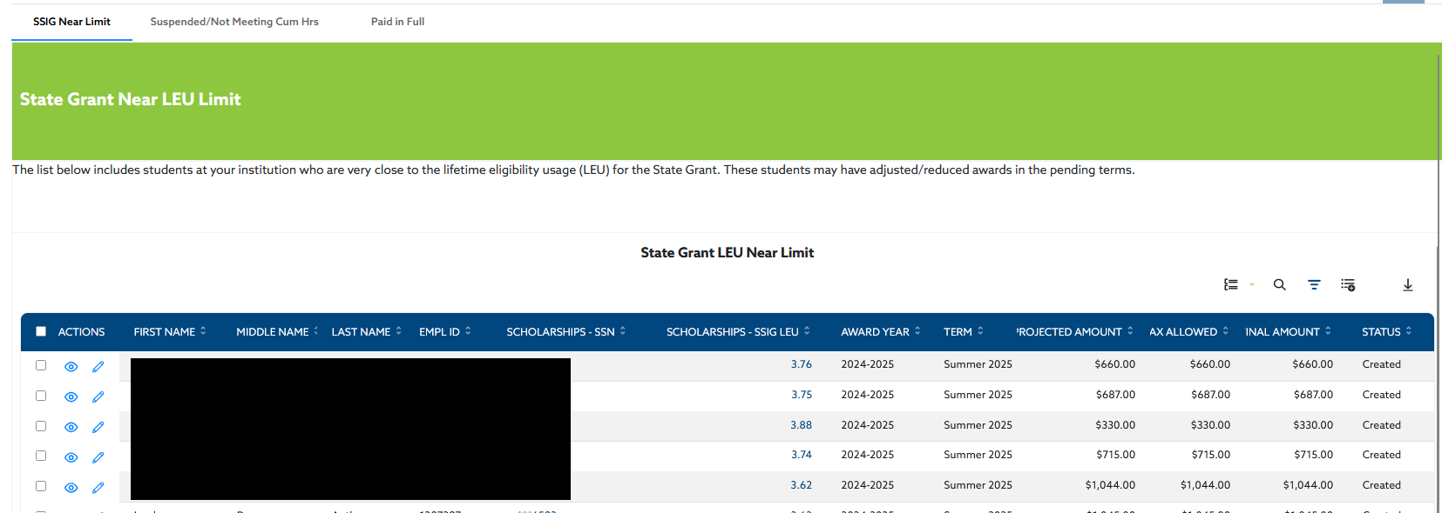
End of Term Reports
Available before EOT Spring 2025!
Notes:
Crystal

Slide 36
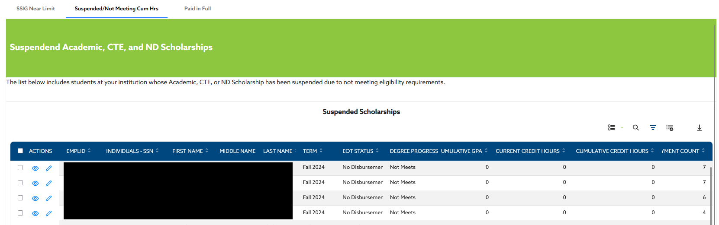
End of Term Reports
Available before EOT Spring 2025!
Notes:
Crystal

Slide 37
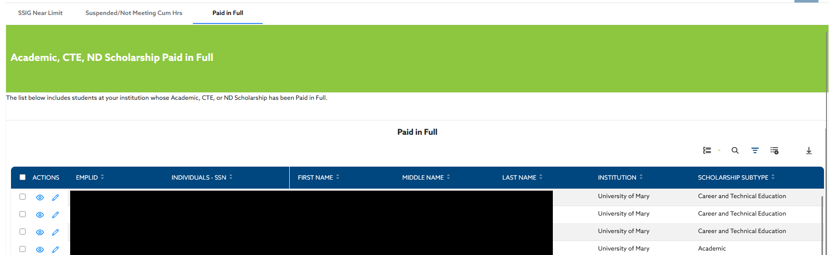
End of Term Reports
Available before EOT Spring 2025!
Notes:
Crystal

Slide 38
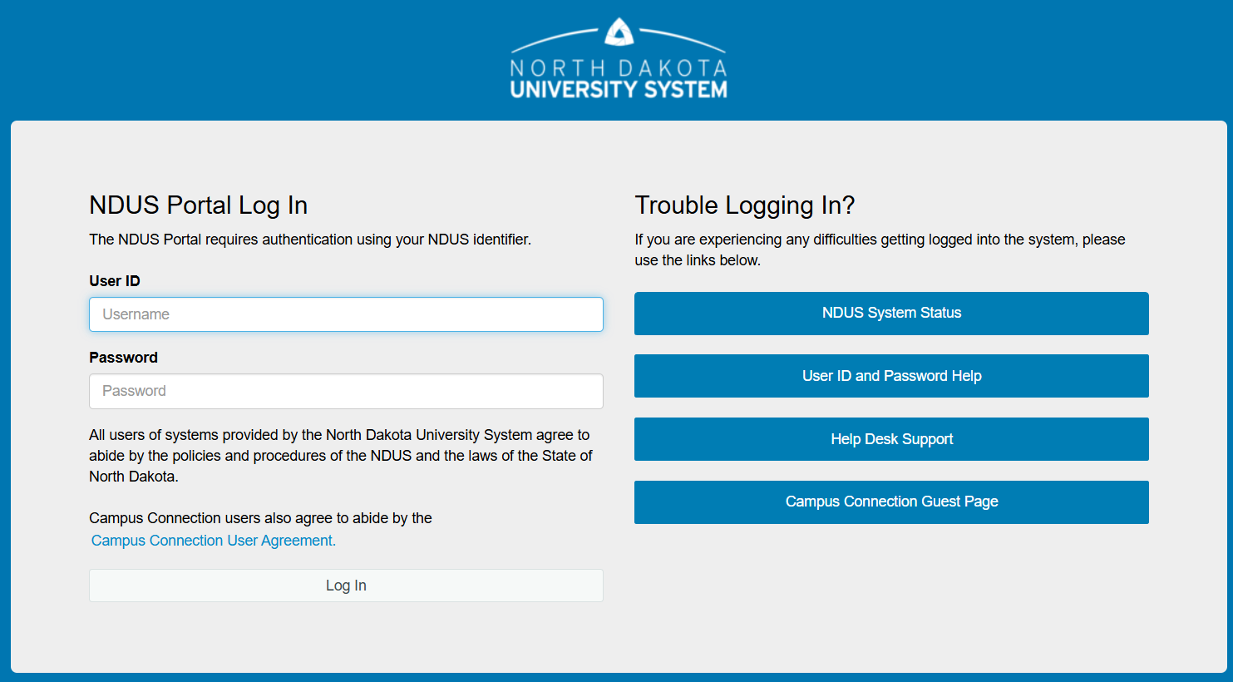
NDUS Single Sign On
NDUS users will be able to login to ND SAMS with your NDUS credentials and DUO.
Notes:
Crystal

Slide 39

User Feedback
Survey
Small Groups
Summary

Slide 40


Slide 41

Questions?

Slide 42
Thank You!

