Slide 1

ALPHABET SOUP: fyi ON fti
Presented Tirzah Knight
SDASFAA President-Elect/RMASFAA State Swap Representative

Slide 2
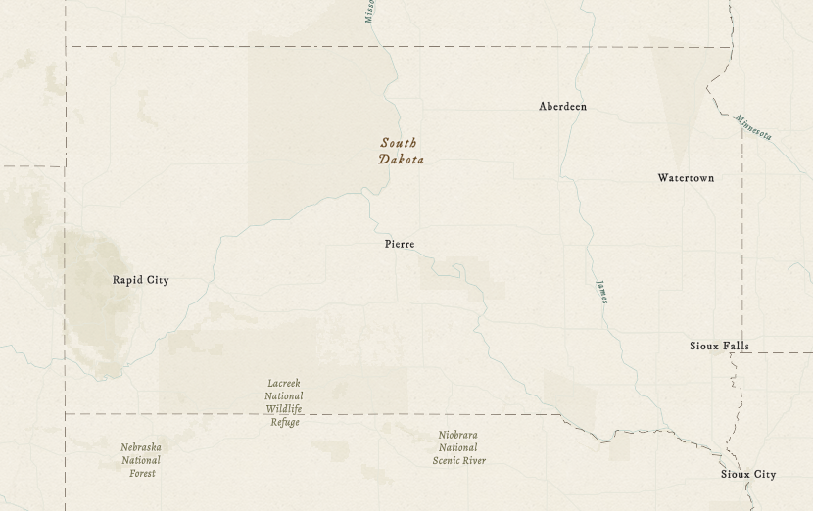



Who am i?
My name is Tirzah (pronounced Tier-za), and I’m the Director of Student Financial Aid at Black Hills State University in Spearfish, SD.
Grew up in Lily, SD, a small town between Watertown and Aberdeen
First-gen college student
Pell and FWS recipient
Used dial-up to complete my first FAFSA
Mom of three boys (so far)
Spearfish
Notes:
Tracey & Tirzah

Slide 3
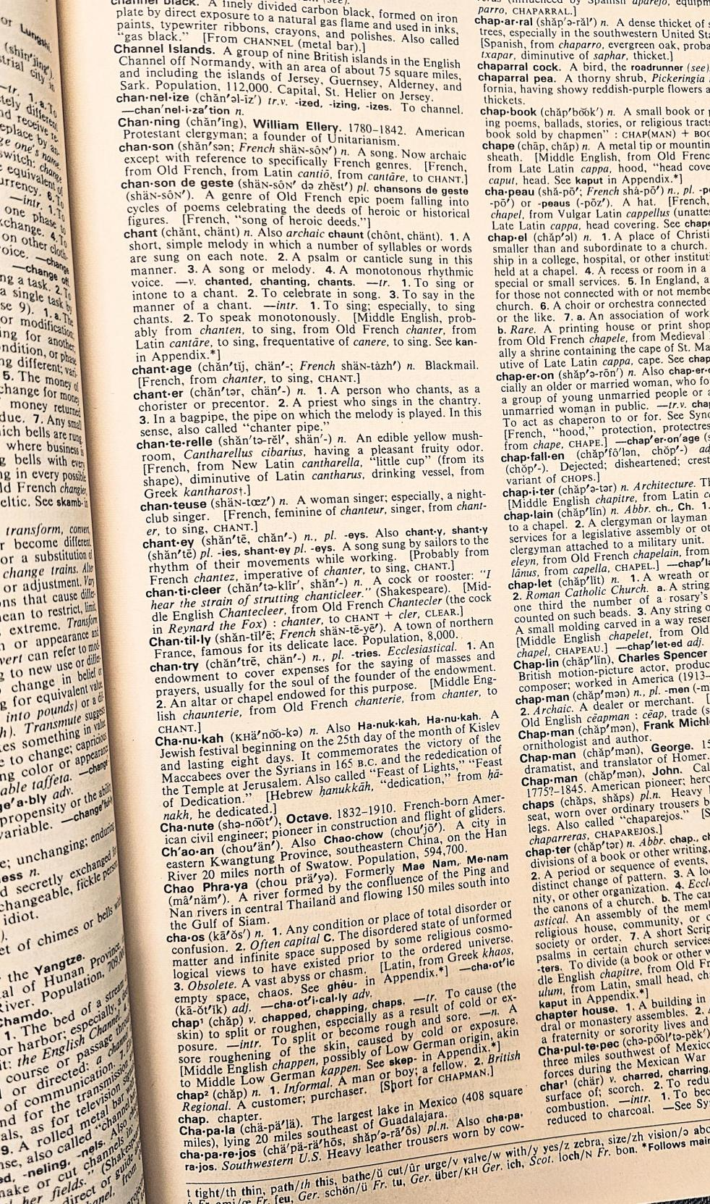
Key definitions
Controlled Unclassified Information/ Specified Tax
contributor
Federal tax information
A contributor on the FAFSA form is anyone who is required to provide information, consent, and approval on the form. This includes: the student, the student's spouse, a biological or adoptive parent, and the parent's spouse (stepparent).
FTI is any return or return information received from the IRS or any secondary source which is protected by the confidentiality provisions of Internal Revenue Code section 6103.
(CUI//SP-TAX): the U.S. National Archives and Records Administration (NARA) classification for federal tax information (FTI) related to returns and return information submitted, gathered, or generated by taxpayers.
Notes:
Tirzah

Slide 4
Question:
How comfortable are you with FTI: what it is?
Who can have access? how to safeguard it?
Notes:
Tracey

Slide 5
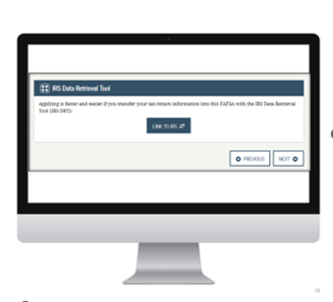

history
IRS Data Retrieval Tool (DRT)
Future Act Direct Data Exchange (FA-DDX)
Started in 2009-2010
Applicants & families could transfer their FTI from the IRS to complete their FAFSA form
Not subject to Internal Revenue Code (IRC) confidentiality requirements
​
Available starting with the 2024-2025 award year
FTI sent directly from the IRS to the Department
FTI categorized as Controlled Unclassified Information/Specified in Tax (CUI//SP-TAX)
Notes:
Tracey

Slide 6
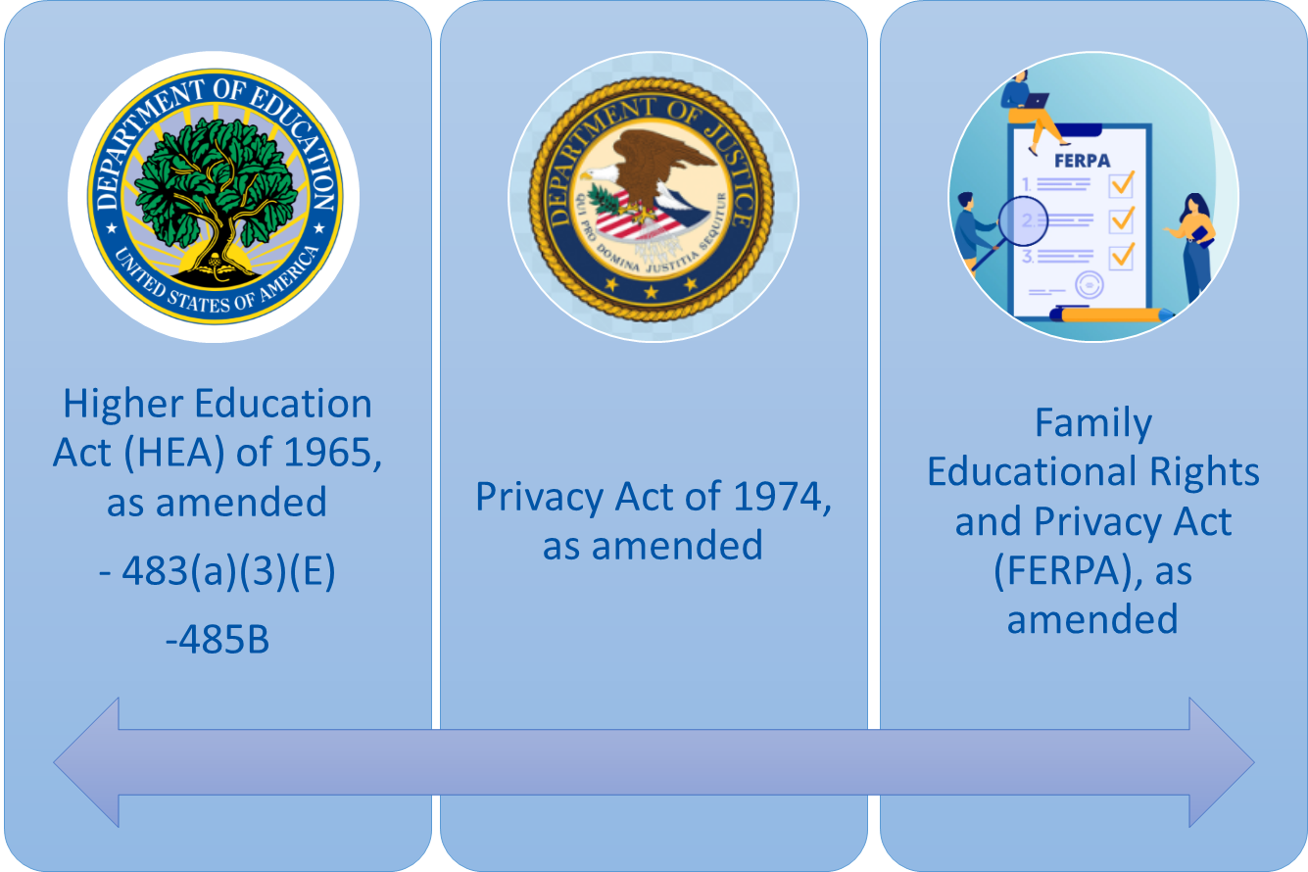
federal Laws: 23-24 & Preceding FAFSA Cycles
Notes:
Tracey

Slide 7
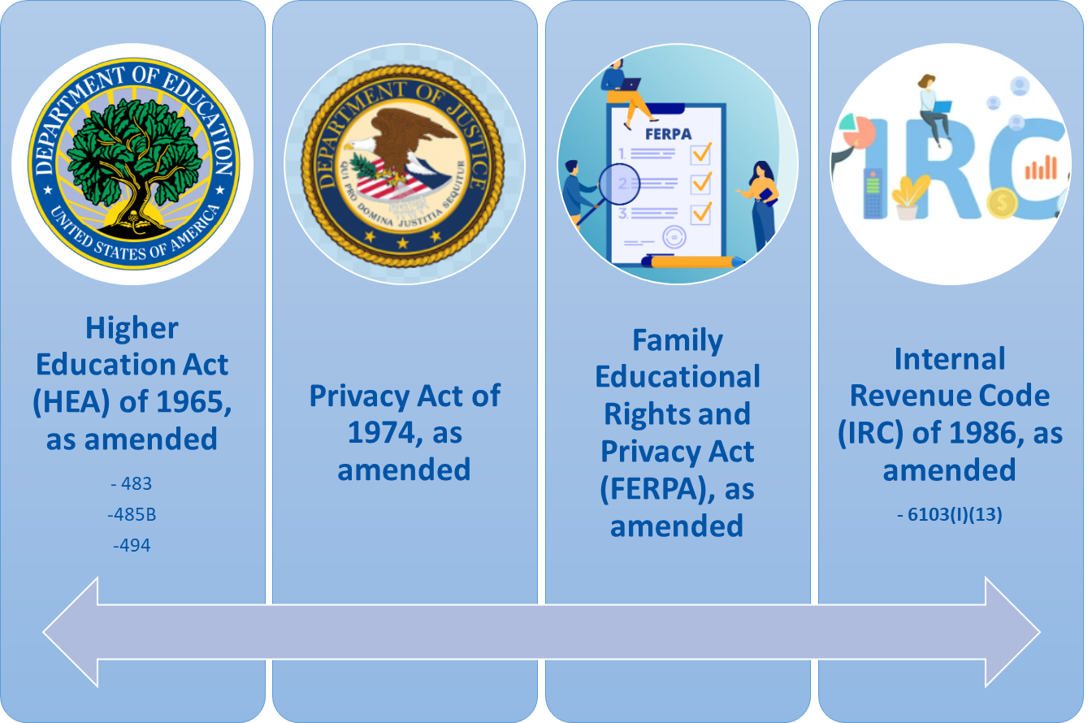
Federal Laws: 24-25 & Succeeding FAFSA Cycles
Notes:
Tracey

Slide 8
Question: how many of you have gotten pushback from campus partners who were used to getting financial aid information that is no longer available to them?
For example: Trio
Notes:
Tracey

Slide 9

What is included in fafsa data?
FAFSA Data Includes:
Applicant & contributor information provided on the FAFSA
Manually Entered/Provided Income & Asset Information*
Derived FAFSA Data Includes:
Student Aid Index (SAI)
Federal Pell Grant Eligibility (Yes/No)
What is Non-FAFSA Data?
Other non-FAFSA Data Includes:
Pell Grant Received/ Amount ($)
Unmet Need
Loan Disbursement Records
Student Admission Records (e.g., admission application)
Other financial aid data and information
FERPA and other HEA restrictions
may still apply to these items.
Notes:
Tirzah

Slide 10

What is included in FTI?
FTI for each tax filer includes the following:
Tax year;
Tax filing status;
Adjust Gross Income (AGI);
Number of dependents;
Income earned from work;
Taxes paid;
Educational tax credits;
Untaxed individual retirement arrangement/account (IRA) distributions;
IRA deductions and payments;
Untaxed pension amounts
Tax-exempt interest;
Schedule C net profit/loss;
Indicators for Schedules A, B, D, E, F, and H; and
IRS response code.
The IRS response code will indicate the status of the tax filer/FTI with the IRS, to include one of the following:
Tax filer and FTI provided to FTIM;
Not found at the IRS;
Found and a nonfiler; or
Found but IRS not able to provide information.
February 11, 2025, Blue Note Update –
New Items Designated as FTI:
Total Parent Allowances Against Income;
Parent Payroll Tax Allowance;
Parent Income Protection Allowance (IPA);
Parent Employment Expense Allowance (PEEA);
Parent Available Income (PAI);
Parent Adjusted Available Income (PAAI);
Parent Contribution (PC);
Student Payroll Tax Allowance;
Student Income Protection Allowance (IPA);
Student Allowance for Parents’ Negative Adjusted Available Income;
Student Employment Expense Allowance (SEEA);
Total Student Allowances Against Income;
Student Available Income (StAI);
Student Contribution from Income (SCI);
Student Adjusted Available Income (SAAI);
Total Student Contribution from SAAI;
Student total income;
Parent total income; and
FISAP total income.
Notes:
Tirzah

Slide 11
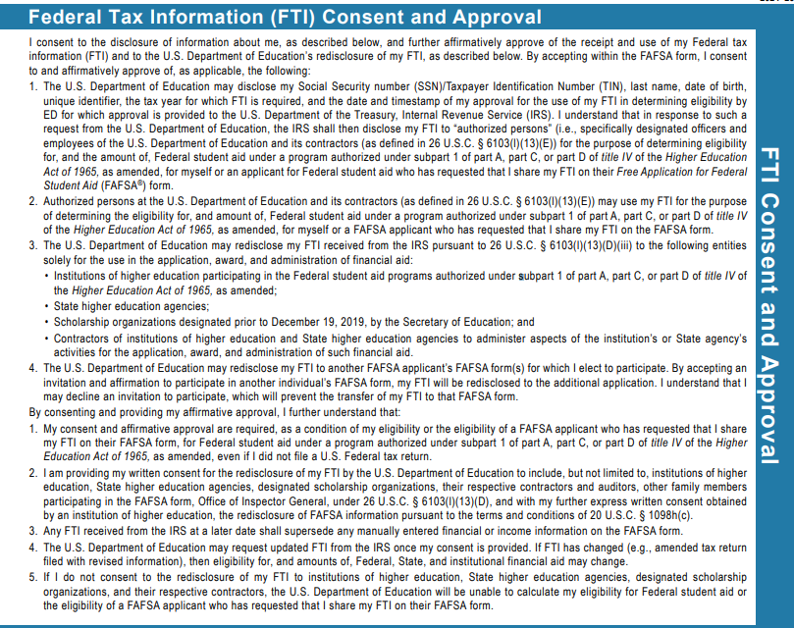
How do we get fti?
Internal revenue code 6103(I)(13)
Amended – allows for the use of FTI for Federal Student Financial Aid
Contributor(s) Consent
Contributor(s) consent to the disclosure of information and approve the receipt and use of FTI
Software system
FTI loads into our software systems and is accessible to financial aid staff. FTI does not show at FAFSA Partner Portal.
Notes:
Tracey

Slide 12

label your CUI
FTI is categorized as CUI//SP-TAX and may contain sensitive PII. Accordingly, all FTI must be handled—at minimum—in accordance with the confidentiality protections of Section 6103(l)(13) of the IRC and in accordance with all applicable privacy laws, regulations, and policies.
The U.S. National Archives and Records Administration has established a CUI Registry that serves as the authoritative reference for all CUI category markings. FTI is a category of CUI and is required to have a banner marking the information as CUI. A federal aid applicant’s ISIR will include two (2) FTI label fields:
FTI Label Start at the beginning: ‘CUI//SP-TAX’
FTI Label End near the end: ‘CUI//SP-TAX’
Notes:
Tirzah

Slide 13
what else should we know what data sharing?!
FTI-SAIG Mailbox
Access to FTI and FAFSA Data
Written Consent
The updated SAIG enrollment agreement was published on the SAIG Enrollment website on Oct. 23, 2023.
To receive ISIR data in a new FTI-SAIG mailbox, the eligible organization must first sign and submit the updated SAIG enrollment agreement.
Personnel authorized to access FAFSA data can be in a variety of offices across the state grant agency or institution, so long as their duties are related to the application, award, or administration of aid.
The term "written consent" means a separate, written document that is signed and dated (which may include by electronic format) by an applicant, which - indicates that the information being disclosed includes return information disclosed under section 6103(l)(13) of title 26 with respect to the applicant; states the purpose for which the information is being disclosed; and states that the information may only be used for the specific purpose and no other purposes.
Notes:
Tirzah

Slide 14

Restrictions on the use of FTI
Under amendments made by the FUTURE Act an applicant must provide written consent before an institution may redisclose an unredacted SAR.
•Includes scholarship organizations – Tribal organizations
•An organization assisting the applicant in applying for and receiving Federal, state, or local assistance.
Requesting FTI – HEA 20 USC 1098h
Redisclosure of information
  Student requests an unredacted copy.
  Written consent by the applicant to an institution of higher education.
Discussion of information
  Upon student written request.
Restriction on disclosing information
  FTI may not be redisclosed or used for any other purpose, such as for research to promote your college.
Notes:
Tracey

Slide 15
Scenarios
Can FAFSA Data (including FTI ) be redisclosed to the Student?
Can FAFSA Data (including FTI) be redisclosed to a student-chosen scholarship organization?
CAN FAFSA Data (including FTI) be used for research?
Yes. All the information in the student’s complete, unredacted FAFSA Submission Summer (FSS), including any return information, may be redisclosed to the student.
Yes. The information in a complete, unredacted FSS, including any return information, may be redisclosed to a scholarship organization of the student’s choosing with the student’s express written consent.
Institutions and state higher education agencies may use FAFSA data, excluding FTI information, for research that does not release individually identifiable information (PII) on any applicant for purposes of promoting college attendance, persistence, and completion.
Notes:
Tracey & Tirzah

Slide 16
Scenarios
A parent calls in and wants a copy of the student’s ISIR. There is a FERPA release for financial aid information on file. Can you send the parent the information?
A student is apply-ing for the TRIO program and doesn’t have the tax documents for the application. The student has submitted written consent to release their FTI to the TRIO coordinator. Can you send the TRIO coordinator the information?
A student has provided written consent and requested a copy of their ISIR. Can you send a password protected email to the student?
No. You do not have the applicant’s written consent to disclose this information.
No. The information is being used for application to the program and not administering a financial aid program.
It depends on your institution’s policy.
Notes:
Tracey & Tirzah

Slide 17

Have you implemented any processes/procedures in your office to safeguard your FTI?

Slide 18

May 12, 2023, Electronic Announcement:
Access and Use of Federal Tax Information (FTI) for Federal Student Aid Programs Beginning with the 2024-25 FAFSA Processing Cycle
March 2023, An Eligible Student Guide to the Family Educational Rights and Privacy Act (FERPA)
2024-25 FAFSA Specifications Guide, Volume 4 – Record Layouts and Processing Codes in PDF Format
IRS Publication 1075 – Tax Information Security Guidelines
NIST Special Publication 800-171 – Protecting Controlled Unclassified Information in Nonfederal Systems and Organizations
FTI Labeling: https://fsapartners.ed.gov/knowledge-center/library/electronic-announcements/2023-05-12/access-and-use-federal-tax-information-fti-federal-student-aid-programs-beginning-2024-25-fafsa-processing-cycle-updated-april-18-2024

Slide 19

Any questions or discussion?

