Slide 1
Diversity
Generational Differences
in the Workplace
How to get 4-5 generations to work together

Slide 2
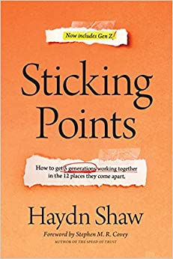


Slide 3
“The general comparisons that we’ll talk about today describe large numbers of people but fail to predict or explain any one individual.”
    Haydn Shaw, Sticky Points

Slide 4
Four options for dealing with five generations
“We can only lead people if we quit trying to change them, and we can’t quit trying to change them until we appreciate them, and we can’t appreciate them until we understand them.”
    Haydn Shaw, Sticky Points
Ignore them
Fix them
Cut a deal with them
Lead them

Slide 5
Cusper – a person born near the end of one generation and the beginning of another; they tend to have a mix of characteristics common to both adjacent generations. Also referred to as a microgeneration.
Traditionalists
1929 to 1945
Boomers
1946 to 1964
GenXers
1965 to 1980
Millennial
1981 to 1996
GenZs
1997 to 2012
Cuspers
1944 to 1949
Cuspers
1963 to 1968
Cuspers
1979 to 1984
Cuspers
1994 to 2000
76 million
80+ million
Early – teens of the 1960s
Late – teens of the 1970s
Early – teens of the 1990s
Late – teens of the 2000s

Slide 6
 | Traditionalists | Boomers | GenXers | Millennials | GenZs
Birth Years | 1929 to 1945 | 1946 to 1964 | 1965 to 1980 | 1981 to 1996 | 1997 to 2012
Characteristics | Frugal, resourceful, conservative | Questioned everything, pushed against the establishment | Jaded, suspicious, feel ignored | Healthy self-esteem, focus on status | Cautious, highly educated, heightened anxiety
Motivation | Stability | Recognition | Flexibility | Work family/tribe | Meaningful causes
Technology | Hope to outlive it | Want to master it | Choose to leverage it | Just enjoy it | Plan on hacking it
Pandemic’s effect | We’ve seen tough times before | My retirement is disappearing | See, I told you life was hard | What will this do to my dreams? | I feel postponed and penalized
Sense of identity | I am humble | I am valuable | I am self-sufficient | I am awesome | I am fluid
Attitude towards authority | Respect authority | Take over and get authority | Ignore and endure authority | Choose your authority | Not sure we need authority
View of the future | Seek to stabilize it | Create it | Skeptical of it | YOLO (you only live once) | FOMO (fear of missing out)
Life events | WWI (1914-18) Prohibition (1920-23) First talking movie Sliced bread introduced The Great Depression (1929-39) The New Deal (1933-39) Move from the farm to the suburbs WWII 1939-45) Atomic bomb (1945) | Surge of births after WWII Kennedy years (“Camelot”) Successful space program Civil rights movement Vietnam conflict Woodstock Watergate Arab oil embargo | Birth control pill readily available Double-digit inflation Iranian hostage crisis Sony Walkman AIDS MTV Household borrowing grows 2x as fast as income Challenger shuttle explodes Berlin Wall torn down Persian Gulf War | OK City bombing Columbine HS shooting Clinton and Lewinsky Y2K September 11, 2001 Dept of Homeland Security is formed Same-sex marriage legalized in MA (2004) Dow Jones hits record high (2007) Great Recession begins (2007-09) First black President (2009) Occupy Wall Street (2011) | War on Terror conflict in Afghanistan Netflix Facebook The Great Recession (2007-2009) Black Lives Matter #MeToo Mass shootings increase Same-sex marriage legalized nationwide (2015) COVID-19 pandemic

Slide 7
Parenting influences
Traditionalist
Boomers
Boomers
GenXers
and
Early Millennials
GenXers
Late Millennials
and
GenZs
Millennials
Gen Alpha
Raised similarly
Female Boomers chose careers
GenX: Latch-key children
Millennials: more open dialogue with them
Over-compensated for latch-key effect
Safety became focus
Prepared them to be cautious
Stay tuned!

Slide 8
Reasons the generation gap is widening
Rapid changes in culture
Increased life expectancy
The mobility of society
Shifting economies
New technologies and media

Slide 9
Five steps for leading through sticking points
First
ACKNOWLEDGE
Calmly TALK about the differences
Second
APPRECIATE
Focus on the “why” (not the “what”) and the common need
Third
FLEX
Agree to accommodate different approaches
Fourth
LEVERAGE
Maximize the strengths of each generation
Fifth
RESOLVE
Make a final decision or policy when flexing isn’t enough
Leveraging:
“Each generation brings different strengths to the team, and smart leaders arrange the various strengths so the whole is greater than the sum of its parts. Effective leaders combine people from multiple generations to accomplish more than if they recruited only from one.” Haydn Shaw, Sticky Points

Slide 10
12 Sticking Points for generations
Communication
Decision Making
Dress Code
Feedback
Fun at Work
Knowledge Transfer
Loyalty
Meetings
Policies
Respect
Training
Work Ethic

Slide 11
Sticking Point: Meetings
Boomers:
  Supportive of meetings – fits in the hierarchical and linear world
  Often use the “Death March” approach to meetings
GenXers and Early Millennials:
  Would prefer reports summarized and sent electronically rather than verbal
Late Millennials and GenZs:
  Struggle with linear – they prefer a more random, zig-zag approach
All Millennials:
  Would appreciate more fun in the meetings!
First
ACKNOWLEDGE
Calmly TALK about the differences

Slide 12
Sticking Point: Meetings
Boomers:
  Meetings have always been necessary (remember the pre-Internet days)
  Teams should actively bond during meetings
GenXers:
  Meetings aren’t productive – technology should be leveraged instead
  Meetings should be supplements to email/online collaboration, not replacements
Millennials:
  They like meetings….but every meeting needs to have something that’s fun and engaging
GenZs
  They might be on the fence about meetings – they like to work alone, but the pandemic has decreased their appreciation for non face-to-face exchanges
Second
APPRECIATE
Focus on the “why” (not the “what”) and the common need

Slide 13
Sticking Point: Meetings
Stop the Death March
  Scrap the verbal reports – have departments/groups provide electronic reports
Allow for a less linear approach
  Follow an agenda to stay on task, but accommodate some “popcorn” topic changes
Provide psychological safety
  There are no stupid questions
  Acknowledge that the status quo doesn’t always have to stay
  Allow for personal interactions that aren’t dependent upon technology
Third
FLEX
Agree to accommodate difference approaches

Slide 14
Sticking Point: Meetings
Traditionalists and early Boomers:
  Wisdom and sage experience
Boomers:
  Process experts; understand the value of interpersonal relationships
GenXers:
  Quick to focus; don’t waste time
Millennials:
  The fun factor, desire balance between work and enjoyment
GenZs:
  Focused on emotional well-being; also expect work-life balance
Fourth
LEVERAGE
Maximize the strengths of each generation

Slide 15
Sticking Point: Meetings
What will be the length of meetings? Must you start/end on time?
Casual chatter at the beginning or in the middle – how do you monitor?
Who is responsible for redirecting the conversation?
Are laptops, tablets, or phones permitted, or are they expected?
Are there any rules to device usage?
What will be the focus of the meeting going forward? Training? Relationship building? Communicating tons of information?
Fifth
RESOLVE
Make a final decision or policy when flexing isn’t enough

Slide 16
Sticking Point: Meetings
First
ACKNOWLEDGE
Calmly TALK about the differences
Second
APPRECIATE
Focus on the “why” (not the “what”) and the common need
Third
FLEX
Agree to accommodate different approaches
Fourth
LEVERAGE
Maximize the strengths of each generation
Fifth
RESOLVE
Make a final decision or policy when flexing isn’t enough
As your team changes (and it will), plan on revisiting a Sticking Point and these five steps annually and adjusting as necessary

Slide 17
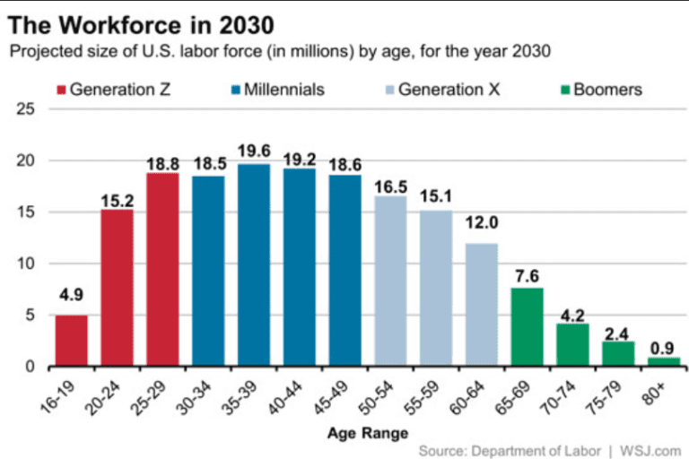
2025 – 88.6 million
2030 – 114.8 million
2025 – 74.7 million
2030 – 58.7 million

Slide 18
Questions?
Shawna Otte
University of Wyoming
307.766.3674
sotte@uwyo.edu

